Slide 1
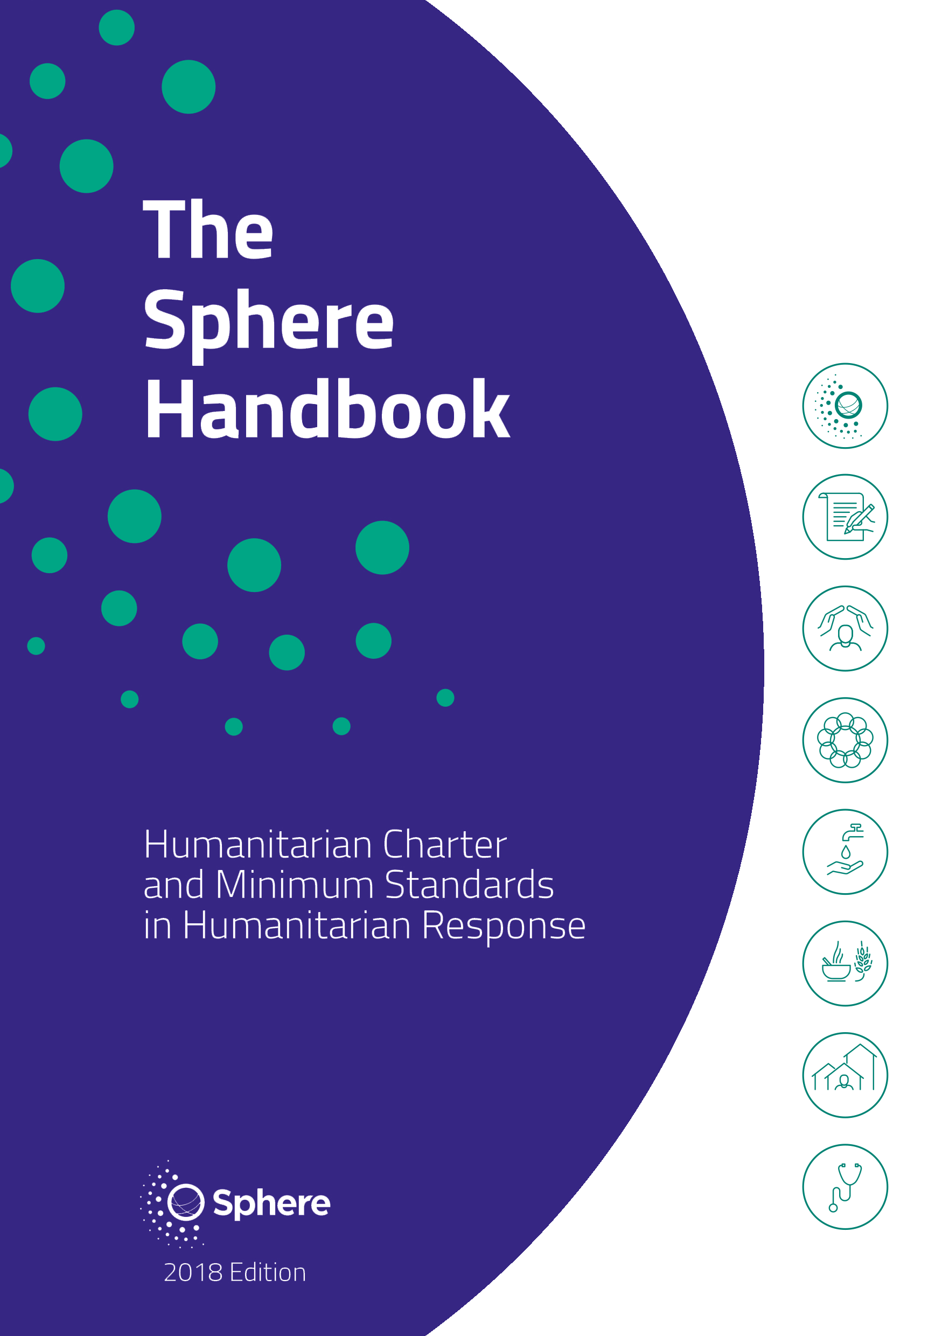
Orientation on WASH Section in Sphere Handbook 2020
THE
WASH SPHERE
Presented By
S.M.Tariquzzaman
Regional WASH Specialist
Plan international

Slide 2



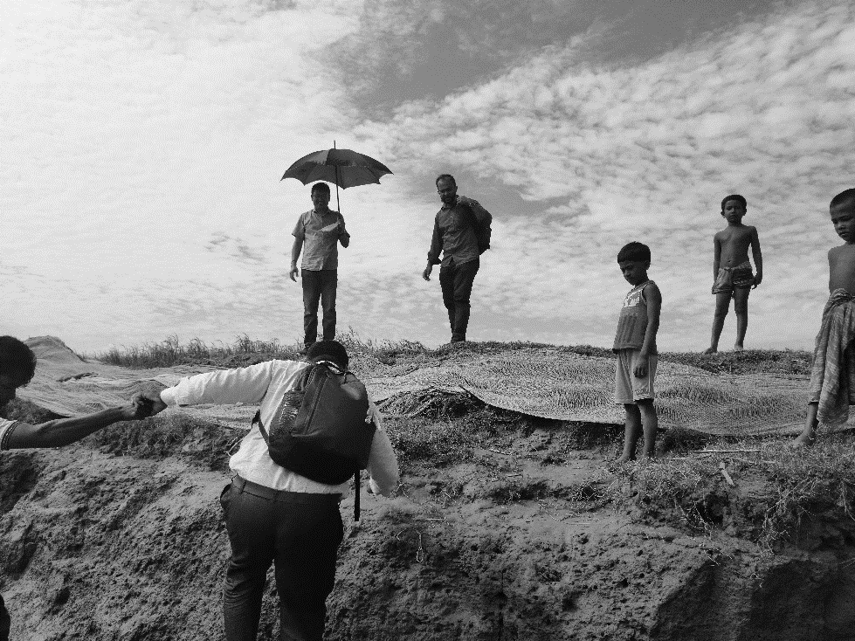

Content
Introduction
Organization of Sphere 2018
Humanitarian Charter
Protection Principle
Core Humanitarian Standard
WASH
Essential Concept of Water
Supply and Sanitation
Hygiene Promotion
Water Supply
Sanitation
FSSM
Excreta Management
Vector Control
Solid Waste Management
WASH in Disease outbreaks
And Healthcare setting
Conclusion
Summary
Questions and Answers

Slide 3
What is sphere? – the handbook
1. People affected by disaster or conflict have the right to life with dignity and, therefore, the right to assistance; and
2. All possible steps should be taken to alleviate human suffering arising out of disaster or conflict.
Why
Sphere?
Two Core Belief

Slide 4
FOUR FOUNDATION CHAPTER
01
02
03
04
What is Sphere
The Humanitarian Charter
Protection Principles
The Core Humanitarian Standard
All people affected by crisis have a right to receive protection and assistance. provides the ethical and legal backdrop to the Protection Principles, CHS & Minimum Standard
principles and rights outlined in the Humanitarian Charter into four principles that inform all humanitarian response
Outlines the Handbook structure, its use and underlying principles. More importantly, how and when to use it
Nine commitments for ensuring minimum standards

Slide 5

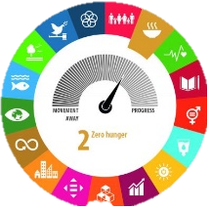


FOUR TECHNICAL CHAPTER
1
2
3
3
WASH
FOOD SECUTIY & NUTRITION
SHELTER & SHETTLEMENT
HEALTH

Slide 6
The
Ethical and legal backdrop to the Protection Principles, the Core Humanitarian Standard and the Minimum Standards that follow in the Handbook
Humanitarian
Charter

Slide 7
1. All people have right to receive protection and assistance based on
Humanity- Born to be free
Humanitarian Imperative- Actions to be taken to prevent/ alleviate sufferings
OUR BELIEF
1
2. We believe community action but supporting from our side
3. Provide assistance & support to responsible agencies and reflect real scenario
OUR ROLES
2
HUMANITARIAN CHARTER
COMMON PRINCIPLES, RIGHTS AND DUTIES
4. In principle we belief those rights
5. Right to life with dignity
6. Right to receive humanitarian assistance
7. Right to protection and Security
3
8. Affected population are center of Hum. action
9 Colla. to reduce unintentional ad. impact
10. Follow HC, RCRCM & NGOs in DR
11. Complying Core, Hum. Standard & Min. standard
12. Make response more effective, appropriate, & accountable
OUR COMMITMENTS
4

Slide 8
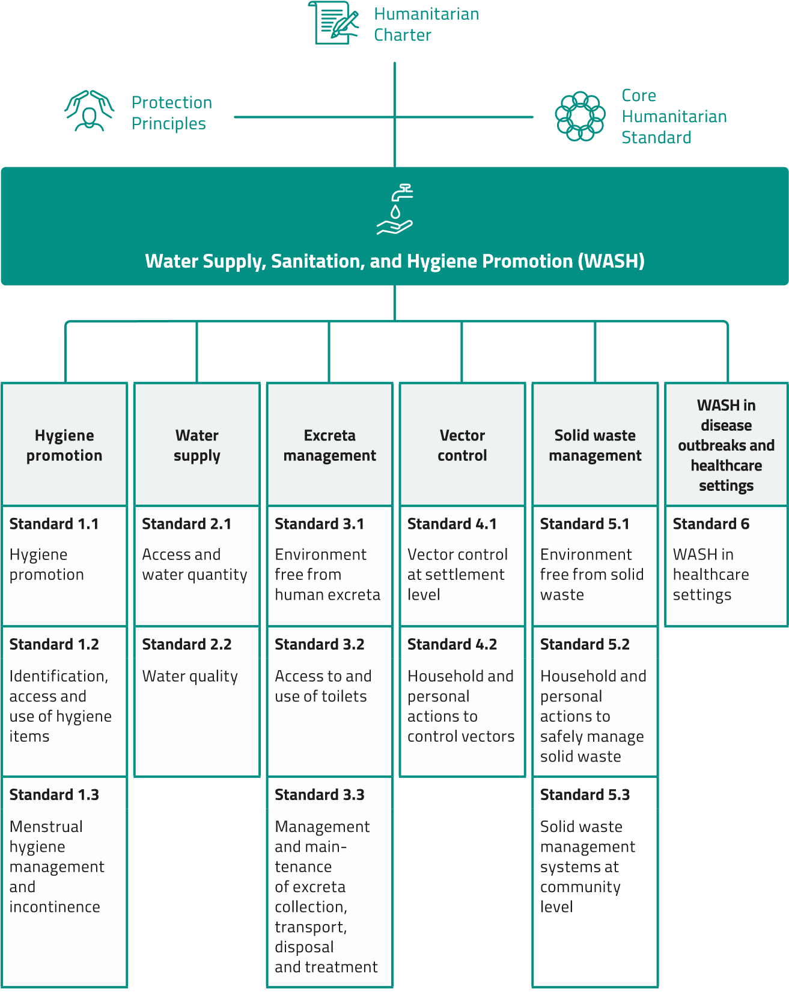
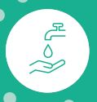
Water
Sanitation
Hygiene

Slide 9





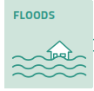

The six categories of standards can be linked to establishing barriers along the five pathways
Solid waste management
WASH in disease outbreaks and healthcare settings
Hygiene promotion
Water supply
Excreta management
Vector control

Slide 10
3 Essential WASH Concept
Such diseases are strongly related to inadequate sanitation and water supplies, and poor hygiene.
People affected by crises are more susceptible to illness and death from disease, particularly diarrhoeal and infectious diseases.
WASH programmes aim to
reduce public health risks.

Slide 11




01
PROMOTE:
good Hygiene Practice
Key WASH Activities
02
PROVIDE:
Safe drinking water & adequate sanitation facilities
03
REDUCE:
Environmental Health Risk
04
ENSURE:
conditions that allow people to live with good health, dignity, comfort, and safety.

Slide 12
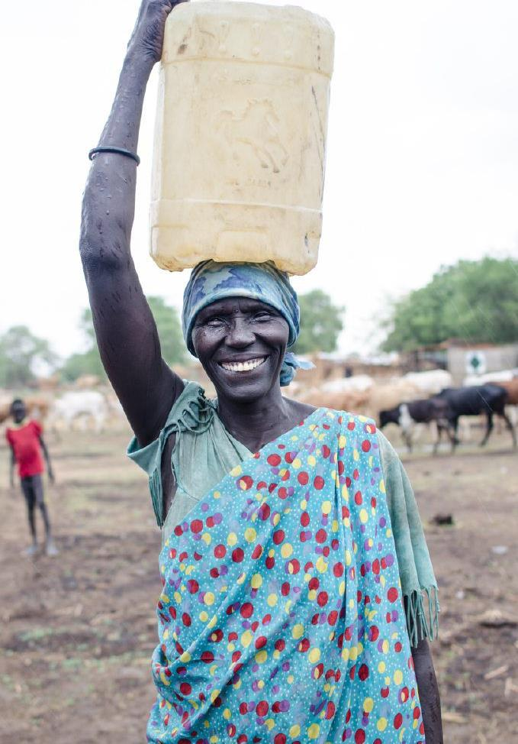
In WASH programmes
It is important to manage the entire water chain:
water sourcing;
treatment;
distribution;
collection;
household storage; and
consumption.
IFRC/Corrie Butler
Notes:
The importance of managing the water chain is highlighted since contamination of water can happen at any point between sourcing and consumption. Failure to plan and monitor activities at each link may result in failure of the entire system.

Slide 13
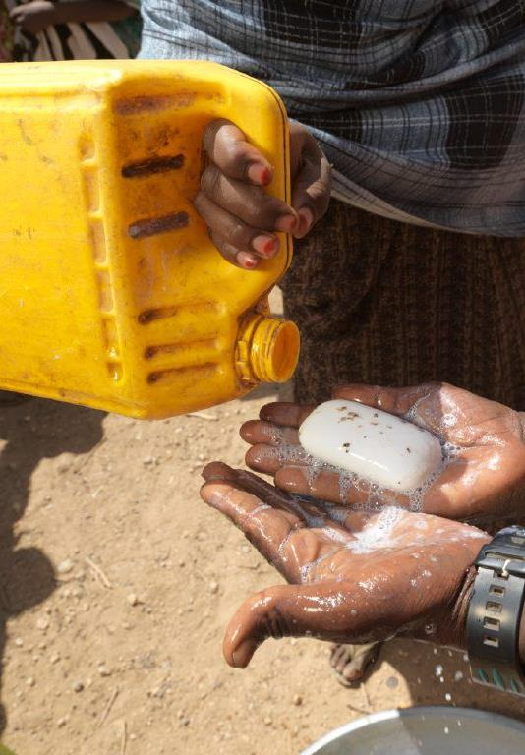
In WASH programmes
It is important to:
manage the entire sanitation chain in an integrated manner;
enable positive healthy behaviours; and
ensure access to hygiene items.
Australian Red Cross
Notes:
This notes the importance of hygiene promotion and the need for soap as a distribution (or otherwise made available) item.
NOTE: The sanitation chain is the process through which waste water, excreta and greywater moves from contamination to its end points of reuse or disposal. Managing the chain will protect people from exposure to disease-causing excreta and other such risks. The chain moves from containment through emptying, transport, and treatment, ending in reuse or disposal. Some entities will refer to the elements of waste water and excreta separately using the excreta flow diagram with reference to the latter. For more information, refer participants to the WHO Sanitation Safety Planning (SSP) manual.

Slide 14
Right to Water & Sanitation
01
Everyone has right to access water sanitation with dignity, right to protection, security and right to get assistance
People are prone to Illness and Death
02
People affected by disaster are more susceptible to illness and death from disease
Community Engagement
03
Community engagement is crucial
Urban areas
04
Particular consideration to urban areas is required.
Combination of Approaches
05
Combined approaches for immediate and long term support
Minimum Standard
06
Minimum standard should not meet in isolation, and linkage is required

Slide 15
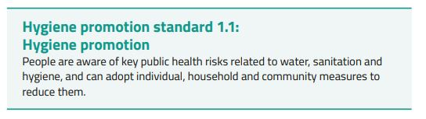
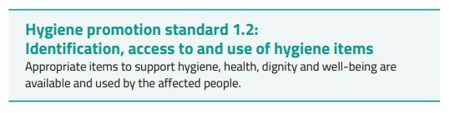
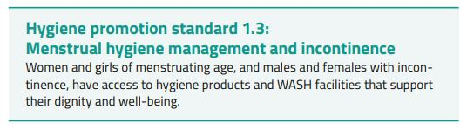
Hygiene Promotion

Slide 16
Minimum Hygiene Standard
two water containers per household (10–20 litres; one for collection, one
for storage)
250 grams of soap for bathing per person per month (+250 gm extra for MHM)
200 grams of soap for laundry per person per month
Soap and water at a handwashing station (one station per shared toilet or
one per household)
Potty, scoop or nappies to dispose of children’s faeces
a dedicated container with lid for soaking cloths and storing pads/cloths
rope and pegs for drying+ underwear (six per year)
either absorbent cotton material (4 square meters per year), disposable pads (15 per month) or reusable sanitary pads (six per year), as preferred by women and girls

Slide 17
Minimum Hygiene Standard for Incontinence
extra soap (500 grams bathing and 500 grams laundry per month)
underwear (12 per year)
two washable leak-proof mattress protectors
additional water containers
bleach or similar disinfectant cleaning product (3 litres of non-diluted
product per year)
bed pan and urinal bottles (male and female),
toilet commode chair (as
appropriate)
either absorbent soft cotton material (8 square meters per year), disposable incontinence pads (150 per month) or reusable incontinence underwear (12 per year)

Slide 18
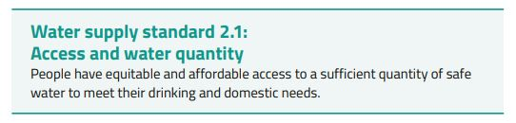
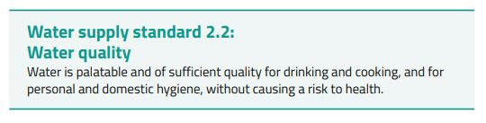
Water
Supply

Slide 19
Minimum Water Standard
(Access)
Minimum of 15 litres per person per day
250 people per tap (based on a flow rate of 7.5 litres/minute)
500 people per hand pump (based on a flow rate of 17 litres/minute)
400 people per open hand well (based on a flow rate of 12.5 litres/minute)
100 people per laundry facility
50 people per bathing facility
Target 5 percent or less HH Income for buying Water
<500 metres from HH to water source
<30 minutes queuing time

Slide 20
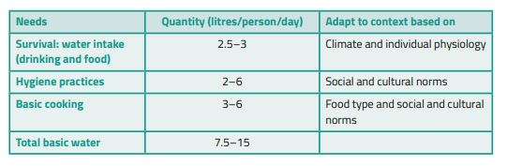
8 hours a day of constant water supply
Water
Supply
8 hours a day of constant water supply
Context specific minimum water supply
HH water treatment
Short term use of bottled water
Notes:
A minimum of 15 litres per person per day is established practice. It is never a “maximum” and may not suit all contexts or phases of a response. For example, it is not appropriate where people may be displaced for many years. In the acute phase of a drought, 7.5 litres per person per day may be appropriate for a short time. In an urban middle-income context, 50 litres per person per day may be the minimum acceptable amount to maintain health and dignity

Slide 21
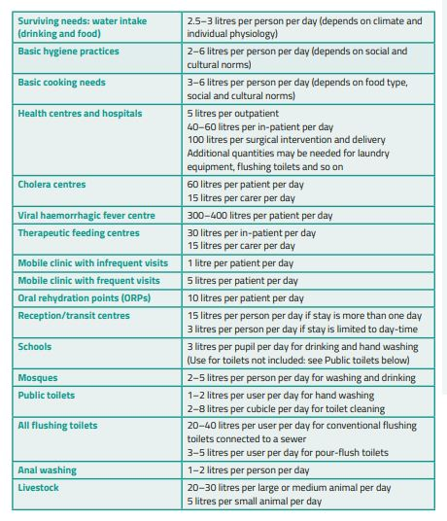
8 hours a day of constant water supply
Water
Supply
Notes:
A minimum of 15 litres per person per day is established practice. It is never a “maximum” and may not suit all contexts or phases of a response. For example, it is not appropriate where people may be displaced for many years. In the acute phase of a drought, 7.5 litres per person per day may be appropriate for a short time. In an urban middle-income context, 50 litres per person per day may be the minimum acceptable amount to maintain health and dignity

Slide 22
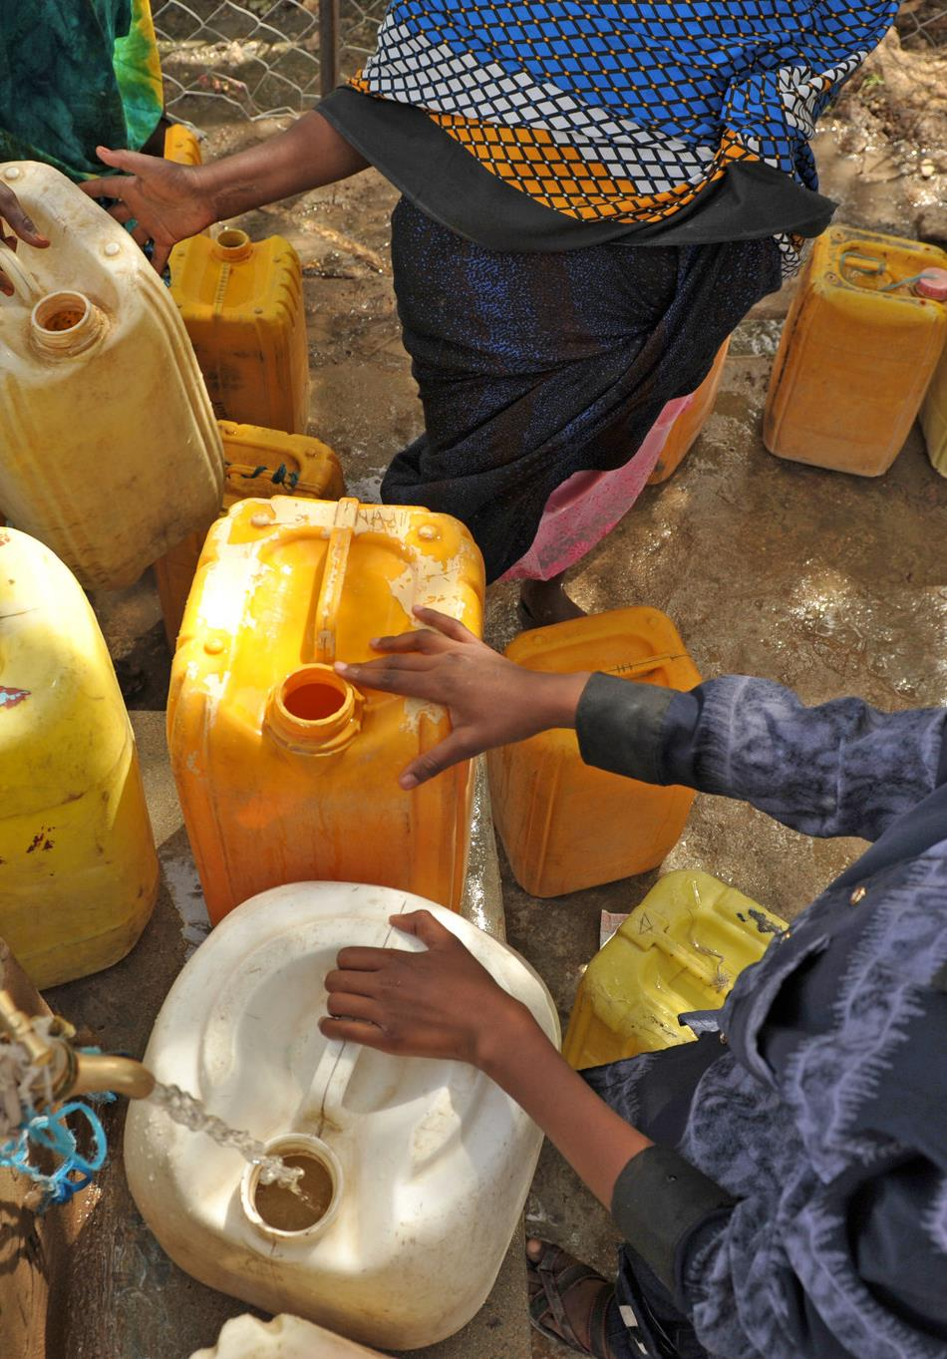
Key indicators of standard 2.1
(continued)
Distance from any household to the nearest waterpoint: 500 metres
Queuing time at water sources: <30 minutes
Maximum of 250 people per tap (based on a flow rate of 7.5 litres/minute)
Lutheran World Federation/C Kästner
Photo: LWF/ C. Kästner
Notes:
Review the key figures on the slide.
Tactile/visualisation exercise continued: This is a great opportunity to get your participants moving, and energised, while allowing them the opportunity to gain a tactile understanding of some of the Sphere WASH indicators.
Pre-fill at least one jerry can that holds 15 litres of water and pre-measure a distance of 25 metres in any nearby location (in the training room, corridor, or nearby outdoor area). Ask for volunteers (at least one man and one woman) to carry the jerry can(s) 25 metres, turn around and come back (i.e. 50 metres in total).
Ask volunteers if that was easy. Then, ask if they could easily do it another nine times? Explain that after walking that distance 10 times, they will still only have enough water for one family member for the day. Ask participants to raise their hands if any of them are from a family of one. Then ask who typically carries water in a refugee camp or other such setting (women and children). Have a couple more volunteers repeat the exercise. Resume the presentation within 10 minutes.
NOTE: A more advanced form of this exercise also incorporates flow rates and queueing. If a tap is available, create a course in which participants carry empty jerry cans 50 metres, fill them from the tap, then return with them filled. Start several participants at the same time, or in reasonably quick succession. Other participants could measure the flow rate and assess queuing times.

Slide 23
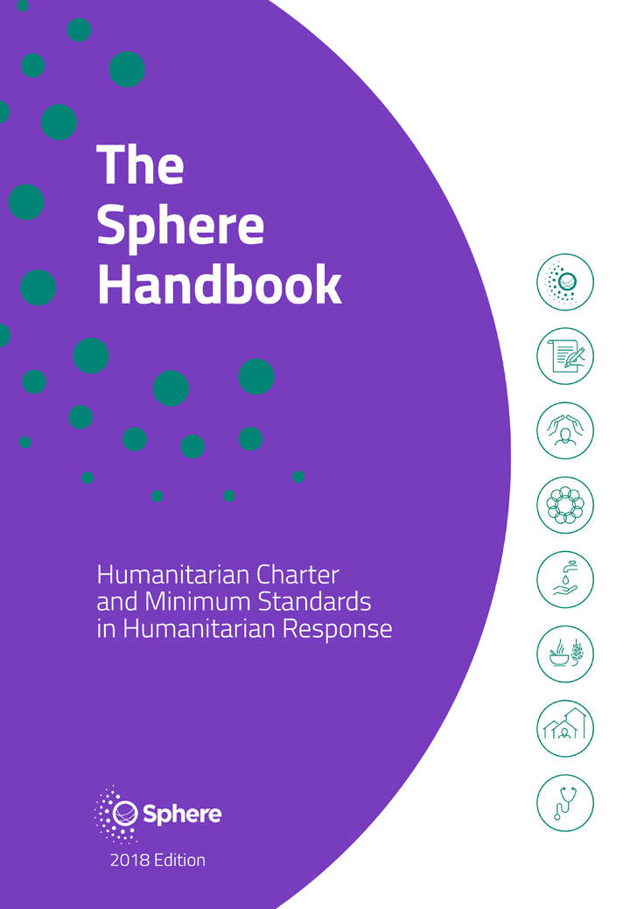
Key indicators of standard 2.2: water quality
Percentage of water quality tests meeting minimum water quality standards
<10 colony forming units (CFUs)/100ml at point of delivery (unchlorinated water)
≥0.2-0.5mg/l free residual chlorine (FRC) at point of delivery of delivery (chlorinated water)
Turbidity of less than 5 nephelometric turbidity units (NTU)
See page 110
Notes:
If you have water testing tools, here is a great opportunity to show participants what they are and how they can be used. Two very simple ways to illustrate turbidity are:
Fill a large barrel, bucket, or basin with murky water. If you have a turbidity stick (a 90 cm long stick with a black and white patterned disk on one end), lower it into the water and show the participants how the visibility of the stick differs with depth. NTU of 5 will be when the disk can no longer be seen through about 85cm of water (roughly the length from shoulder to fingertips).
Alternatively, fill three clear plastic water bottles (with the labels removed) with equal amounts of water and a small amount of soil the night before the presentation. Shake them up for the same amount of time and place them in the training room. Before the session, shake two of the bottles. When you are done reading the content of this slide shake one of the two bottles. This should allow for a clear distinction in the turbidity of all three bottles. Explain that water storage can be a contributing factor in the water purification process as allowing water to settle can decrease its turbidity (allowing it to be separated from the sediment within the container before the purification process). Water clarity does not indicate safety (or vice versa as coffee is safe to drink), but it does indicate if the water is clear enough to further treat with chlorine.

Slide 24
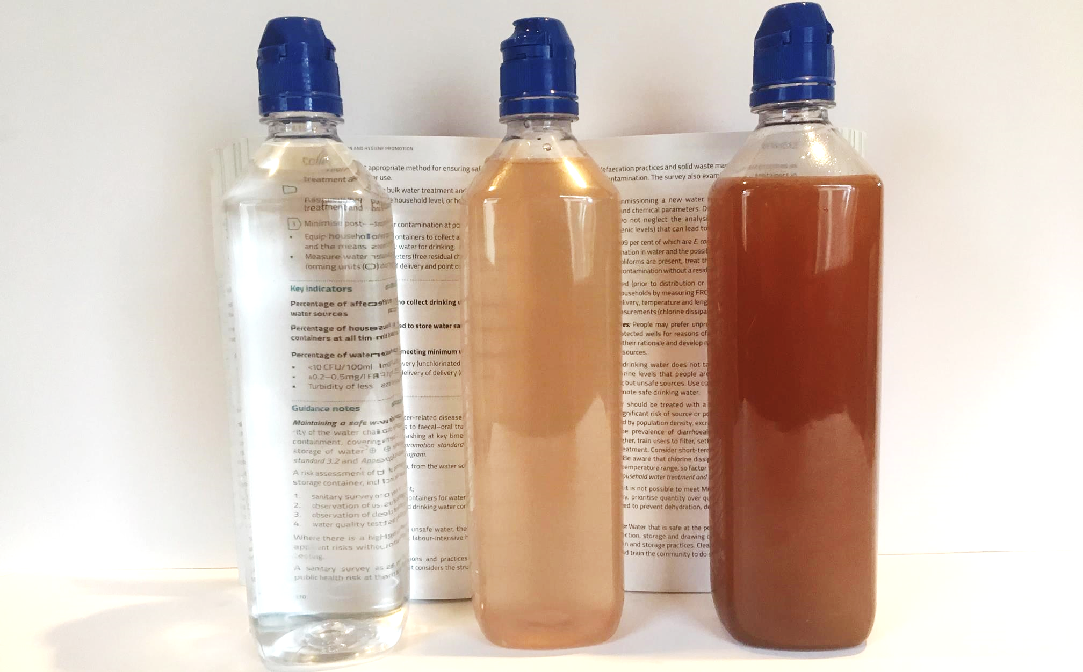
What does <5 NTU mean?
InterWorks photo
<5 NTU
>100 NTU
>5 NTU
This is a measure of water clarity, to determine if water is
clear enough to chlorinate efficiently.
24
Notes:
If you do not have access to materials described in the previous slide, use this image to explain what turbidity means, and to show a rough idea of how clear the water needs to be to allow effective chlorination. Note that in the middle bottle, the text can still be made out through the cloudy water. In simplest terms, 5 NTU means that the water is pretty clear.

Slide 25
<10 CFU/100ml at point of delivery (unchlorinated water
COLIFOM
1
Minimum Water Standard (Quality
≥0.2–0.5mg/l FRC at point of delivery of delivery (chlorinated water)
FRC
2
TURBIDITY
3
Turbidity of less than 5 NTU

Slide 26

Water math
Visualising water quantities
1 metre
1 m³ of water = 1 metric ton
1 cubic meter = 1 metric ton
1 m³ of water = 1,000 kg
1 metre
1 m³ of water = 1,000 litres
1 metre
1 litre of water = 1 kg
10 cm
10 cm
1 litre
Notes:
This slide illustrates the way water is represented in assessments, reports and evaluations. Understanding this basic definitional and mathematical foundation will make it possible for users to properly apply the Sphere indicators and better understand discussions of various water programming issues.
Tactile/visualisation exercise: As a physical demonstration, provide a 1 litre bottle, and 10, 15 and 20 litre jerry cans filled with water. These will help participants visualise the volumes and feel the weight of water. Ask them to identify the volumes in each and pass them around.

Slide 27
Let’s do a quick evaluation mission
We’ll travel to Uganda to evaluate a WASH programme being run by Oxfam. Watch the video that follows and answer these evaluation questions.
From the information provided by the engineer:
Is water quantity sufficient?
Is water quality sufficient?
Who else would you like to talk to, and what would you ask?
Notes:
Explain that the group will do a quick evaluation mission to Uganda, using some of the information just covered in this session, as well as other standards, actions, indicators, and guidance not explicitly presented. Ask participants to make a quick note of the three questions before going on the mission (viewing the video that follows on the next slide).

Slide 28

Let’s design an evaluation
Notes:
Show the video, which includes a lot of positivity about the WASH programme being implemented.
Ask participants – working individually – to watch it with a critical eye, and to note any specific information provided.
On YouTube: https://www.youtube.com/watch?v=61R2CuPr3t8
Click “cc” in the video to view subtitles.

Slide 29
Evaluation mission
From the information provided by the engineer:
Is water quantity sufficient?
Is water quality sufficient?
Who else would you like to talk to, and what would you ask?
Figures stated
98,000 refugees
105 storage tanks at 10m³ each
Water tankers provide
584,000 litres/day of treated water
Notes:
Ask participants (working together at their tables or in groups of five or six people) to answer the three questions using whatever parts of Sphere are useful.
As a tip, use the animation on this slide to reveal the numbers that were provided by the engineer.
If they are unclear about how to proceed, ask participants to review the indicators for quality and quantity, as well as to think about the potential challenges not mentioned in the video, but identifiable from what is shown (jerry cans, water pumps, length of lines at water points, general attitude of people using the facilities, etc.).
Allow about 15 minutes for the group work.
Once the time has passed, call for contributions, asking each group in turn to provide just one answer or key point. Continue until all groups have provided at least one answer. Some of the maths work and textbook answers are provided in the notes view on the next slide.

Slide 30
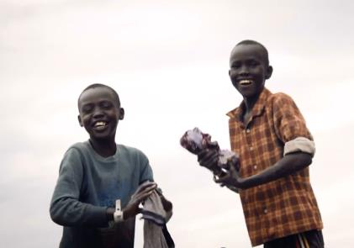
Evaluation mission
From the information provided by the engineer:
Is water quantity sufficient?
Is water quality sufficient?
Who else would you like to talk to, and what would you ask?
Notes:
Textbook answers:
The water quantity is too low based only on the information given. 98,000 refugees x 15 l/p/day = 1,470,000 litres required daily. The mount provided by the Oxfam trucks was reported to be 584,000 l/day. While this is a red flag, note that there may be other programmes also contributing water beyond Oxfam’s fleet, and refugees may have access to other water sources. Also, remind everyone that if people are satisfied and healthy, the standard is being met – even if this indicator is not. Failure to meet an indicator means we must look farther and at other aspects to determine if the standard it supports is being met or not. People who are washing clothes and looking happy are not thirsty. However, this may indicate that water is not being distributed fairly, rather than there being an excess. Unfair distribution and wastage challenge the otherwise “simple” maths formula of 15 x number of people: those that get to the tap first may use and take more than their fair share.
Water quality is addressed in principle, but not proven. The engineer refers to turbidity, bacteriological contamination (e-coli), and residual chlorine. These are all in line with the Sphere water quality indicators, but test results are not made clear. Note that if people are satisfied and healthy, this is another indicator that water quality is probably acceptable.
Who else to talk to: It would be a mistake in an evaluation of a WASH programme to only talk to the WASH programme engineer. Evaluators should talk to community leaders, facility users (women and children), as well as technicians. Evaluation should also include questions to other responders to understand the totality of the response, and how the Oxfam programme integrates with them. Other questions to ask include forward-planning questions on coming rainy seasons, the quality of roads in all seasons, sustainability of the water tinkering (purification) system, etc.
Review the CHS. All of the nine commitments should also be evaluated as they relate to the WASH response.
Note that evaluations in this sector must also investigate community involvement, feedback mechanisms, and other community participation-related aspects – not just quality and quantity.

Slide 31
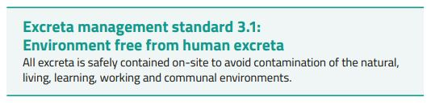
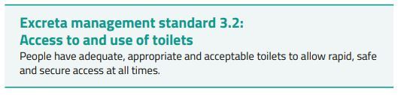

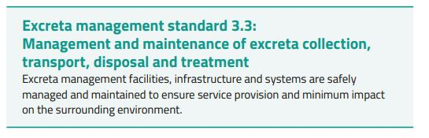
Excreta management

Slide 32
Minimum Excreta Management Standard
There should be no Human Excreta Presence in Environment
Excreta should be contained properly and sited properly
Shared Latrine: 1:20; Max. 50 m from HH
1:50 (for immediate support); 1:250 Inclusive toilet
All human excreta is disposed of in a manner safe to public health and the
environment
Containment: 1-2 L/person/day (Short term) & 40-90 L/p/Yr. (Long Term)
Use of Local materials
Resource Recovery
30 m Horizontal from GW Source ; 1.5 m Vertical (From Water Table ); Making Containment Water Tight for High GWL

Slide 33
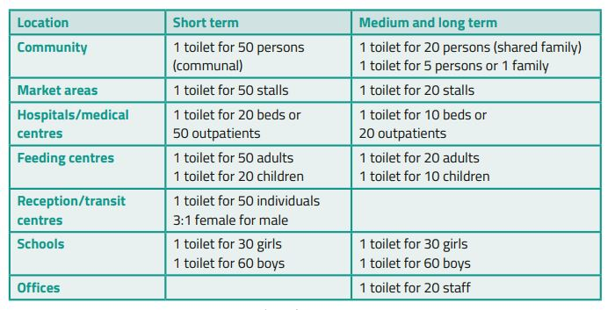
Excreta management

Slide 34
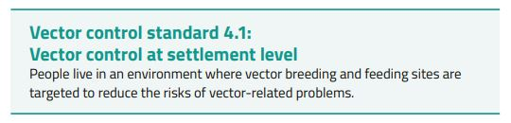
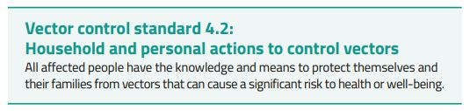
VECTOR
CONTROL

Slide 35
F Diagram
Sanitation
Safe Water Supply
Hand Hygiene
Fluids
Fingers
New
Host
Faeces
Food
Flies
Fields

Slide 36
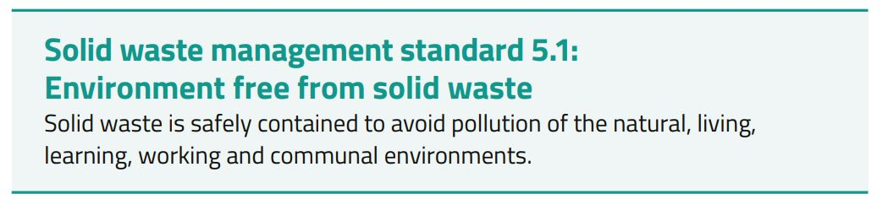
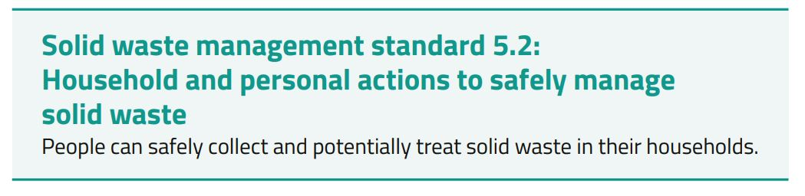

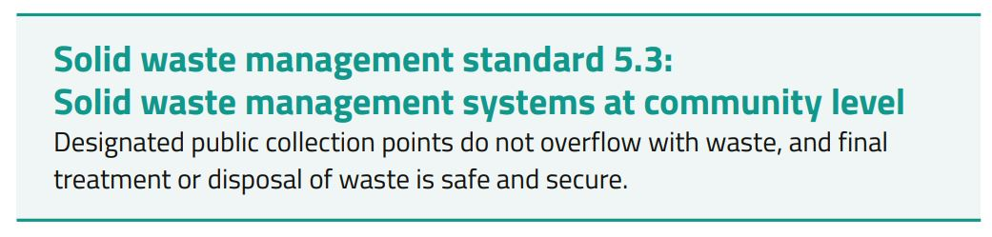
SOLID WASTE
MANAGEMENT

Slide 37
Minimum Solid Waste Management Standard
Waste disposal pits should be15 meter from HHs
100 liter container for 40 HHS
2.5 person maintenance team for 1000 person
0.5 Kg/p/day SW generation= 1-3 L for 200-400 kg/m3
Schools and institutions should have waste management system
Public place should have waste management system
Communal and individual containment
If possible source segregation

Slide 38
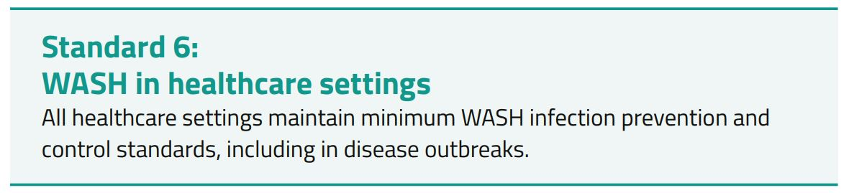
WASH in disease outbreaks
and healthcare settings
Key Actions:
Provide a reliable water supply of sufficient quantity and quality, appropriate to the healthcare setting.
Provide sufficient excreta disposal facilities to limit disease transmission.
Provide enough cleaning materials and equipment for healthcare workers, patients and visitors to maintain hygiene.
Maintain a clean and hygienic environment.
Handle, treat and dispose of waste correctly.
Ensure all healthcare workers, patients and carers use appropriate PPE.
Manage and bury the dead in a way that is dignified, culturally appropriate and safe according to public health practices.

Slide 39
Minimum WASH in Healthcare Setting Standard
Minimum: one station for every ten inpatients
Drinking Water Quality: Minimum: 0.5–1mg/l FRC
Safe Water Availability: Minimum: 5 liters per outpatient per day
Accessible toilets: Minimum: four in outpatient facilities (separated for men, women, children and healthcare W)
Safe Water Availability: Minimum: 300–400 litres per patient per day in viral hemorrhagic fever treatment centre
Minimum: 1 per 20 inpatients (separated for men, women, children and
healthcare workers)
Safe Water Availability: Minimum: Minimum: 60 litres per patient per day in cholera treatment centre
Ensure at least a 48-hour supply (and storage) per facility; 72 Hr. for Cholera/ Ebola

Slide 40
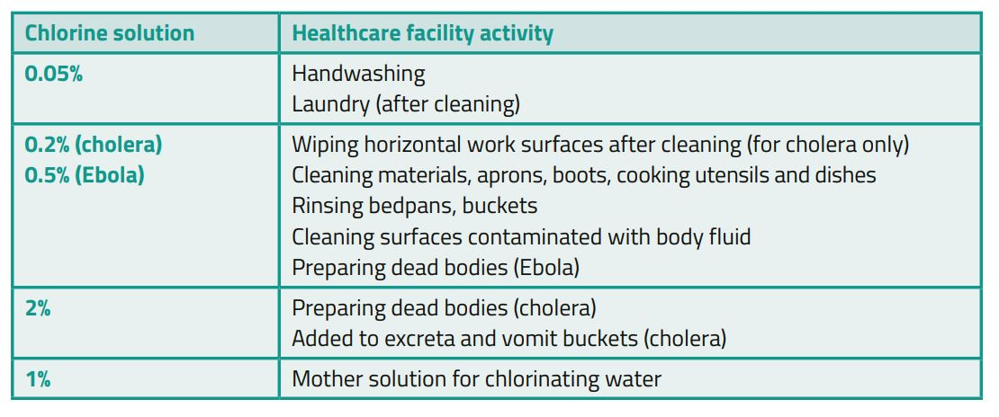
SOME OTHER IMPORTANT THINGS

Slide 41
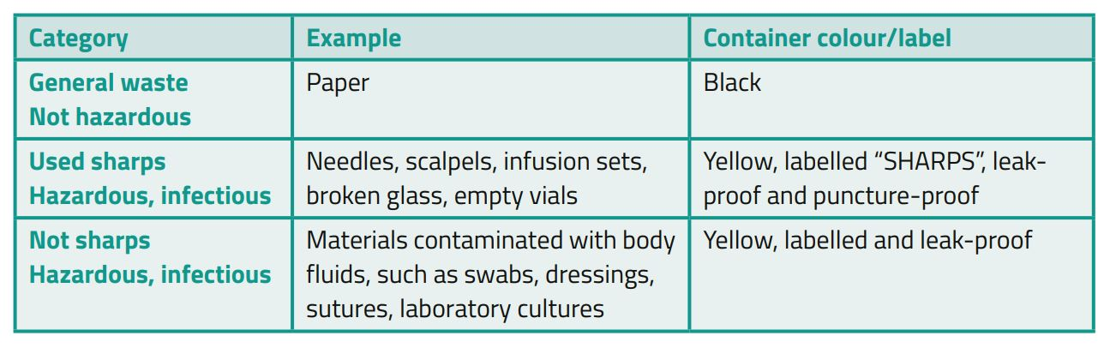
SOME OTHER IMPORTANT THINGS
Notes:
Healthcare waste contains infectious organisms such as HIV and hepatitis B, which can also contaminate soil and water sources. Use a minimum three-bin method to collect and segregate waste as soon as it is created

Slide 42
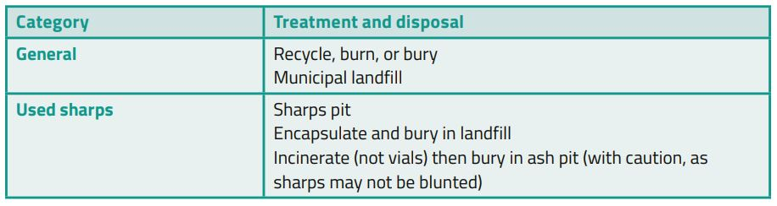
SOME OTHER IMPORTANT THINGS
Notes:
Healthcare waste contains infectious organisms such as HIV and hepatitis B, which can also contaminate soil and water sources. Use a minimum three-bin method to collect and segregate waste as soon as it is created

Slide 43
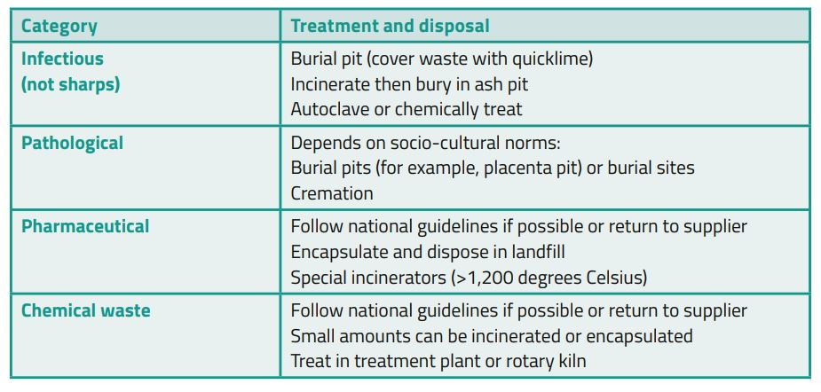
SOME OTHER IMPORTANT THINGS
Notes:
Healthcare waste contains infectious organisms such as HIV and hepatitis B, which can also contaminate soil and water sources. Use a minimum three-bin method to collect and segregate waste as soon as it is created

Slide 44
Thank you
Questions?

