Slide 1


Reimagining the Digital Research Commons for the Canadian HSS Community
(Full paper available for download at https://hcommons.org/deposits/item/hc:38809/)
CSDH/SCHN Conference, May-June 2021
inke.ca | @INKEProject
Graham Jensen, Caroline Winter, Alyssa Arbuckle,
Luis Meneses, & Ray Siemens (UVic)

Slide 2
What is the Canadian HSS Commons?
An open online space where Canadian HSS researchers and stakeholders can gather to share information and resources, make connections, and build community

Slide 3












The Canadian HSS Commons and its Partners
Prototype built on HUBzero (open source, modifications available on GitHub)
Initiative of the INKE Partnership (inke.ca), coordinated by the Canadian Social Knowledge Institute (c-ski.ca), based in the Electronic Textual Cultures Lab (etcl.uvic.ca) at the University of Victoria. In partnership and alignment with the Humanities Commons.

Slide 4
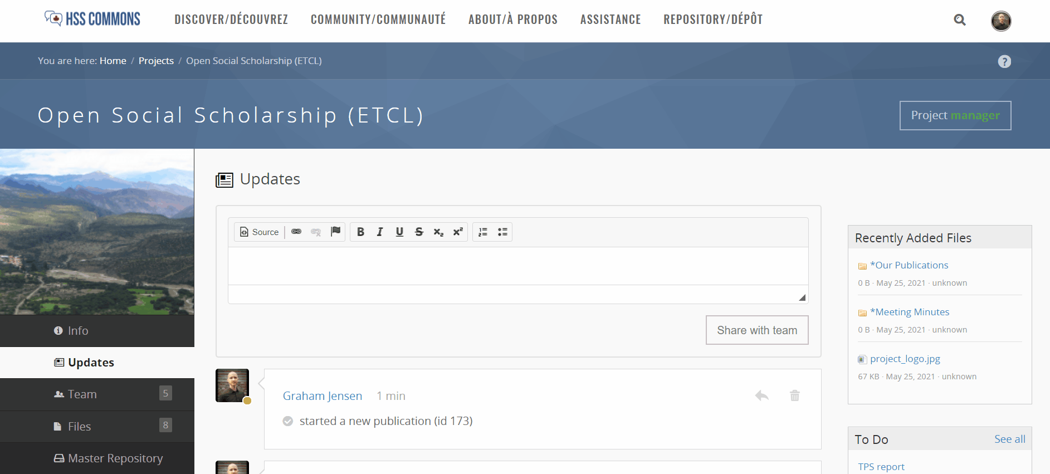
(Above: a quick look at the Canadian HSS Commons project development space)

Slide 5

Interested in testing out the Canadian HSS Commons?
If so, we’d invite you to sign up to be notified when the platform is ready for testing:
  https://forms.gle/F253hZ5i2n2EURuq7

Slide 6
Thank you!
Graham Jensen – ghjensen@uvic.ca, @grahamhjensen
Caroline Winter – winterc@uvic.ca, @editrixcaroline
Alyssa Arbuckle – alyssaa@uvic.ca, @arbuckle_alyssa
Luis Meneses – ldmm@uvic.ca, @ldmm
Ray Siemens – siemens@uvic.ca, @RayS6
inke.ca, @INKEProject
For more information about the Canadian HSS Commons, please check out https://popjournal.ca/issue02/winter

