Slide 1
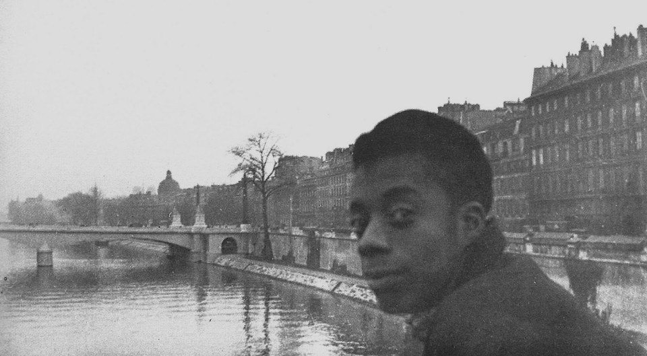
Giovanni’s Room
By James Baldwin
Published 1956

Slide 2
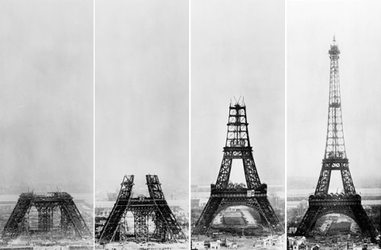
Structure
Structure

Slide 3
Structure
169 Pages.
2 Parts.
First Part: 3 Chapters.
Second Part: 5 Chapters.
Follows “traditional” length and structure of today’s literary fiction; reader-friendly.

Slide 4
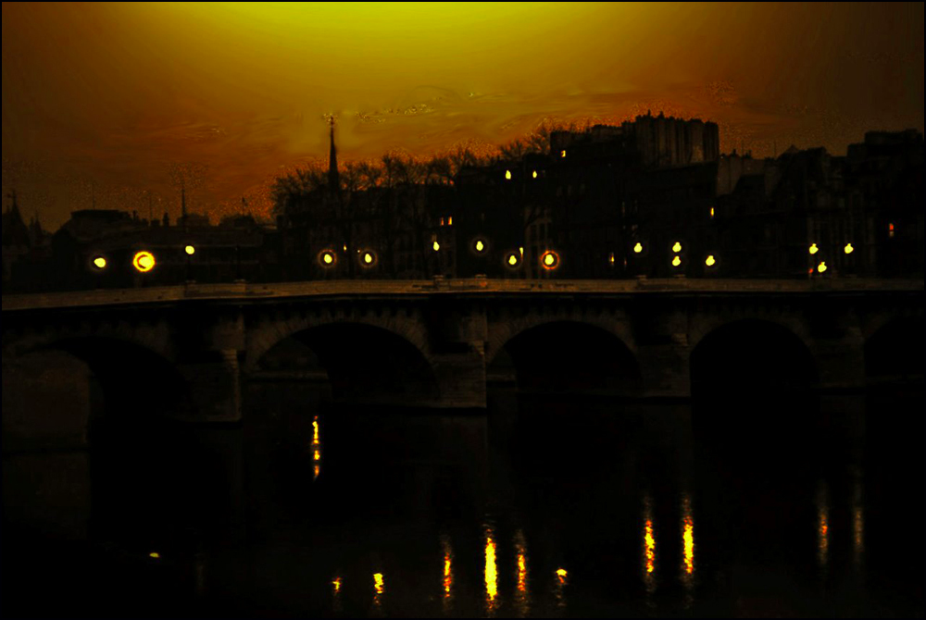
Setting
Setting

Slide 5
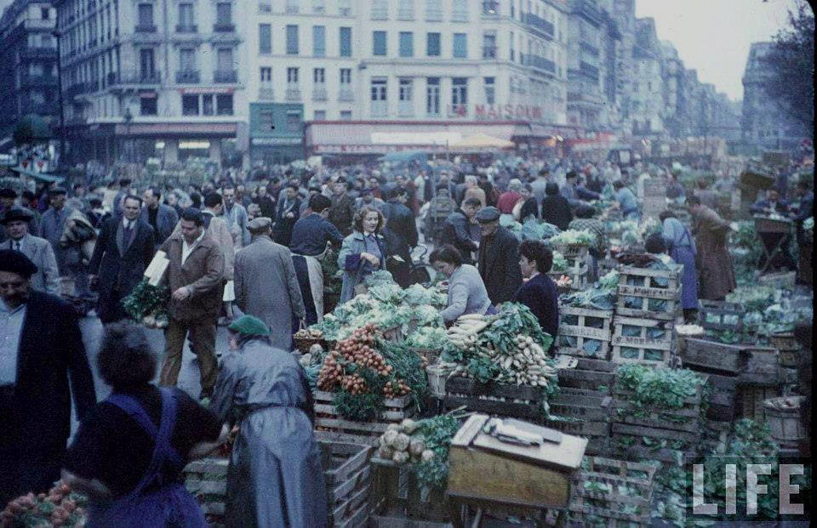
Characters

Slide 6
Characters
Jacques: Older Gay Acquaintance of David’s.
Guillaume: Bar Owner, friend of Jacques, also gay.
David: Protagonist, Anti-hero, American
Giovanni: Italian Immigrant, Working-Class, Hustler, David’s Lover
Hella: American Girl, Free Spirit, David’s “Beard” & Fiancé
David’s Father
Ellen: David’s Paternal Aunt

Slide 7
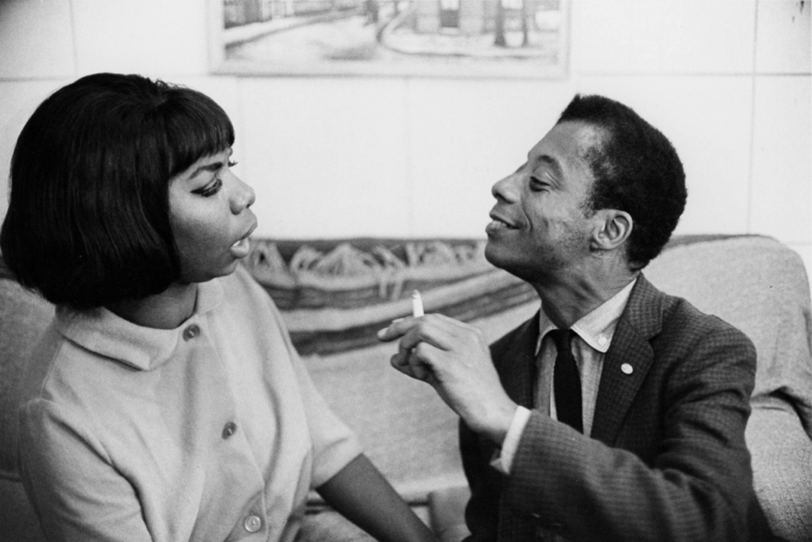
Plot

Slide 8
Plot
An American man in his late 20s wonders why he continues to linger in Paris while his girlfriend is travelling in Spain. In her absence, he is introduced to a handsome Italian bartender through his older gay acquaintances. Quiet but Tense, Social Thriller
X1: Hook: Page 8, 1.1: David is affectionate with adolescent friend, Joey; witnesses family fight.
X2: Inciting Incident: Page 28, 1.2: David meets Giovanni.
X3: Climax: Page 117, 2.4: Hella comes home; the two men fight; David moves out.
X4: Plot Point 3: Page 148, 2.4: Guillaume found dead.
X5: Plot Point 4: Page 162, 2.5: Hella catches David with a sailor.

Slide 9
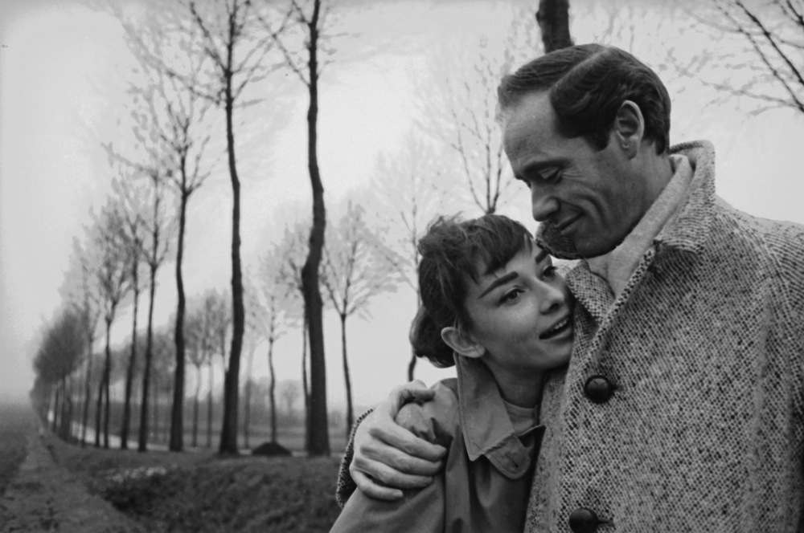
Themes

Slide 10
Themes/Motifs
Themes | Motifs
Loneliness | Ocean -- drowning; to show distance
Crossing Boundaries/Cultural Differences | Yellow -- to show cowardice; extend decision-making until daybreak
How are Men Supposed to Act? | Prisons, Cells, Rooms, Haunts
Love, Misogyny, Bisexuality, & Homosexuality | God, Bible, Jesus & Judas

Slide 11
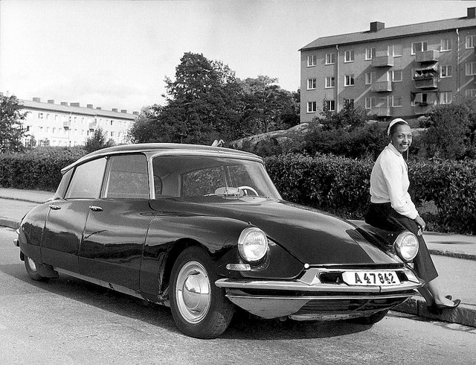
Tone/Language

Slide 12
Tone/Language
Bon Mot (pg. 30).
High, Lyrical, Precise, Exacting.
Interspersed with over a hundred French phrases.
Dialogue: French philosophical musings; playful but not frivolous (pg. 41).
Use of the Paradox (see Wilde; pg. 25).

Slide 13

Point of View

Slide 14
Point of View
1st Person Point of View (David’s).
Both Past and Present Tense.
This was not a novel about race; all of the characters were white; European and European-American.
An American (Puritanical) POV in France (pg. 165).
Narrative Distance: Torn; Paradoxical; Hot-and-Cold; Close-and-Faraway.

Slide 15
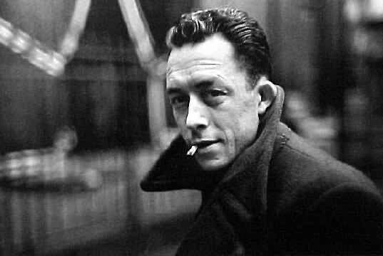
Literary Significance & Criticism

Slide 16
Literary Significance & Criticism
The Publishing Triangle. “the 100 best lesbian and gay novels.” 1999
LA Times. “21 classic works of gay literature.” June 26, 2015
Top Choice for LGBT Book Clubs across country.

Slide 17

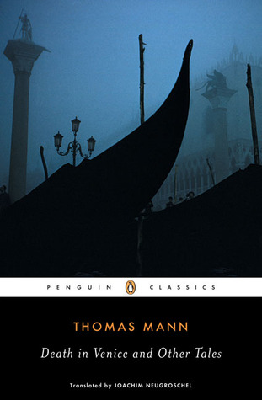

Similar Works (Literature)
1938, UK 1912, Germany 1959, USA
1925, Eng Translation

Slide 18



Legacy (Film)
1991, USA 2003, USA 2005, USA

Slide 19
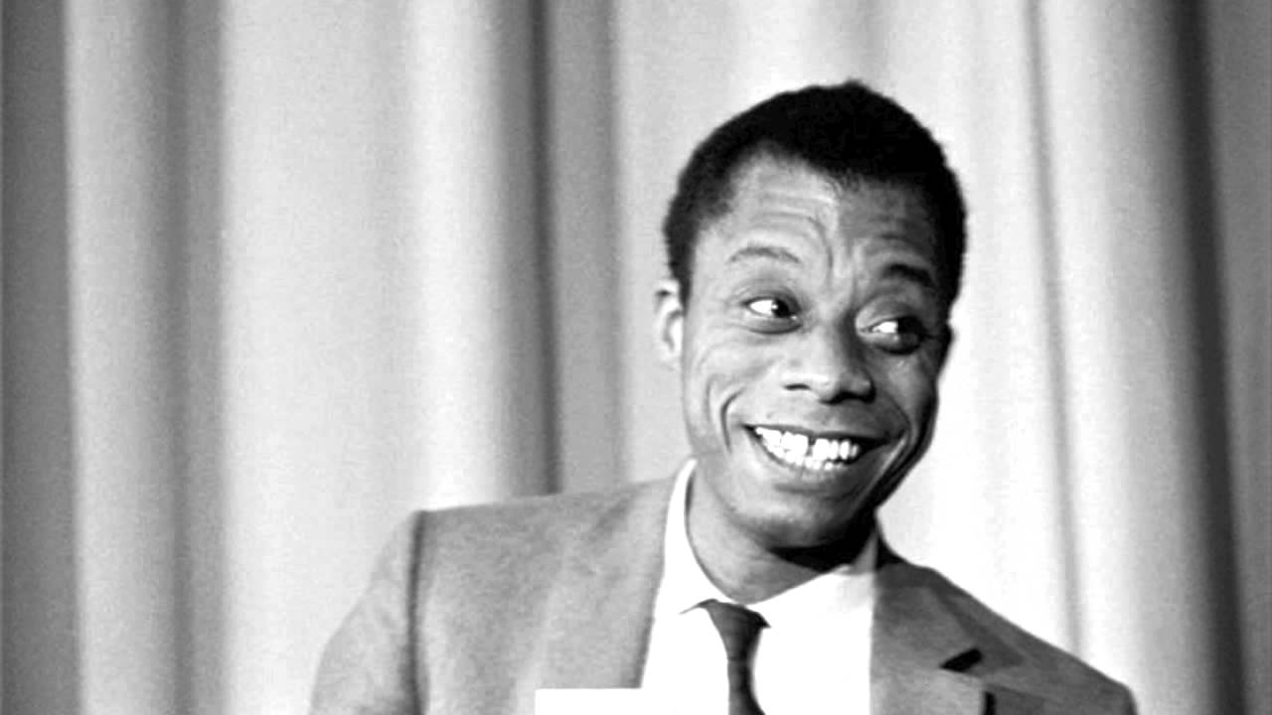
Insights

