Slide 1

Beyond Binaries:
Refactoring Corpus Analysis with the Gender Analysis
Toolkit (GATK)
Ken Alba, Funing Yang, Erica Zimmer (+ team)
MIT Digital Humanities Lab

Slide 2
Debinarizing

Slide 3
Goals For the Refactor
Remove hard-coded Gender values
Support non-binary identifiers
Accept multiple Pronoun Series (and names)
for a Gender
Support neopronouns
These can all be done at the same time.

Slide 4
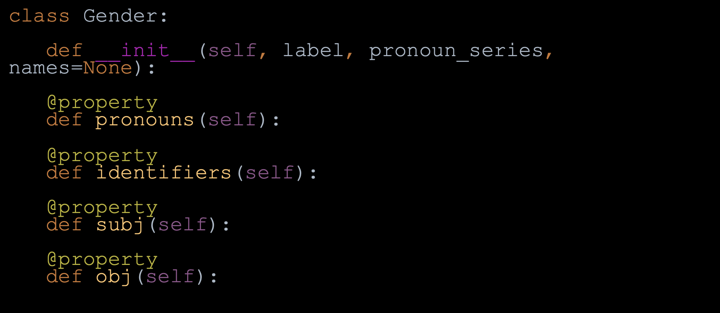
Defining Gender Objects by Use

Slide 5
Declaring Genders in Code

Slide 6
Code Comparison

Slide 7
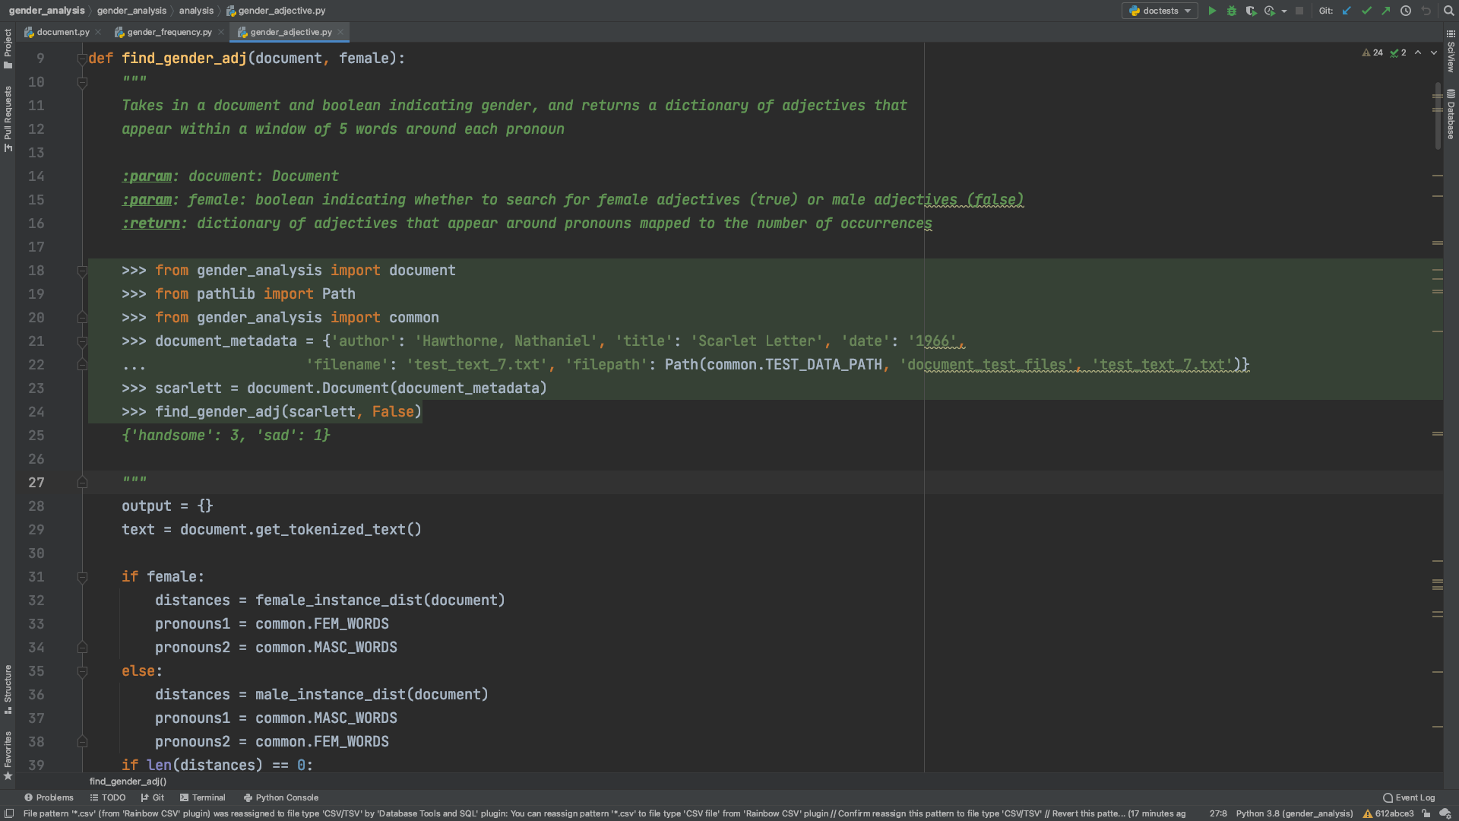
Notes:
previous

Slide 8
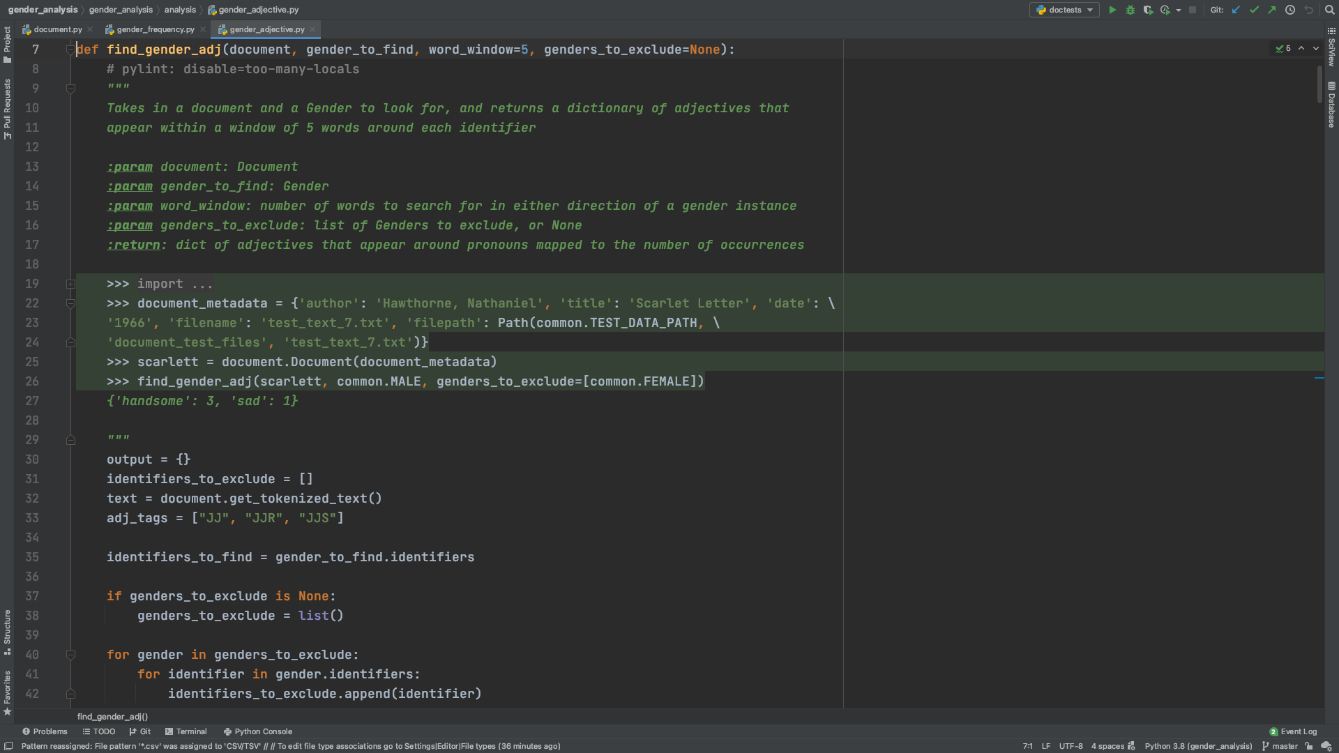
Notes:
current

Slide 9
Example Analysis

Slide 10
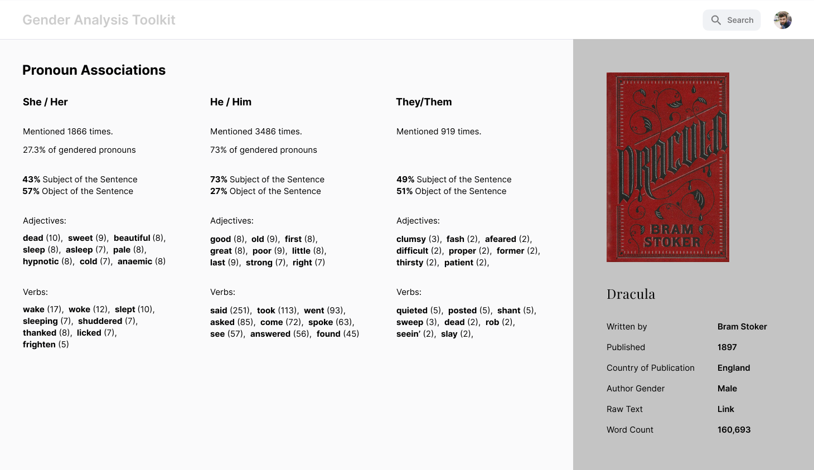
Analysis of a Text

Slide 11
Breaking Up Gender Searches
Define the Genders that will be searched for
Attribute identifiers (i.e. pronouns/names) to these Genders
Perform searches in text hinging on these identifiers
Compile and analyze data attributed to the Pronoun Series and identifiers for each Gender

Slide 12
Preliminary Findings

Slide 13

Fanfiction, Metadata, and Neopronouns
Question: How does the prevalence of gendered pronouns change between
19th century canonical texts and AO3 fanfiction about those texts?
Corpora: Scraped, tagged fanfiction
from An Archive Of Our Own (including
exhaustive metadata)
Objectives: Demonstrate subcorpus slicing
and GATK nonbinary pronoun analysis.

Slide 14
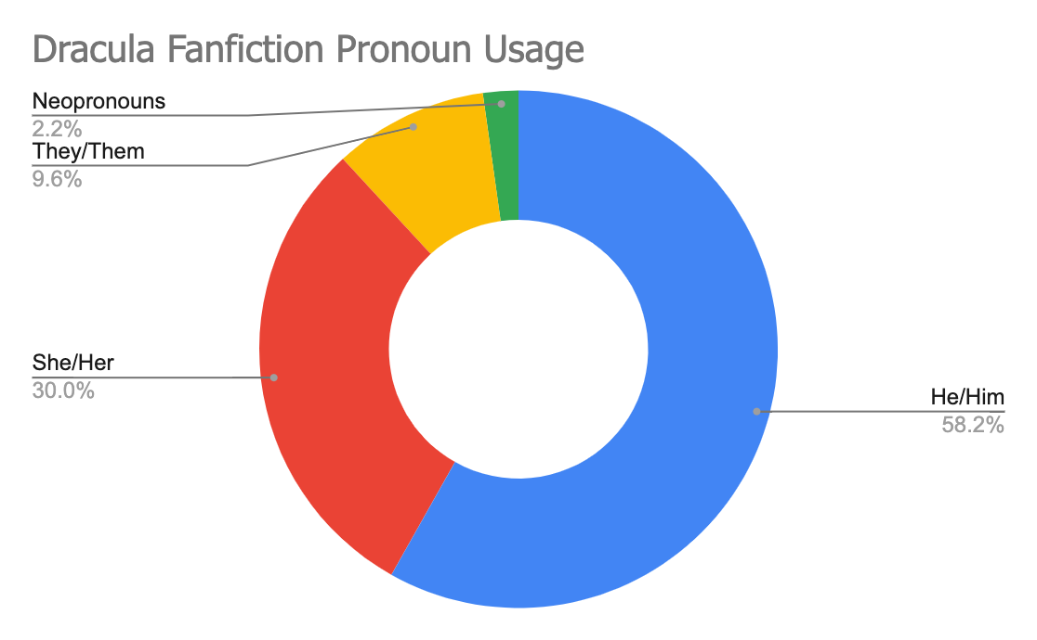
DRACULA, Bram Stoker | He/Him | She/Her | They/Them | Neopronouns
Not Rated | 58.18% | 29.14% | 12.67% | 0.01%
General Audiences | 58.49% | 29.75% | 9.40% | 2.36%
Teen And Up Audiences | 55.30% | 33.53% | 10.73% | 0.44%
Mature | 57.76% | 32.51% | 8.41% | 1.31%
Explicit | 61.01% | 25.10% | 6.94% | 6.95%
Fanfic Average | 58.15% | 30.01% | 9.63% | 2.21%
Canonical Text | 64.15% | 24.11% | 11.72% | 0.03%

Slide 15
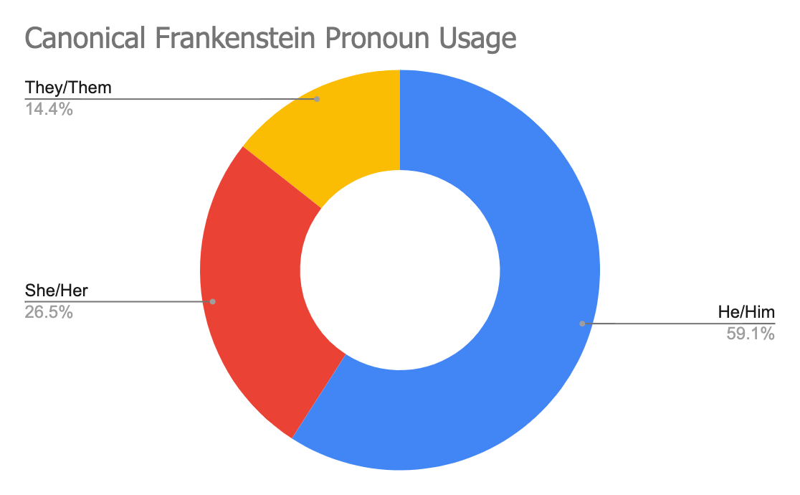
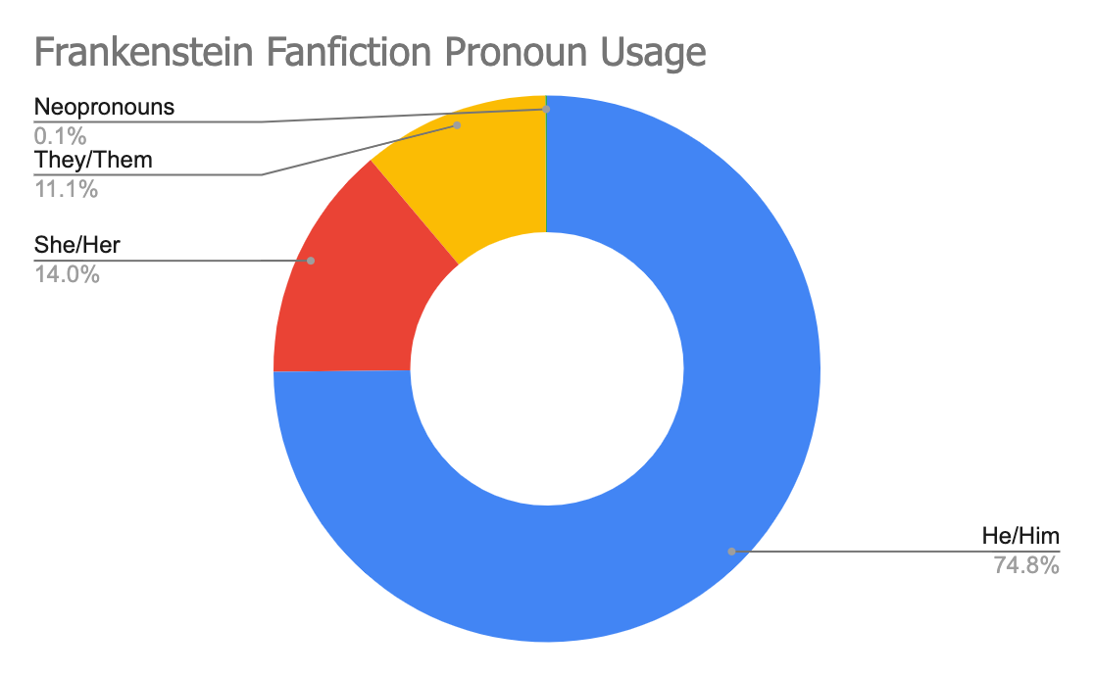
FRANKENSTEIN, Mary Shelley | He/Him | She/Her | They/Them | Neopronouns
Not Rated | 72.93% | 10.86% | 16.19% | 0.02%
General Audiences | 77.01% | 13.62% | 9.29% | 0.09%
Teen And Up Audiences | 76.62% | 12.25% | 11.10% | 0.03%
Mature | 68.24% | 23.20% | 8.50% | 0.05%
Explicit | 79.35% | 10.11% | 10.24% | 0.30%
Fanfic Average | 74.83% | 14.01% | 11.06% | 0.10%
Canonical Text | 59.09% | 26.51% | 14.40% | 0.00%

Slide 16
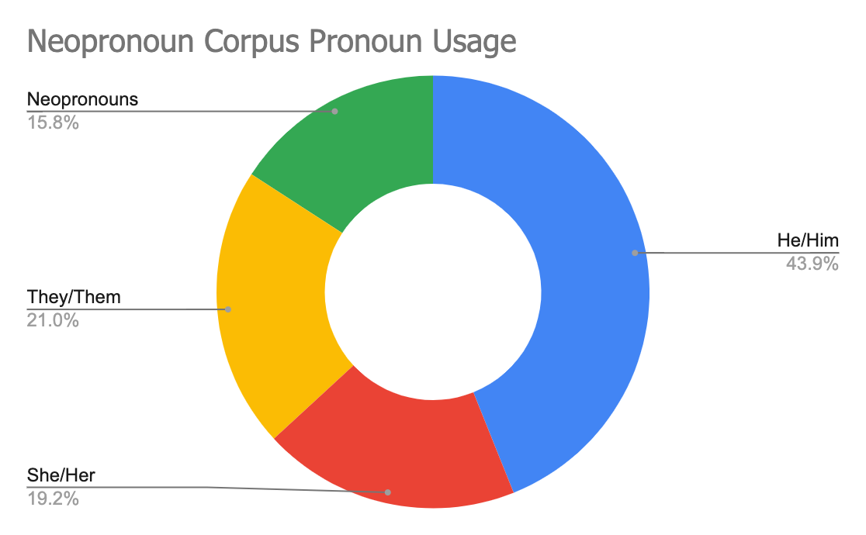
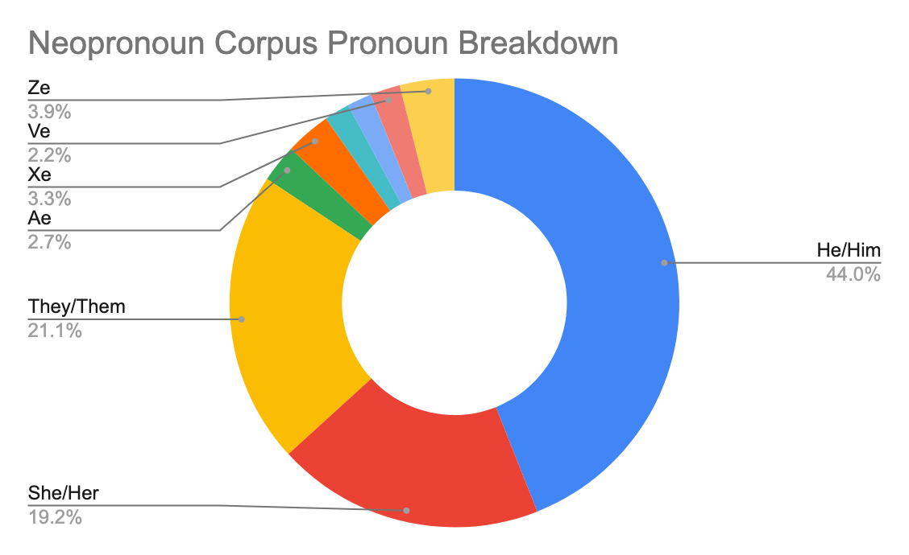
Neopronouns with all_genders list | He/Him | She/Her | They/Them | Ae | Xe | Fae | Ey | Ve | Ze
Not Rated | 43.32% | 18.23% | 27.96% | 0.91% | 3.03% | 0.00% | 0.12% | 3.97% | 2.46%
General Audiences | 43.66% | 14.42% | 23.12% | 1.43% | 5.73% | 1.50% | 2.47% | 1.26% | 6.43%
Teen And Up Audiences | 44.22% | 17.27% | 22.07% | 1.57% | 5.43% | 1.51% | 0.70% | 0.36% | 6.87%
Mature | 45.15% | 21.30% | 19.68% | 0.17% | 1.25% | 3.71% | 0.10% | 4.88% | 3.75%
Explicit | 43.63% | 24.92% | 12.55% | 9.63% | 0.91% | 2.48% | 5.42% | 0.34% | 0.11%
Average | 44.00% | 19.23% | 21.08% | 2.74% | 3.27% | 1.84% | 1.76% | 2.16% | 3.92%

Slide 17
Next Steps

Slide 18
Upcoming Work
Character class + coreference resolution
Approaches to they/them -
disambiguating between singular and plural "they"
Subject-object analyses
Refactoring for package-based deployment
  GitHub: https://github.com/dhmit/gender_analysis
Creating a robust frontend for non-programmers
Other corpora, slicing on other axes (hits? date? 'warning' tags?)

Slide 19



Alternative Genres
How are genders represented differently among different media?

Slide 20



Credits
MIT Programs in the Digital Humanities
Andrew W. Mellon Foundation
GATK UROP Team: Sam York, Jordan Wilke, Funing Yang
MIT DH Lab Lead Programmer Mike Jean
MIT DH Lab Technical Director Ryaan Ahmed
Professor Stephanie Frampton, DH Lab Faculty Director
Professor Myke Cuthbert, DH Lab Faculty Director 2018-2020
Fall 2018 Digital Humanities Lab UROPs and Staff

