Slide 1
“Scripta Qumranica Electronica and
The Use of Scripture in the Damascus Document”
Shani Tzoref, representing the German team of Scripta Qumranica Electronica
Editorial team for D/CD: Tzoref, Peter Porzig, James Tucker
San Antonio SBL Annual Meeting, November 2016

Slide 2
Collaborative “Interactivity”: please access the abstract for this paper S21-238
As part of the Scripta Qumranica Electronica digitization project, Göttingen University is preparing a digital edition of the Damascus Document, which will take maximum advantage of the electronic medium. The foundation of the project is the merging of the textual data of Göttingen’s Qumran-Lexicon-project with the images of the IAA’s Leon Levy Digital Dead Sea Scrolls Library. The exemplary edition of D/CD will feature multiple search capabilities and viewing options for the images, transcriptions, and translations of all of the manuscript witnesses, with extensive critical apparatuses, and notes. A composite edition will be based upon the material reconstruction work done by Stegemann and Steudel, including some of their previously unpublished research….
Notes:
INTENT: show you what SQE can do.
But as it turns out, working on the deliverables has taken a back seat to working on some of the basics and preliminaries to the project. I have learned that behind the buzzwords “digital edition” and more broadly, “Digital Humanities”, there is a great deal of theoretical and pragmatic thinking, research, data, methodology, philosophy, technology….
I want to unpack some of the mystery by stepping through my abstract.
Soapbox and plea. Talking mostly about what i want to do, and soliciting ideas about how We as a community can try to do this.

Slide 3
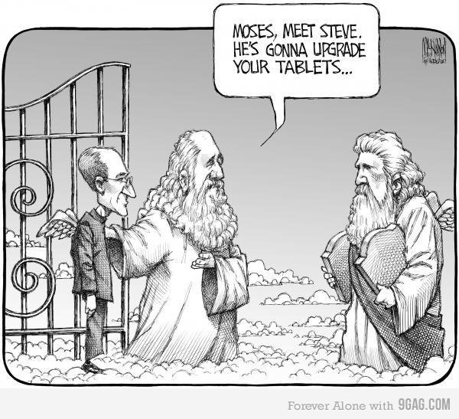
What SQE is *NOT* (according to Tzoref, following, esp. Pierazzo, Andrews)
EXCERPT from ABSTRACT
As part of the
Scripta Qumranica Electronica digitization project,
Göttingen University is preparing a digital edition of the
Damascus Document
Notes:
2 weeks ago, Jonathan Ben-Dov used this slide to conclude his
Minerva presentation. I’ve not gotten to watch the livestream, so I so i don't know how he used it---whether just to end on a light humorous note, or to make some more substantive statement.
But in my secondary re-use here in San Antonio, i have a very substantive statement to make.
This cartoon embodies some of the misconceptions about digital humanities that I am dedicated to changing.
I want to emphasize that digital humanities, as I understand it—along with such scholarly specialists as Elena Pierazzo and Tara Andrews, it, is *not* about bringing in tech wizards to fix and upgrade outmoded methods of presenting textual information. (That’s how I understood this cartoon. On the other hand, Martin, the programmer on the project, saw it as representing the technicians as servants, service personnel who just do one’s bidding, almost like some popular views of computers themselves).
Rather, my vision for SQE– and the impetus for the collaborative project in the first place, is that this must be a collaborative effort with clear and sensitive communication. We all need to figure out our assumptions and needs and options and articulate them to one another, and integrate the different areas of expertise.
Sounds simple, especially when most participants state their commitment to this mode of operations, which is also emphasized in our project description and grant proposals. But it’s not. One simple example of the sort of obstacle that arises….

Slide 4
INTELLECTUAL PROPERTY: CREDIT– proprietary concerns
By Bruce McKinnon, editorial cartoonist for The Chronicle-Herald in Halifax, Nova Scotia Canada, Oct. 2011
accessed via Asaf Geyer, via
http://134.76.19.179/redmine/boards/2/topics/297 ,
upload of slides for presentation: Jonathan Ben-Dov,
“Scripta Qumranica Electronica: Dead Sea Scrolls Aggregated Database
and Virtual Research Environment”
http://www.thedigin.org/2016/11/09/digital-jewish-studies-special-track-streaming/
As part of the Scripta Qumranica Electronica digitization project, Göttingen University is preparing a digital edition of the Damascus Document
editors: Tzoref, Peter Porzig, James Tucker
programmer: Martin Schröter
QWB: …
SQE: ...
Notes:
SLIDE 4
CREDIT. Difficult to determine, difficult to document, and we don’t yet have a CULTURE of credit and documentation.
CREDIT: tracking down artist was not simple. But also, not SO difficult. I am not sure I would have bothered if it were not a part of the point I am trying to make.
When my abstract refers to “Göttingen” , this is a form of metonymy: Rome, Athens, Jerusalem, Washington. But it’s also real people. (well, we’ll see about washington). So how do we properly give credit to digital work?
Essler Digital Corpus of Literary Papyri (DCLP) - Essler / Ast papyri.info. Rodney Ast (University of Heidelberg) and Holger Essler (University of Würzburg)
Nor, of collaboration. We have a culture of hierarchy and authority. Which also relates to freedom to contribute.
Charlotte in Leuven: ECONOMICS of Knowledge.
Press releases and promotions of SQE Göttingen will usuall name tohe Academy of Sciences and Humanities; Reinhard Kratz; Ingo Kottsieper; Annette Steudel and students. But what about the graduate students over the course of 15 years who entered the data? (SQL aggregate in raw form)

Slide 5
INTELLECTUAL PROPERTY: HIERARCHIES. Propriety
OPEN ACCESS. Economics of Knowledge, Expression
CD 14 ³ The rule of dwelling in all the camps. All shall be mustered by their names: the priests first, ⁴ the Levites second, the children of Israel third, the proselyte fourth. Then they shall be recorded by name, ⁵ one after the other: the priests first, the Levites second, the children of Israel ⁶ third, the proselyte fourth.
In the same order they shall sit, and in the same order they will inquire of all. The priest who presides ⁷ at the head of the general membership must be between thirty to sixty years old, learned in the Book of Meditation ⁸ and in all the regulations of the Law, speaking them in the proper way. The Overseer of ⁹ all the camps must be between thirty and fifty years old, master of every ¹⁰ secret of men and of every deceptive utterance. At his command the members of the congregation shall enter, ¹¹ each in his turn. Anything that any man might have to say, let him say it to the Overseer
Notes:
But also: freedom of expression.. Not ancillary, but the heart.

Slide 6
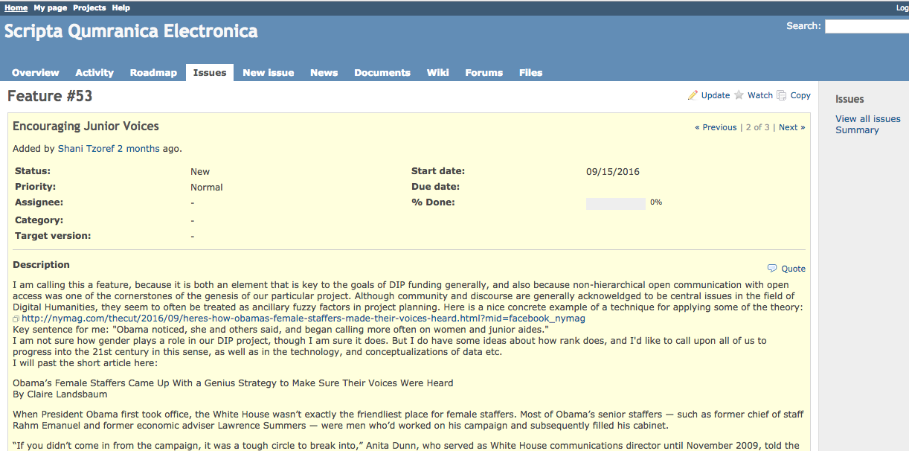
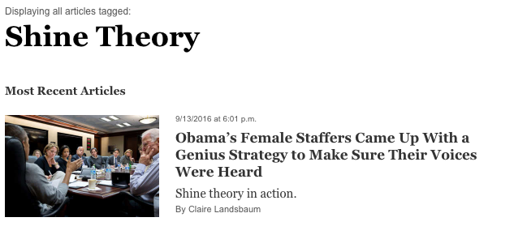
INTELLECTUAL PROPERTY: HIERARCHIES. Propriety
Economics of Knowledge, Expression
Notes:
REDMINE. Check names of Papyrus Group. And wikipedia them: they can’t get credit at their universities.
Amplifying. But not so simple. Amplifying becomes a potential way of asserting authority and rank.
Rodney Ast, University of Heidelberg, Institut für Papyrologie, papyri.info/ (personal communication, July 2017, as summarized in e-mail)
1. Mock-ups: through communication of visualized front-ends (workspace/edition) to the technician
2. Issue-Tracker
3. Regular skype meetings: (Rodney said their group of 7-8 people meet every week, and he finds this indispensable.)

Slide 7
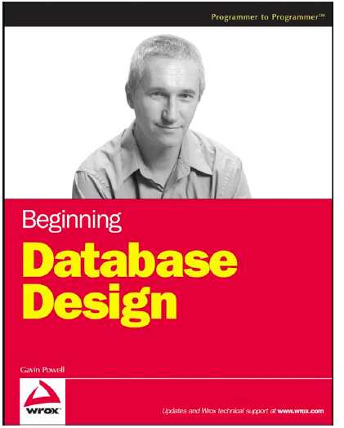
INTELLECTUAL PROPERTY:
COLLABORATIVE COMMUNICATION
“HUMAN INTERFACE”
Called to attention of SQE team by James Tucker,
following conversation with So Miyagawa
“For example, a car salesman may picture selling a Ford and selling a Chevy as two distinctly different processes.
From the perspective of the database modeler, however, both Ford and Chevy are automobiles,
they are both either automatic transmissions or stick-shift, and they are both sold.”
Gavin Powell:
“Whereas end-users see specifics, database model designers should look for common elements for abstraction”.
Notes:
But we academic end-users are programmed for abstraction, conditioned to it, anyway. So we have our own set of inclinations, preconceptions, habits, discourse etc. That need to be brought into conversation with the tech people. OR, ideally: CAN BE BOTH! COPTIC: So and Carrie Schroeder.

Slide 8
As part of the Scripta Qumranica Electronica digitization project, Göttingen University is preparing a digital edition of the Damascus Document, which will take maximum advantage of the electronic medium. The foundation of the project is the merging of the textual data of Göttingen’s Qumran-Lexicon-project with the images of the IAA’s Leon Levy Digital Dead Sea Scrolls Library. The exemplary edition of D/CD will feature multiple search capabilities and viewing options for the images, transcriptions, and translations of all of the manuscript witnesses, with extensive critical apparatuses, and notes. A composite edition will be based upon the material reconstruction work done by Stegemann and Steudel, including some of their previously unpublished research….

Slide 9
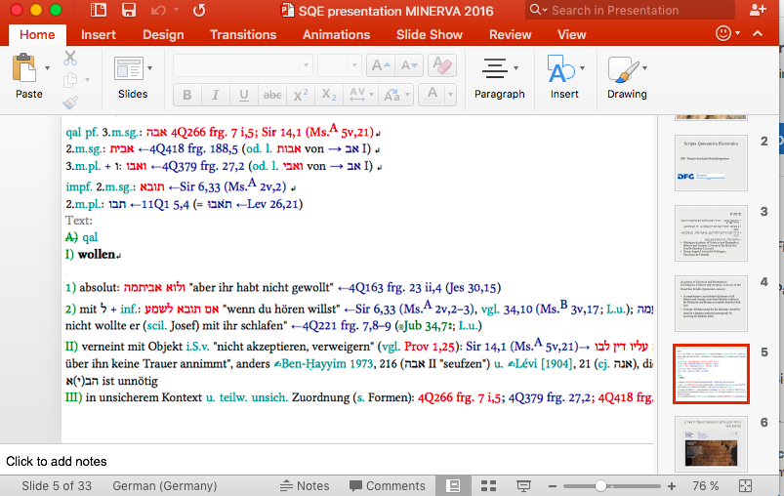
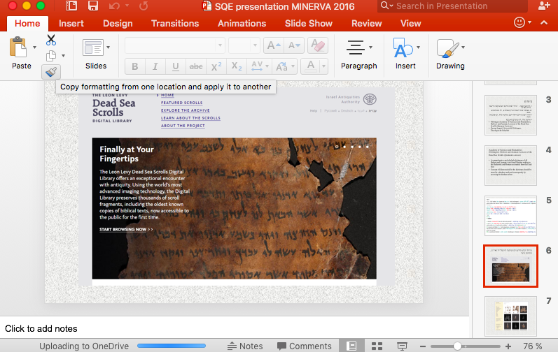
Scripta Qumranica Electronica
Deutsch-Israelische Projektkooperation (DIP)
“the merging of the textual data of Göttingen’s Qumran-Lexicon-project with the images on the IAA’s Levy Digital Dead Sea Scrolls Library website” OPEN ACCESS
Leon Levy Digital Dead Sea Scrolls
http://www.deadseascrolls.org.il/
Israel Antiquities Authority
Göttingen University’s Qumran Wörterbuch
Notes:
QWB: no URL. Created for Print edition; store data. Through SQE: itself a powerful tool. But transition is needed. OPEN ACCESS; also, using OPEN SOURCE

Slide 10
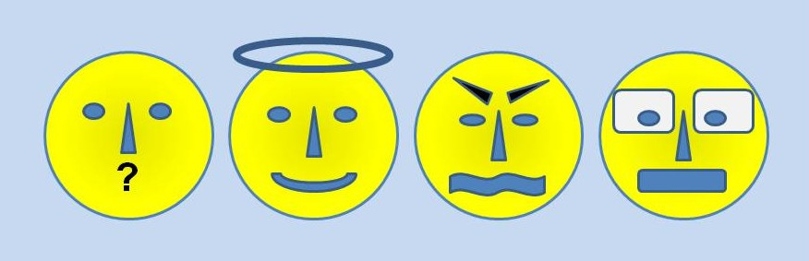
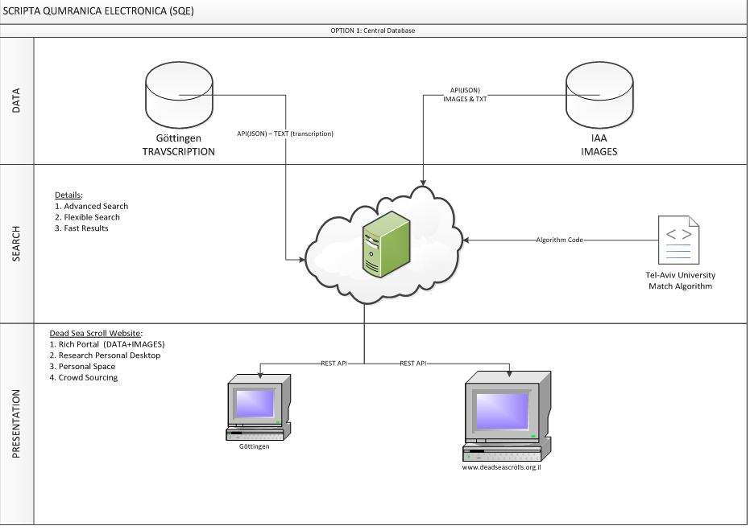
Preliminaries: technical, logistical, conceptual challenges
Who? Communication
Merging Image and Text:
Where? How?
Linking databases, not just data; relational databases (Note: thanks to James).
What is a Digital Edition?
Pierazzo, Andrews…
What is “D”? What is a composition? a fragment? “an image”? ….

Slide 11




WHO? ACADEMIC POLITICS & PREJUDICES 1:
Is Digitization Scholarship?
Notes:
Note: De Gruyter

Slide 12
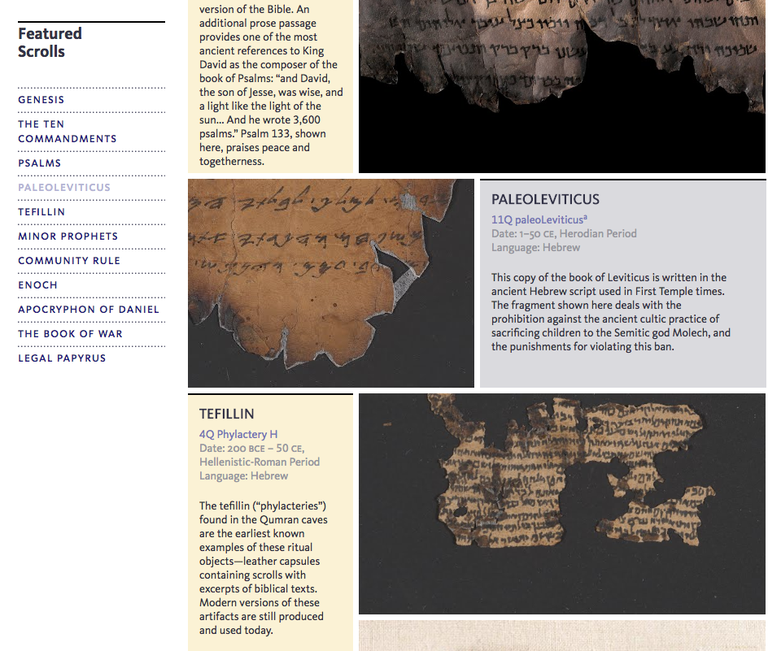
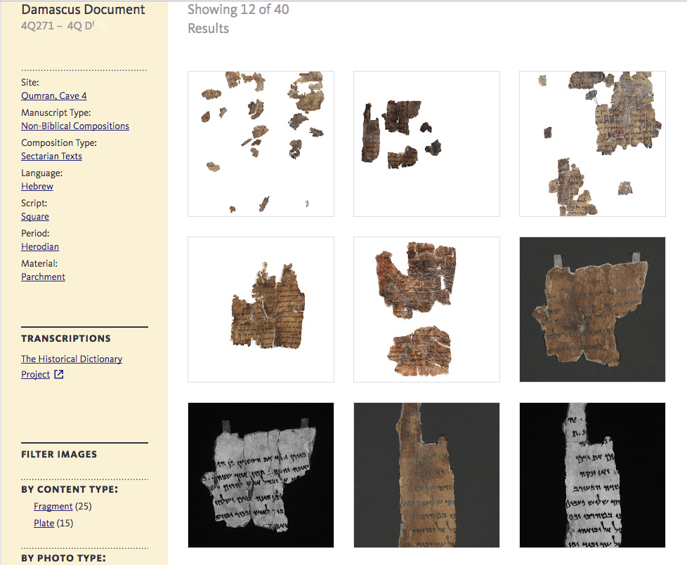
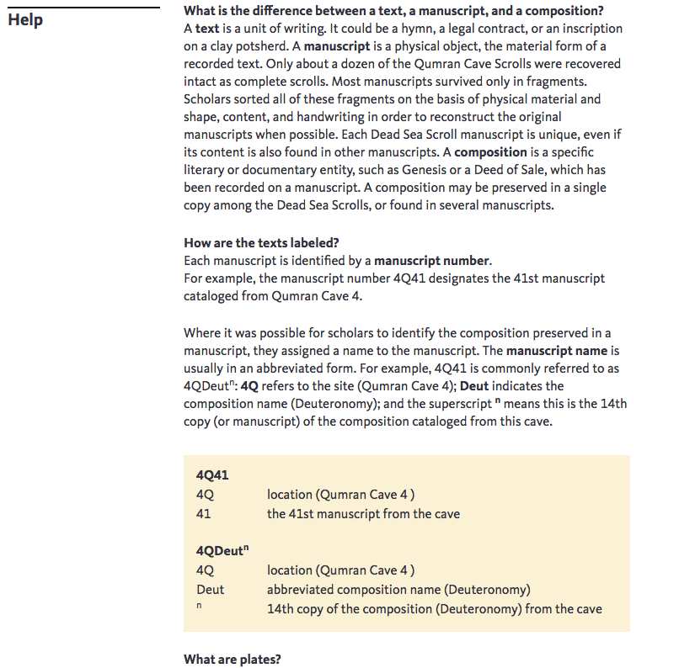
Notes:
GOOGLE.
”all those numbers are too confusing. Just choose one basic “Title” for each image: Genesis, Enoch.”
IDENTIFIERS, UNIQUE IDENTIFIER: “composition” on a ”manuscript”
*****On Sun, Aug 24, 2014 at 12:32 PM, Shani <s.tzoref@gmail.com> wrote:
Dear Oren and Orit,
Following up on my previous e-mail about standardizing labels, especially in the context of developing digital resources, I'd like to enlist your help on the most pressing question of unique identifiers for fragments. You'll see I've added some names to the conversation here.
Nachum has helpfully isolated two separate issues:
- Matching images of each old fragment with new images (nontrivial because fragments have fallen apart or been pasted together)
- Choosing a unique identifier for the fragment (that is creating a table of correspondences between various identifiers).
Each fragment needs a unique identifier…. Each image. Different resolutions.
Google: 3 pages → 1 page → paragraph → couple of lines to go with the image → caption.
Some teenager non-specialists: hover or click. Digital, duh?
Help
What is the difference between a text, a manuscript, and a composition?
A text is a unit of writing. It could be a hymn, a legal contract, or an inscription on a clay potsherd. A manuscript is a physical object, the material form of a recorded text. Only about a dozen of the Qumran Cave Scrolls were recovered intact as complete scrolls. Most manuscripts survived only in fragments. Scholars sorted all of these fragments on the basis of physical material and shape, content, and handwriting in order to reconstruct the original manuscripts when possible. Each Dead Sea Scroll manuscript is unique, even if its content is also found in other manuscripts. A composition is a specific literary or documentary entity, such as Genesis or a Deed of Sale, which has been recorded on a manuscript. A composition may be preserved in a single copy among the Dead Sea Scrolls, or found in several manuscripts.
How are the texts labeled?
Each manuscript is identified by a manuscript number.
For example, the manuscript number 4Q41 designates the 41st manuscript cataloged from Qumran Cave 4.
Where it was possible for scholars to identify the composition preserved in a manuscript, they assigned a name to the manuscript. The manuscript name is usually in an abbreviated form. For example, 4Q41 is commonly referred to as 4QDeut^{n}: 4Q refers to the site (Qumran Cave 4); Deut indicates the composition name (Deuteronomy); and the superscript ^{n} means this is the 14th copy (or manuscript) of the composition cataloged from this cave.
4Q414Qlocation (Qumran Cave 4 )41the 41st manuscript from the cave
4QDeut^{n}4Qlocation (Qumran Cave 4 )Deutabbreviated composition name (Deuteronomy)^{n}14th copy of the composition (Deuteronomy) from the cave
The definitions are not my point; The PROCESS is, the need for them. And for even knowing what we know.

Slide 13

UNIQUE IDENTIFIERS… vs... Havoc

Slide 14
ACADEMIC POLITICS & PREJUDICES 2
(WHY and) WHAT and WHY?
Is producing a DIGITAL EDITION considered SCHOLARSHIP?
The exemplary edition of D/CD will feature multiple search capabilities and viewing options for the images, transcriptions, and translations of all of the manuscript witnesses, with extensive critical apparatuses, and notes. A composite edition will be based upon the material reconstruction work done by Stegemann and Steudel, including some of their previously unpublished research

Slide 15
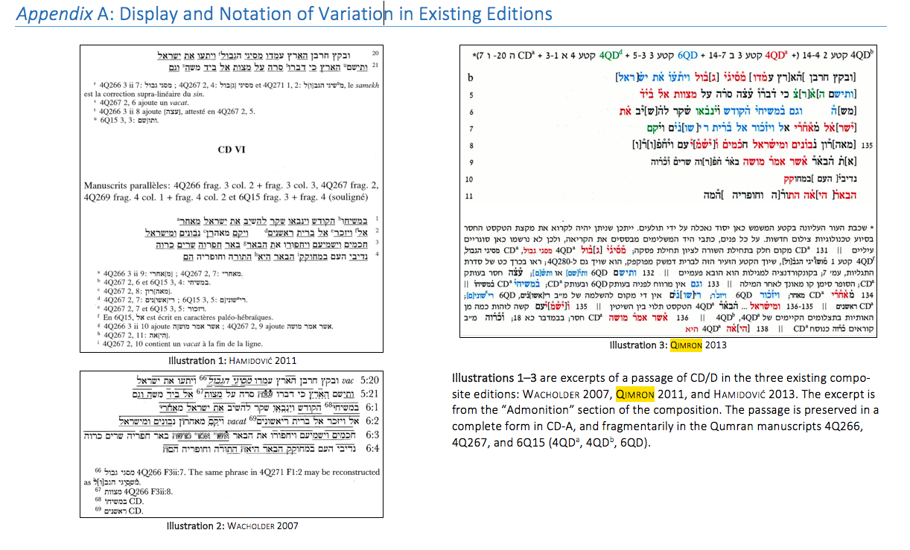
Notes:
Not criticism. This was an inspired approach--- for print media.

Slide 16
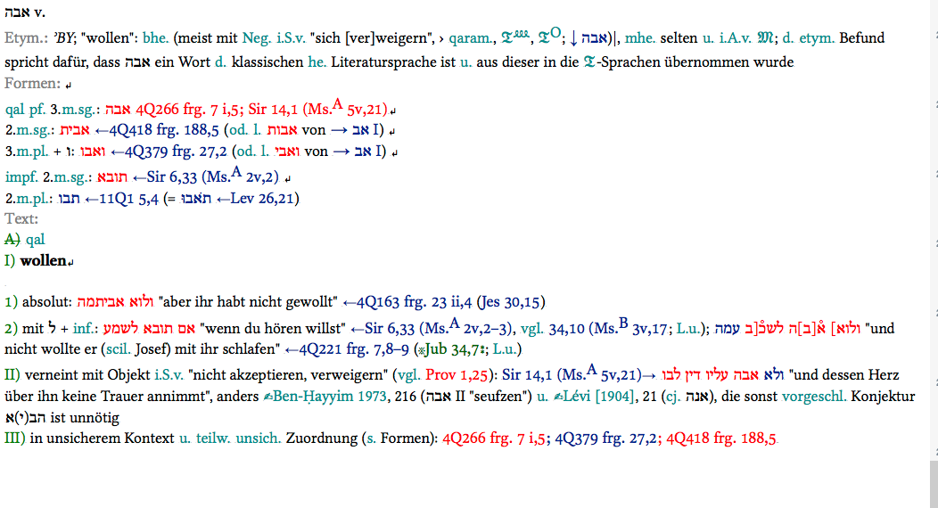
QWB
Notes:
Tool for producing static Print Lexicon… and itself a comprehensive dynamic digital resource

Slide 17

ACADEMIC POLITICS 3: WHERE?
Your Place or Mine
Notes:
Haifa meeting. OPEN ACCESS, but WHERE DOES THE DATA LIVE and WHERE is it DISPLAYED? AND ****HOW DOES THIS GET NEGOTIATED****
but (me: naïve,neutral; but was it? Pompey was also a neutral party. )

Slide 18
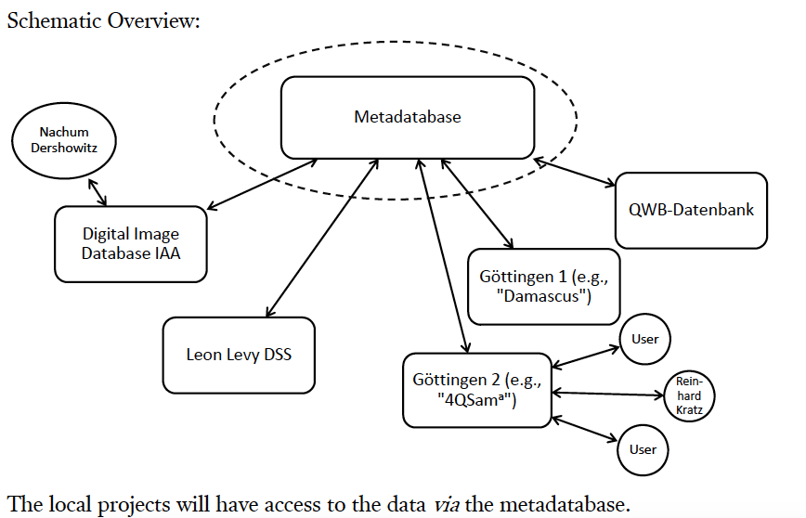
7 July, 2017 API

Slide 19
API sketch posted to Redmine 13 Nov, 2017
Notes:
Here’s a later sketch of Ingo’s model by ITAI Ben-Shalush of the IAA. By the time it was posted, it was outdated.
The main issue was Back-end; Front-End
NOTE DIRECTION OF ARROWS: Sharing AND Protection

Slide 20

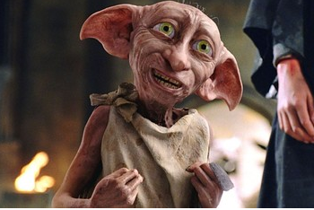
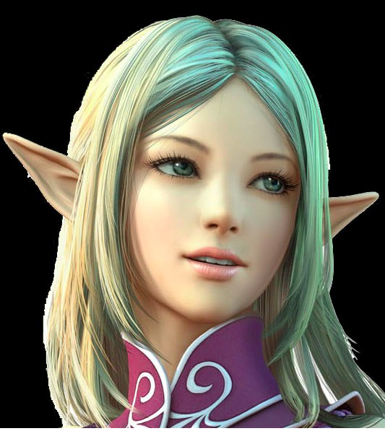
ELVES and ICE CREAM
?

Slide 21

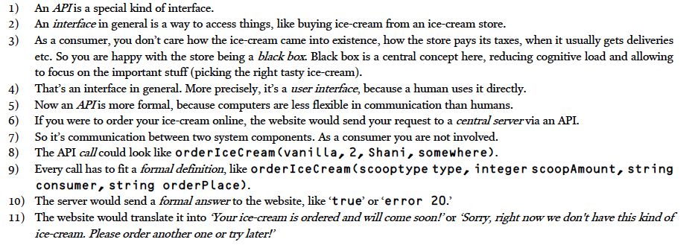

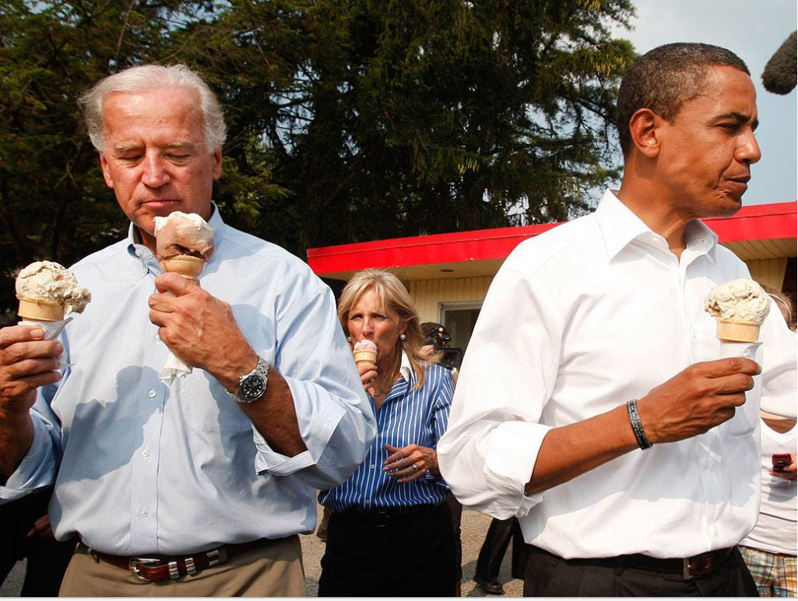
ICE-CREAM API
By Martin Schöter
From protocol Göttingen SQE meeting, prepared by Peter Porzig, July 2017
Notes:
I love ice cream. But it was not my question. I was able to figure out from the diagram what the point of the API was. I appreciate the Ice Cream attempt to find a common comfort zone. But what I needed to know was– where and how could I start doing my work? But Martin could not answer that questions, since he did not yet know what work I wanted to do. She’eno yodea lishol
Application program interface (API)

Slide 22
Back-end, front-end. ”Where do I fit in”?
Notes:
The back-end data was where the technical complicated stuff was going to happen, and this was going to be served to me as the user. But I am not just a user--- I need to be a producer

Slide 23
DYNAMIC INTERACTIVE EDITION
The notes in the edition will include a full record of all proposed readings attested in the secondary literature, as well as semantic, syntactic, and morphological information for each word.
They will record, and link to, variant readings in parallel passages in the multiple D manuscripts, and a bibliography.
Notes:
Politics resolved, funding earned.

Slide 24
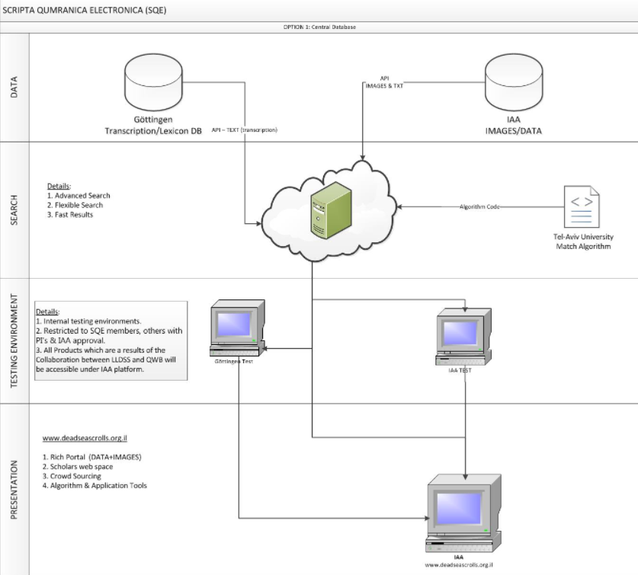
Notes:
Date? WORKSPACES. Still presented as a front-end, but an interim space. A “Testing Environment” rather than a Working environment

Slide 25
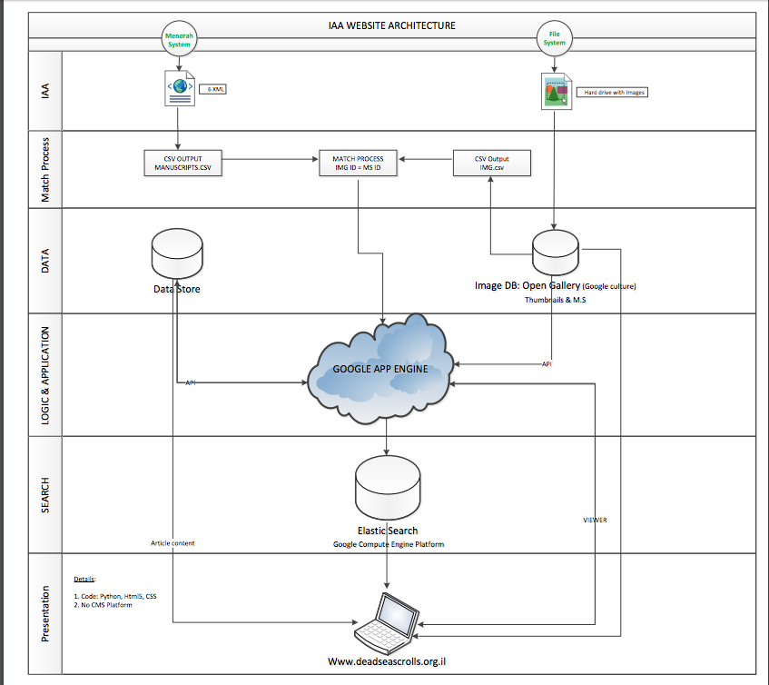
NOV 2017
IAA WEBSITE ARCHITECTURE
In progress.
Sketch by Itai Ben-Shalush, IAA,
via REDMINE

Slide 26
NOV 2017
Notes:
Black BOX: restricted access zone.
MY concern was where I could do my work. But the IAA’s concern is securing their Data. For example, the Leon Levy Database is tied to the general IAA Database, called Menorah. Menorah is not just Dead Sea Scrolls. The participants in SQE should not have access to all of the IAA’s complete database. And it might be unwieldy for us to have access to every single image taken of every single fragment. The term Black Box can be used to describe data that is made inaccessible to certain parties. So, the involved parties need to negotiate both access to information ABOUT the system, and also access to information WITHIN the system.

Slide 27
Black Box: sharing and protection
WIKIPEDIA
GAVIN POWELL (thank James for reminding me)
We make our own black boxes. Information overload.
Cp. Archaeology session by Zevitt.
Cp. Hanan on archaeology and history
Cp Forgeries: Academia.edu
Cp. Sexual misconduct.
Transparency and Accountability
Notes:
We just want the ice cream. But it is our responsibiltiy to learn to access and process information. And it begins by acknowledging what one does not know, not covering or apologizing, but recognizing, discerning, asking. Transparency and Accountability Within And Without

Slide 28
Niglot and Nistarot
CD 13 This is the rule for the Overseer of a camp. … 11 He shall observe everyone who is added to his group as to his actions, his intelligence, his ability, his strength, and his wealth 12 and write him down by his place according to his share in the allotment of Light. No members of the camp are allowed 13 to bring anyone into the group except by permission of the Overseer of the camp;
From to and onward …
Notes:
And also, access to information for those OUTSIDE the system. I was rebuked. Though, as I see it, my conversation with So enabled me to ask some essential questions, to identify and articulate needs and wants and clarify assumptions--- the sort of questions that moved the sketches along so a functioning workspace for editorial work finally looks like an imminent reality, or at least a realistic possibility.
My chief asset for the project had become a liability. BUT I MAINTAIN THAT THERE IS GREATER SAFTEY in OPENNESS. STEFAN ZWEIG?

Slide 29
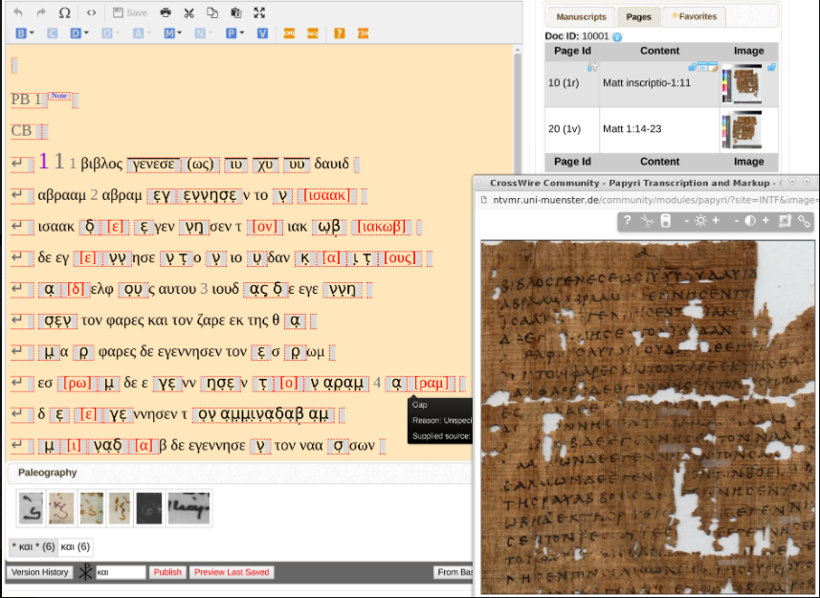
Notes:
So Miyagawa Coptic Editor
Virtual Manuscript Room Collaborative Research Environment (VMR CRE)
Troy Griffitts' GUI editor of XML for manuscripts, which Muenster NT project and Goettingen Coptic OT project are using.
COPTIC EDITOR from SO.

Slide 30
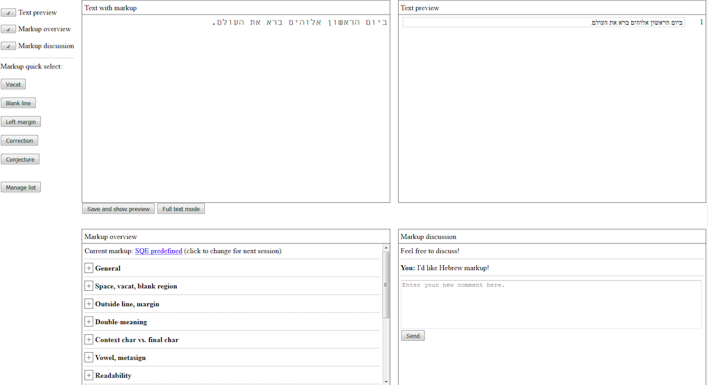
Place comfy editor here
Notes:
And also, access to information for those OUTSIDE the system. I was rebuked. Though, as I see it, my conversation with So enabled me to ask some essential questions, to identify and articulate needs and wants and clarify assumptions--- the sort of questions that moved the sketches along so a functioning workspace for editorial work finally looks like an imminent reality, or at least a realistic possibility.
My chief asset for the project had become a liability. BUT I MAINTAIN THAT THERE IS GREATER SAFTEY in OPENNESS. STEFAN ZWEIG?

Slide 31
םויב ןושארה םיהלא ארב
Hi Martin,
I think I've asked you this before. If so, i am sorry.
Where did you get the hebrew text that you put in your mock-up?
I am assuming you typed in German to an automatic translator? It is good Hebrew. Just not Biblical Hebrew. (In fact, I would be interested to compare it to an edition of the Bible that was produced in Israel a few years ago-- translating the ancient Hebrew into modern Hebrew.
This is relevant to me as an example of tech people (you) trying to accommodate users (me and others), by literally trying to use our "language". I see this as a development from your Ice Cream example for describing API. In that attempt-- you tried to look for something universal, that we could all talk about. At this piont of the project, you are able to try some "style switching", and adaptation of users' frames of reference.
Something else I noticed. I am not sure if it's just me, or common among academics, at least in my field. I notice that in your simple explanation of the API, you did not include a key to the acronym. Maybe you were relying on this info being provided elsewhere in the minutes? I think it is important to me to know that API is Application program interface (API) or that GUI is Graphical User Interface
Is there a reason not to pose the comfy editor to Redmine?

Slide 32
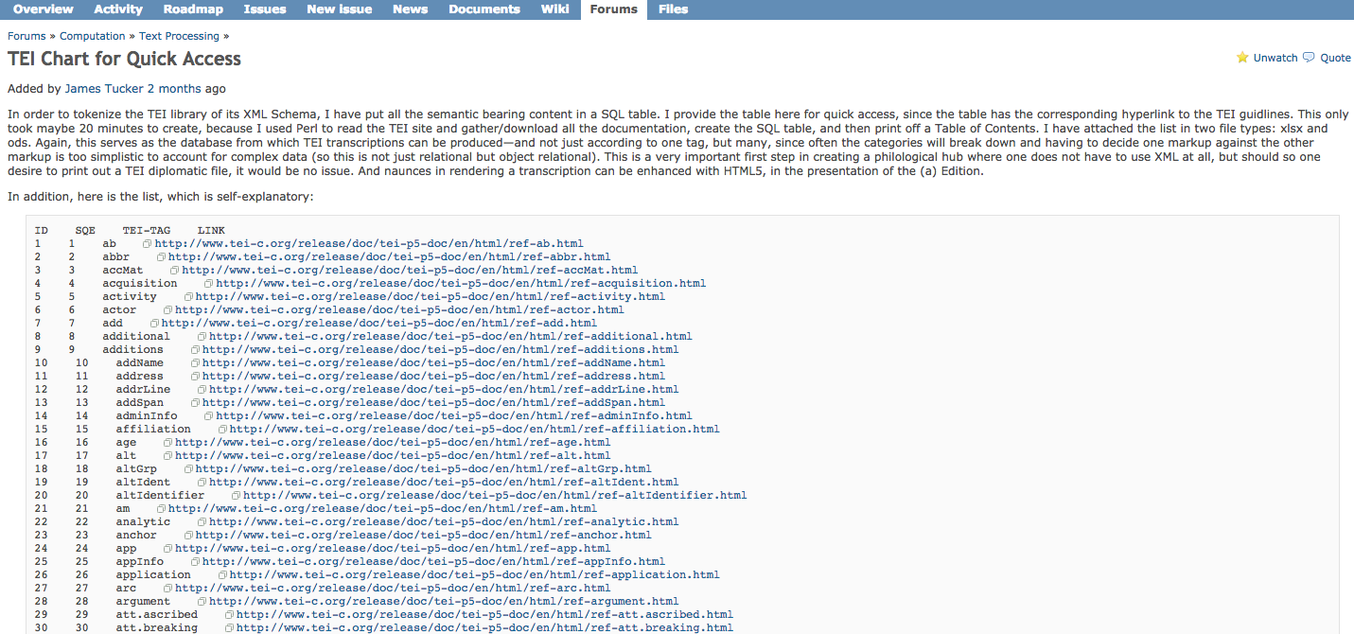
TEI

Slide 34

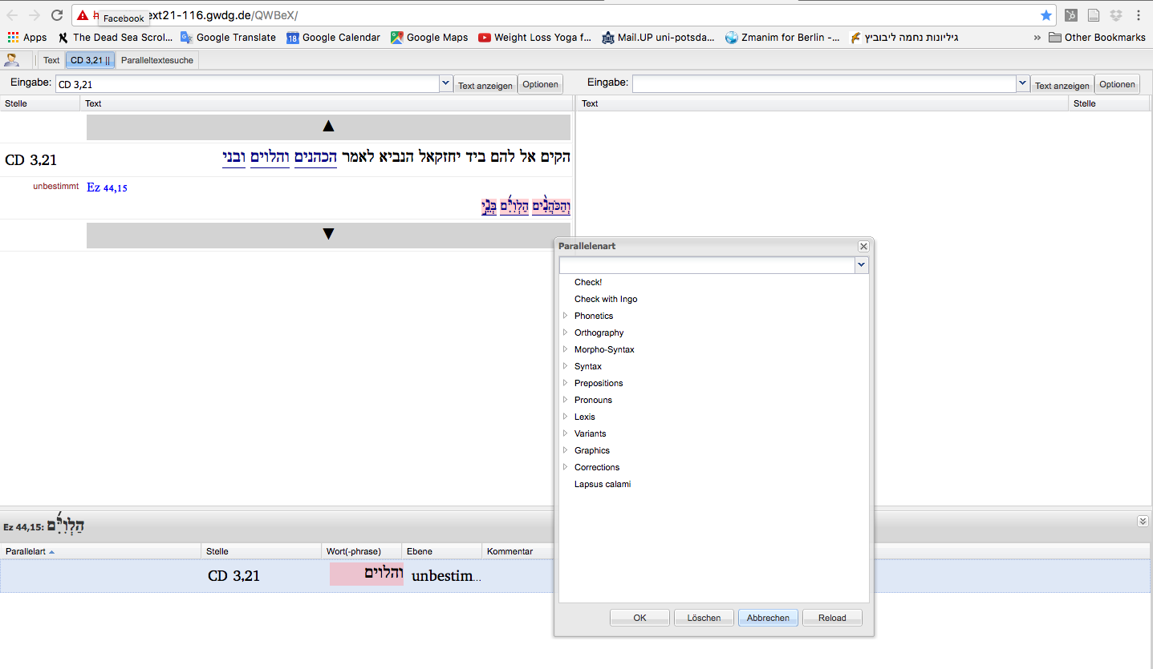
Noam’s Database
Notes:
Tracer, Paleography

Slide 35

The Medium
is
the ___________
Notes:
According to McLuhan biographer W. Terrence Gordon, "by the time it appeared in 1967, McLuhan no doubt recognized that his original saying had become a cliché and welcomed the opportunity to throw it back on the compost heap of language to recycle and revitalize it. But the new title is more than McLuhan indulging his insatiable taste for puns, more than a clever fusion of self-mockery and self-rescue—the subtitle is 'An Inventory of Effects,' underscoring the lesson compressed into the original saying." (Gordon, p. 175.)

Slide 36
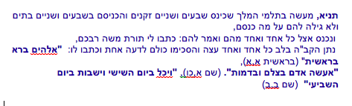
LXX translation
b.Megilla 9a
King Ptolemy once gathered 72 Elders. He placed them in 72 chambers, each of them in a separate one, without revealing to them why they were summoned. He entered each one's room and said: "Write for me the Torah of Moshe, your teacher". God put it in the heart of each one to translate identically as all the others did.

Slide 37
DIGITAL
DIVERSITY: we don’t need to agree with one another (Even about the questions)
DYNAMIC: we can change our minds (responding to new evidence and arguments)
LETTER of ARISTEAS
302 was placed at their disposal. So they set to work comparing their several results and making them agree, and whatever they agreed upon was suitably copied out under the direction of Demetrius
307 As I have already said, they met together daily in the place which was delightful for its quiet and its brightness and applied themselves to their task. And it so chanced that the work of translation was completed in seventy-two days, just as if this had been arranged of set purpose

Slide 38

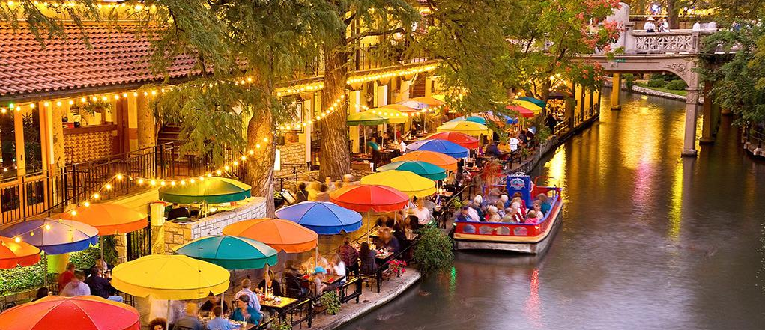
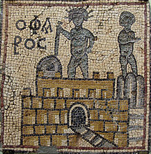
301 Three days later Demetrius took the men and passing along the sea-wall, seven stadia long, to the island, crossed the bridge and made for the northern districts of Pharos. There he assembled them in a house, which had been built upon the sea-shore, of great beauty and in a secluded situation, and invited them to carry out the work of translation, since everything that they needed for the purpose 302 was placed at their disposal. So they set to work comparing their several results and making them agree, and whatever they agreed upon was suitably copied out under the direction of Demetrius.
307 As I have already said, they met together daily in the place which was delightful for its quiet and its brightness and applied themselves to their task. And it so chanced that the work of translation was completed in seventy-two days, just as if this had been arranged of set purpose.
*https://en.wikipedia.org/wiki/Lighthouse_of_Alexandria#/media/File:Mosaic_Ancient_Lighthouse_of_Alexandria.jpg
A mosaic depicting the Pharos of Alexandria (labeled "Ο ΦΑΡΟC"), from Olbia, Libya c. 4th century AD

Slide 40
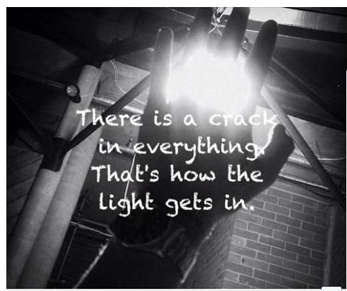

Slide 41
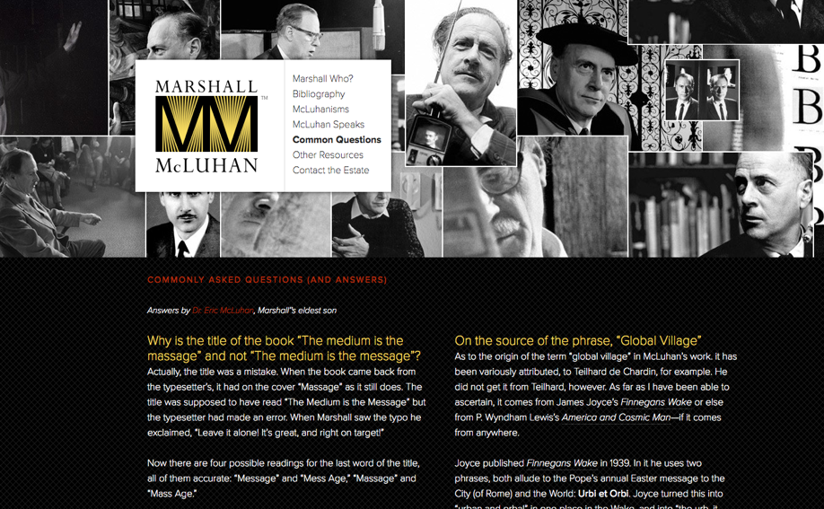

Slide 42
QWB
The notes in the edition will include a full record of all proposed readings attested in the secondary literature, as well as semantic, syntactic, and morphological information for each word.
They will record, and link to, variant readings in parallel passages in the multiple D manuscripts, and a bibliography.

Slide 43
295 I have written at length and must crave your pardon, Philocrates. I was astonished beyond measure at the men and the way in which on the spur of the moment they gave answers which 296 really needed a long time to devise. For though the questioner had given great thought to each particular question, those who replied one after the other had their answers to the questions ready at once and so they seemed to me and to all who were present and especially to the philosophers to be worthy of admiration. And I suppose that the thing will seem incredible to those who will 297 read my narrative in the future. But it is unseemly to misrepresent facts which are recorded in the public archives. And it would not be right for me to transgress in such a matter as this. I tell the story just as it happened, conscientiously avoiding any error. I was so impressed by the force of their utterances, that I made an effort to consult those whose business it was to make 298 a record of all that happened at the royal audiences and banquets. For it is the custom, as you know, from the moment the king begins to transact business until the time when he retires to rest, for a record to be taken of all his sayings and doings - a most excellent and useful arrangement. 299 For on the following day the minutes of the doings and sayings of the previous day are read over before business commences, and if there has been any irregularity, the matter is at once set right. 300 I obtained therefore, as has been said, accurate information from the public records, and I have set forth the facts in proper order since I know how eager you are to obtain useful information.
301 Three days later Demetrius took the men and passing along the sea-wall, seven stadia long, to the island, crossed the bridge and made for the northern districts of Pharos. There he assembled them in a house, which had been built upon the sea-shore, of great beauty and in a secluded situation, and invited them to carry out the work of translation, since everything that they needed for the purpose 302 was placed at their disposal. So they set to work comparing their several results and making them agree, and whatever they agreed upon was suitably copied out under the direction of Demetrius. 303 And the session lasted until the ninth hour; after this they were set free to minister to their physical 304 needs. Everything they wanted was furnished for them on a lavish scale. In addition to this Dorotheus made the same preparations for them daily as were made for the king himself - for thus he had been commanded by the king. In the early morning they appeared daily at the Court, and 305 after saluting the king went back to their own place. And as is the custom of all the Jews, they washed their hands in the sea and prayed to God and then devoted themselves to reading and 306 translating the particular passage upon which they were engaged, and I put the question to them, Why it was that they washed their hands before they prayed? And they explained that it was a token that they had done no evil (for every form of activity is wrought by means of the hands) since in their noble and holy way they regard everything as a symbol of righteousness and truth.
307 As I have already said, they met together daily in the place which was delightful for its quiet and its brightness and applied themselves to their task. And it so chanced that the work of translation was completed in seventy-two days, just as if this had been arranged of set purpose.

Slide 44
