Slide 1






Beyond Close Reading: An Empirical Approach for Annotation and Classification of Multimodal Texts
Asen O. Ivanov & Kenzie Burchell
CSDH 2020, June 1-5
Congress 2020
&

Slide 2
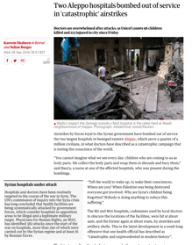
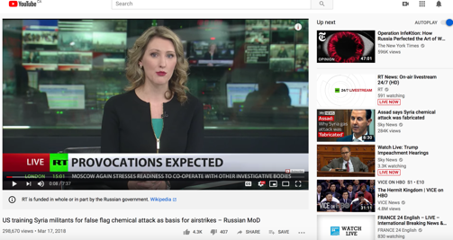
Background
Develop a method for analysis of strategic narratives in online political communication
  Two types of texts (so far):
  news articles and broadcasting news items
&
Empirical objective: identify patterns of similarities and differences in the deployment of production and aesthetic features in news articles and broadcasting items.
Analytical objective : go beyond the analysis of news’ linguistic features to understand how para-linguistic modes of communication (e.g., layout and composition, Image motif and aesthetics, image-text relations, navigation) accentuate and nuance the meaning, and convey the emotional content, of online articles and broadcasting items.
—i.e., NOT only what is being said BUT how it is being said (and consumed by audience online)

Slide 3
Paper Outline
Multimodal discourse analysis
  And our approach therein
The Method (at present, and still untitled)
  Transcription procedures
  Coding classification/ Data dictionary
  Techniques for analyzing multimodal narrative
Areas for future work (for the Q&A—if interested)
  Automating transcription and coding
  Areas of application
  Sampling

Slide 4
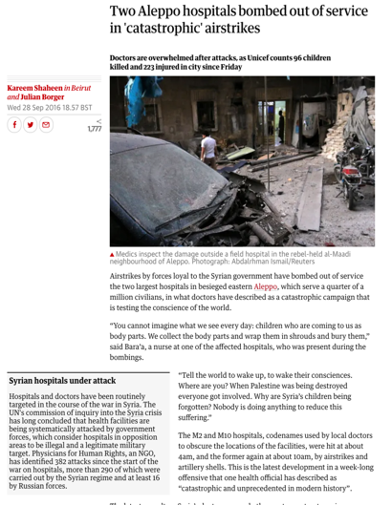
Multimodal Discourse Analysis
An integrative approach for analyzing the communicative potential provided to “readers” by multimodal texts (i.e., texts that combine a range of linguistic, visual, and design resources/modes).
Advanced in two fields (with common roots in SFL):
  Social Semiotics
  Corpus Linguistics
Uptake in:
  Visual and political communication
  Education
  Other disciplines (e.g. HCI, Design)

Slide 5
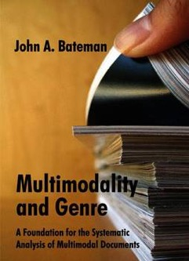

Corpus Linguistics
  Bateman, John. 2008. Multimodality and Genre: A Foundation for the Systematic Analysis of Multimodal Documents. New York: Palgrave Macmillan.
  Seizov, Ognyan. 2014. Political Communication Online: Structures, Functions, and Challenges. New York: Routledge.
  Bateman, John, Janina Wildfeuer, and Tuomo Hiippala. 2017. Multimodality: Foundations, research and analysis—A problem-oriented introduction. Berlin: Walter de Gruyter.
This work offers more rigours techniques for transcription, annotation, and classification—what we call the scholarly primitives of distant reading.
Social Semiotics
  Kress, Gunther, and Theo Van Leeuwen. 2001. Multimodal Discourse: The Modes and Media of Contemporary Communication. New York: Oxford University Press.
  Kress, Gunther. 2010. Multimodality: A social semiotic approach to contemporary communication. New York: Routledge.
  Van Leeuwen, Theo. 2005. Introducing social semiotics. New York: Routledge.

Slide 6
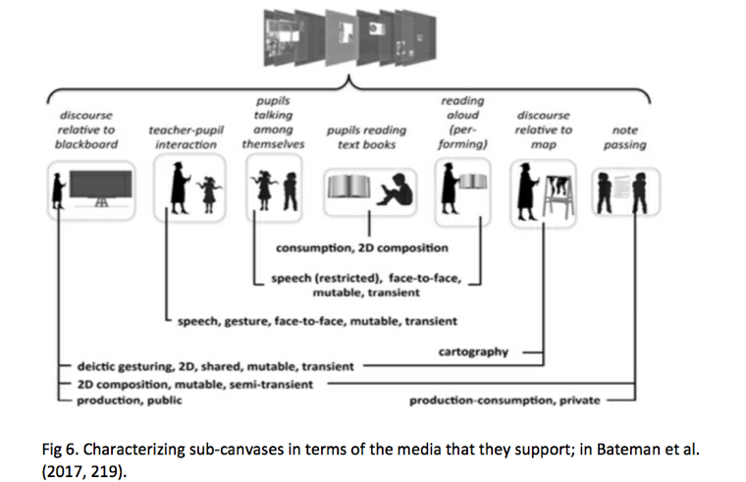
Transcription – the Virtual Canvas
Multimodal texts offer a diverse range of communicative resources that can be articulated differently in the virtual canvas.

Slide 7
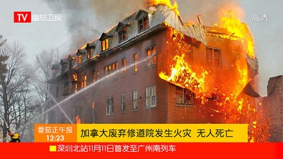

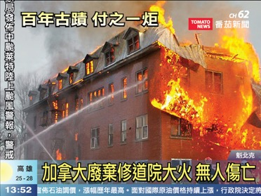
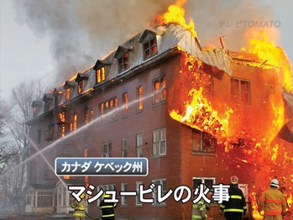
Mainland China
Hong Kong
Taiwan
Japan
Source: Television news screen layout, URL: https://en.wikipedia.org/wiki/Television_news_screen_layout

Slide 8
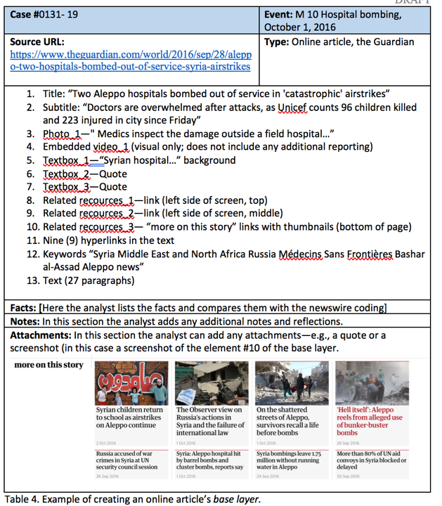
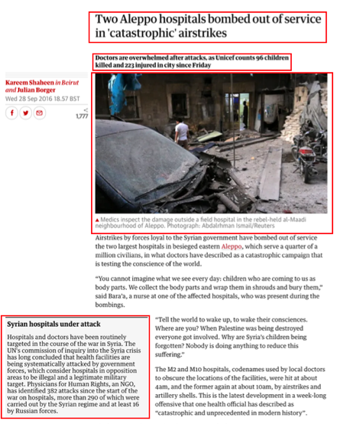
#1 Title
#2 Sub
=
#3
Photo1

Slide 9
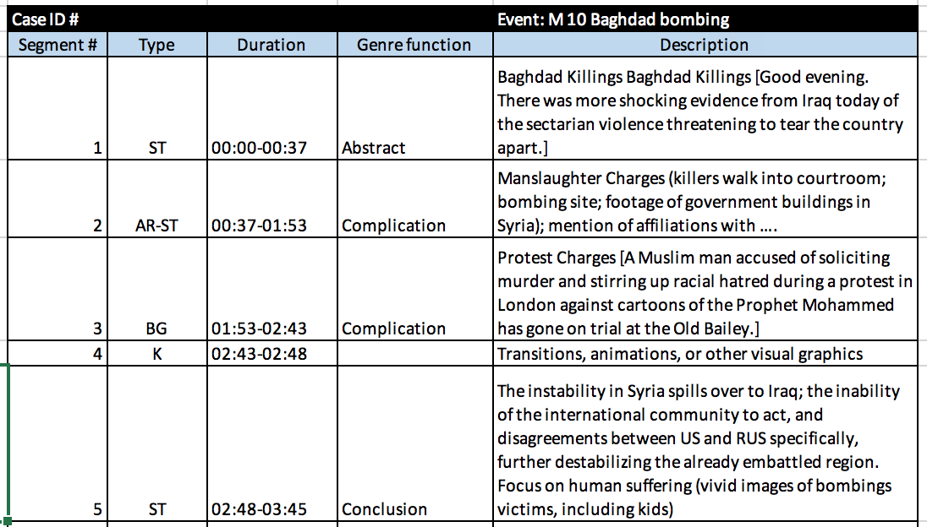
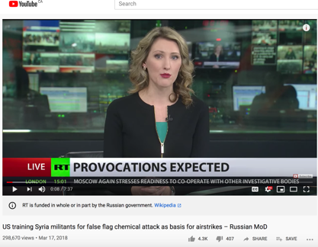
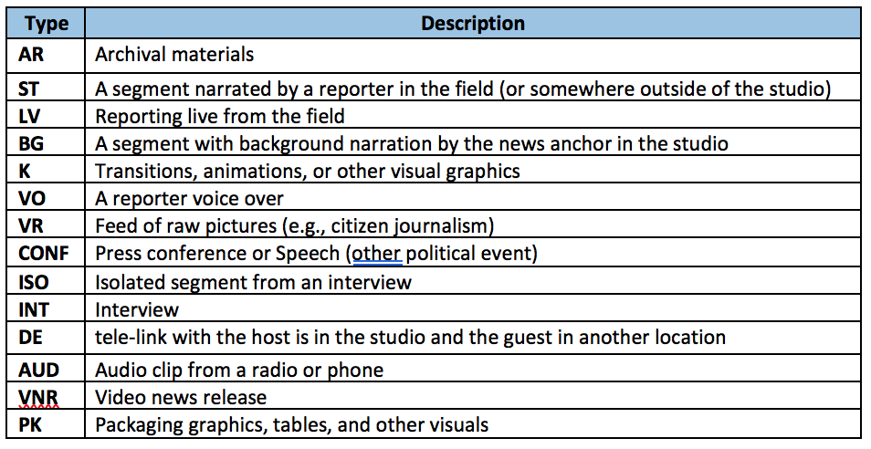
=

Slide 10
Coding
Our coding approach follows the logic of the GeM model (extended by Seizov [2014]) —the multimodal text is broken down into layers, and each layer is classified separately.
Layout type
Five (5) layers:
  Layout
  Visual
  Multimodal composition
  Narrative relationship
  Navigation
A total of 23 properties across the 5 layers.
Each property can take between 3 to 5 values.
Layout
Layout structure
Layout complexity
Visual type
Image colour
Visual
Visual
Image distance
Image angle
….

Slide 11
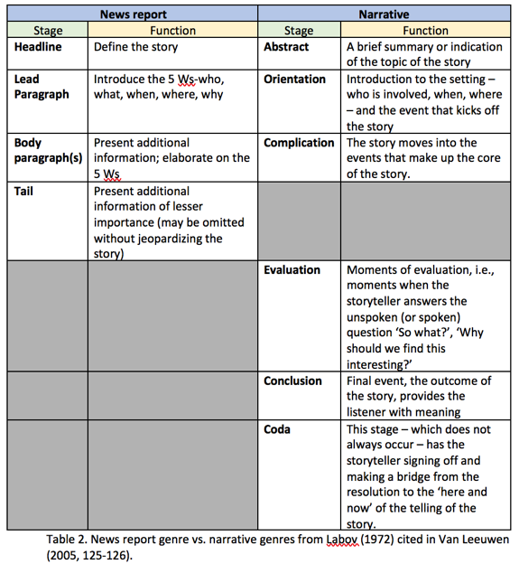
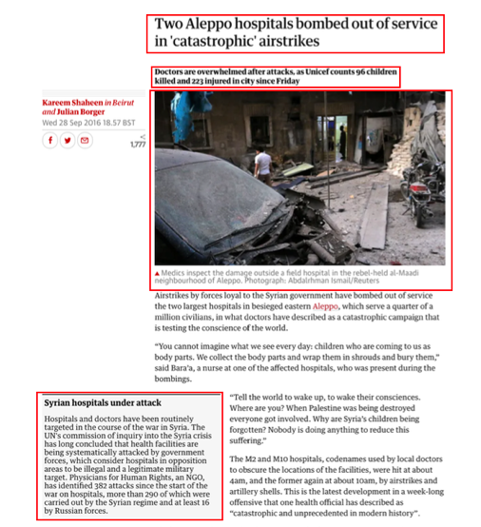
Analysis : Narrative
#1 Title
#2 Sub
#3 Photo1

Slide 12
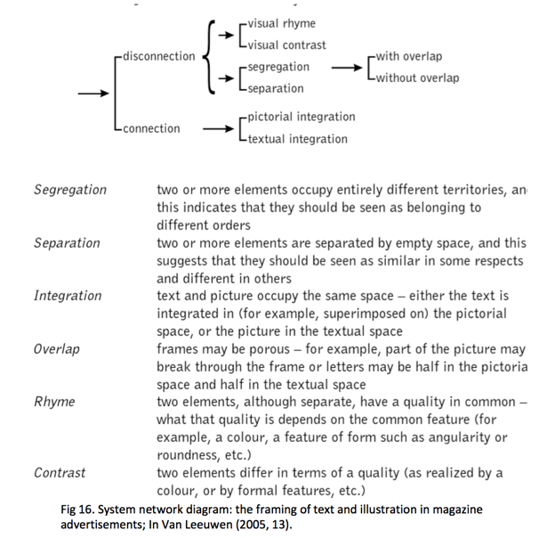
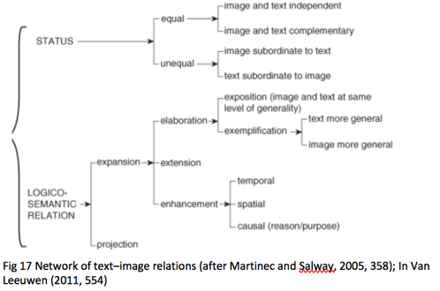
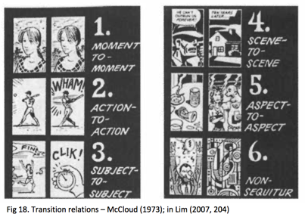
Analysis : Image-Text; Rhythm; Transitions

Slide 13


Future work
How to automate
  See, https://doi.org/10.1080/1472586X.2016.1173892
Areas of application
  Communication research
  DH-education
    See, http://web.mit.edu/hyperstudio/ans/NEHWhitePaper2016_AnnotationStudio.pdf
Sampling/Design
  Corpora vs. Archive
    See, http://www.helsinki.fi/varieng/series/volumes/19/introduction.html

Slide 14
Thank you!
Please get in touch. Let’s collaborate!
@KenzieBurchell
kenzie.burchell@utoronto.ca
ivanova@uoguelph.ca

