Slide 1

Intro to Citation
A Supplement to Your Graduate Studies
Presented By: Jamaica Jones
PhD Student, University of Pittsburgh School of Computing and Information

Slide 2
Agenda
Introduction to Citation
Why We Cite
When We Cite
How We Cite
1
4
4.a
Citation Style
2
4.b
Citation Tools
3
5
Why Citation is Important

Slide 3


Hello!
I'm Jamaica.
PhD Student, University of Pittsburgh School of Computing and Information, Information Culture and Data Stewardships
Research Interests: Research assessment, citation analysis, scientific values
M.A. from NYU
I HAVE CREATED CITATIONS ON A TYPEWRITER.

Slide 4

What is Citation?
Noun.
A reference, in writing, to an external source.
Verb.
The practice (in writing) of referencing external sources

Slide 5

What is Citation?
Parenthetical.
"Citation has been argued to be an infrastructural device within scholarly communications (Wouters 52)"
Notation.
"Christine Borgman notes that where, when and whom to cite are among the many decisions authors make.¹ "
¹ Borgman, Christine L. “The Continuity of Scholarly Communication.” In Scholarship in the Digital Age: Information, Infrastructure, and the Internet, 47–74. Cambridge: MIT Press, 2007. http://ebookcentral.proquest.com/lib/pitt-ebooks/detail.action?docID=3338751.

Slide 6

What is Citation?
Bibliography
Borgman, Christine L. “The Continuity of Scholarly Communication.” In Scholarship in the Digital Age: Information, Infrastructure, and the Internet, 47–74. Cambridge: MIT Press, 2007. http://ebookcentral.proquest.com/lib/pitt-ebooks/detail.action?docID=3338751.
Wouters, Paul. “The Citation: From Culture to Infrastructure.” In Beyond Bibliometrics: Harnessing Multidimensional Indicators of Scholarly Impact, edited by Blaise Cronin and Cassidy R. Sugimoto, 47–66. Cambridge: The MIT Press, 2014. http://direct.mit.edu/books/book/4039/chapter/167946/Science-Metrics-and-Science-Policy.

Slide 7

Why Do We Cite?
Documentation
Acknowledgement
Let your readers know when/where you are drawing on the work of others
Give credit where credit is due
Honesty
Respect
Avoid plagiarism by identifying sources
Help your readers back up your claims
Context
Practice
Center your work in a broader discourse
Learn what it means to contribute to your field
Notes:
Those are the basics of what citation is. Now I want to take a few minutes to consider why we do it.
It may be that thus far in your career, you’ve included citations in your writing just because you had to. But there are other reasons – and truly important reasons – why we cite. Some of them are important no matter what stage of your career your in. I would guess that you’ll find that others begin to take on new importance as you progress through your doctoral studies.
Some of the reasons that are always important have to do with documentation, context and honesty. You want to let your readers know when and where you are drawing on the work of others and, particularly as a doctoral student, you’ll want to center your work in a broader discourse as much as possible. Citation does this, as your readers will be able to infer quite a bit just by way of the sources that you draw in to support your own a positions.
You were likely reminded last week in your conversation about research ethics that citation is also essential – critical – in avoiding plagiarism precisely because citation provides acknowledgement, giving credit where credit is due.
Two other reasons that I personally have come to value more and more as I have moved through my own doctoral adventure include respect and practice. If you think about it, citation really offers a nod of respect to your reader – it says, “hey. I know you’re smart and I don’t expect you to take my word for this. Go check out this work over here and that work over there and tell me if you come to the same conclusion that I have”. In this sense, it also suggests a healthy level of confidence. “I don’t need to hide my sources, because anyone who reads this article I’m referencing would come to the same conclusion.”
Finally, it’s also excellent and necessary practice. It’s not a given that because you’re pursuing a PhD you’ll be going into academia or research but it is likely that whatever position you hold on the other side of this, you will be producing some work that is developed on the work of others. So it is therefore also likely that you will need to know how citation works in your field. This is the time to start practicing.

Slide 8

When Should We Cite?
1
When the fact or arugment was established by someone else
2
When the fact or arugment is not commonly known outside of the given context
3
When in doubt

Slide 9

When Should We Cite?
1
Quoting
2
Paraphrasing
3
Summarizing
4
Facts, stats, etc.
https://www.bu.edu/sph/students/student-services/student-resources/academic-support/communication-resources/when-to-cite/
5
Indebtedness

Slide 10
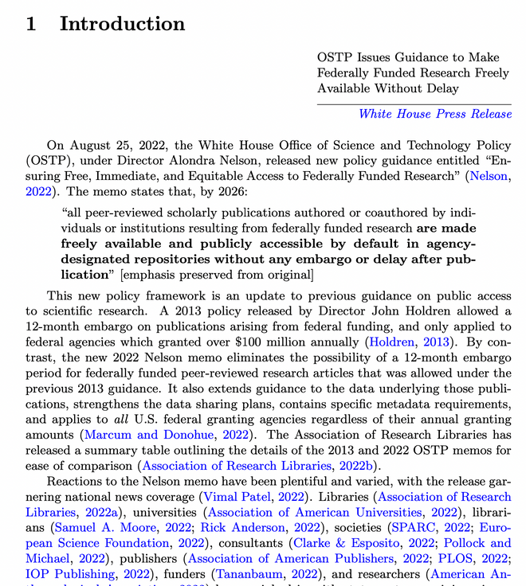
When Should We Cite?
Eric Schares, “Impact of the 2022 OSTP Memo: A Bibliometric Analysis of US Federally Funded Publications, 2017–2021,” Quantitative Science Studies 4, no. 1 (March 1, 2023): 1–21, https://doi.org/10.1162/qss_a_00237.

Slide 11

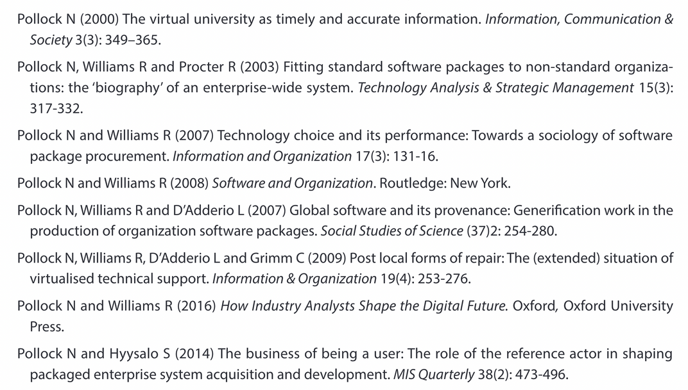
When Should We Cite?

Slide 12

How Do We Cite?
This is a matter of custom
Citation styles are dictated by scholarly publishers
And of technology
Citation management software makes the tedious tolerable
Zotero
Mendeley
EndNote
O for bubbles
C for confetti
U for unveil
Q for quiet
D for a drumroll
B for blur
Any number from 0-9 for a timer
M for mic drop
Notes:
Alright, so, we’re writing and we know that it’s time for us to include a citation. How do we do it? The answer is determined by both custom and by – gratefully – technology.
In terms of custom, what I am referencing here is that each discipline generally has its own standards and practices when it comes to the proper formatting of a citation. I will get to those on the next slide.
Before I do, this is the moment where I again sing the praises of citation management software solutions. There are a number of options you can choose from – some of the most common are Mendeley, EndNote and Zotero, which is what I use. Many are free to download and use, and basically all of them will format both your citations and your works cited lists with just a few clicks of a button. Many of these programs also feature other research management tools, including supporting note taking and hosting pdf copies of your sources. Zotero allows me to mark up these pdfs with comments and highlights and will store my notes as related resources, keeping everything that I need to manage my literature reviews and other writing all in one place.

Slide 13



What is Citation Style?
Modern Language Association (MLA)
https://style.mla.org/mla-format/
American Psychological Association (APA)
https://apastyle.apa.org/
Chicago Style
https://www.chicagomanualofstyle.org/tools_citationguide.html
O for bubbles
C for confetti
U for unveil
Q for quiet
D for a drumroll
B for blur
Any number from 0-9 for a timer
M for mic drop

Slide 14

Why is Citation Important?
1
Acknowlegement
2
Documentation
3
Honesty
4
Context
5
Credit

Slide 15
Why is Citation Important?
1
Credit
2
Credit
3
Credit
4
Credit
5
Credit

Slide 16
Why is Citation Important?
5
Credit
Citations are taken as proxies for quality and impact
The academic reward system prioritizes credit for citations.
Hiring, promotion & tenure review are based on citation metrics
Knowing how to cite accurately is a critical skill in the professional development of any information professional

Slide 17
Citation Resources
1
Purdue OWL: https://owl.purdue.edu/
2
Hillman Library: https://pitt.libguides.com/researchhelpuls/writing-reviewing-citing
3
Citation Management Software (Zotero)
4
Pitt’s Graduate Writing Center: https://www.writingcenter.pitt.edu/graduate-services

Slide 18


Thank you for listening!
jaj160@pitt.edu

