Slide 1
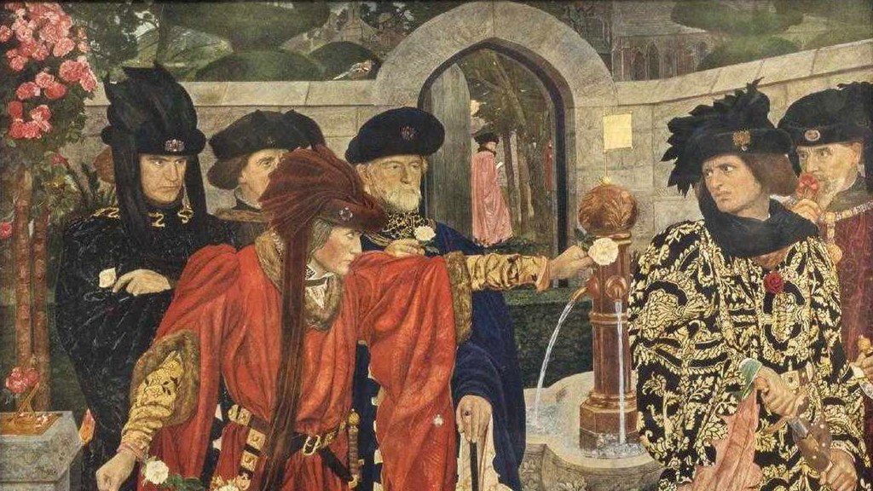
The Wars of the Roses
ENGL 212

Slide 2
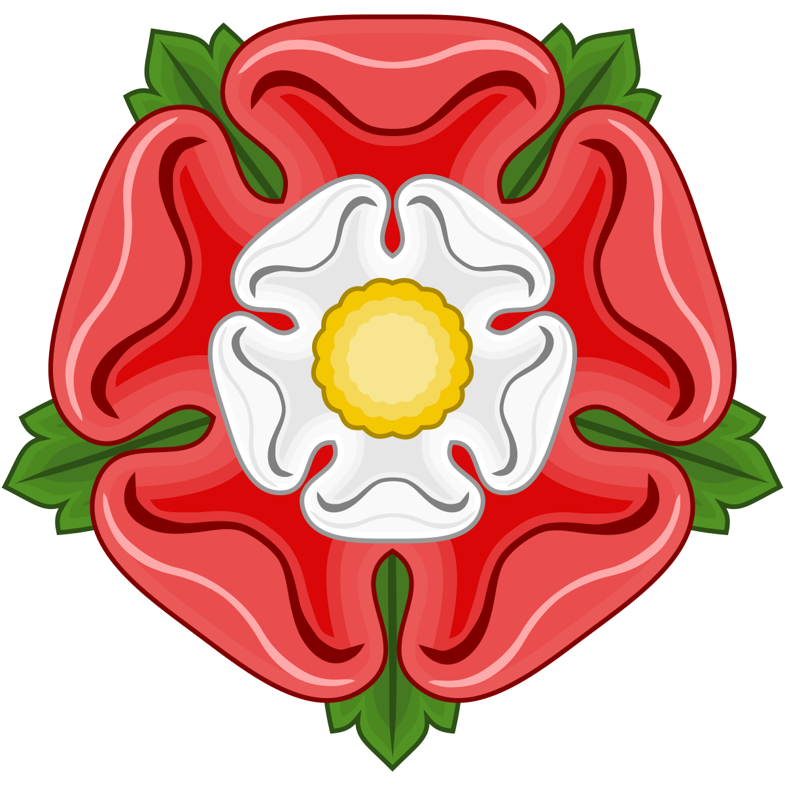
Overview
English war of dynastic succession, 1455-87
Ends in the rise of the Tudor dynasty (Elizabeth I’s family)
Gets its name from Shakespeare
Scene in Henry VI, Part 1
White rose: House of York
Red rose: House of Lancaster*
Symbolically combined in the Tudor rose (left)
Shakespeare writes eight plays about the WotR
Early plays: Henry VI Parts 1, 2, & 3, Richard III
Late plays: Richard II, Henry IV Parts 1 &2, Henry V
The late plays are first chronologically

Slide 3
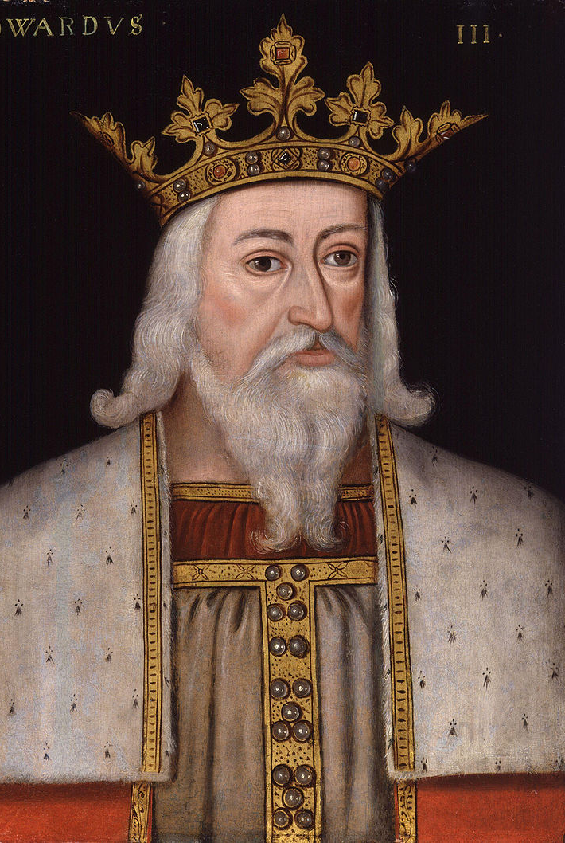
Edward III’s Descendants
Edward, the Black Prince
Lionel of Antwerp, Duke of Clarence
John of Gaunt, Duke of Lancaster
Edmund of Langley, Duke of York
Thomas of Woodstock, Duke of Gloucester (“gloss-ter”)

Slide 4
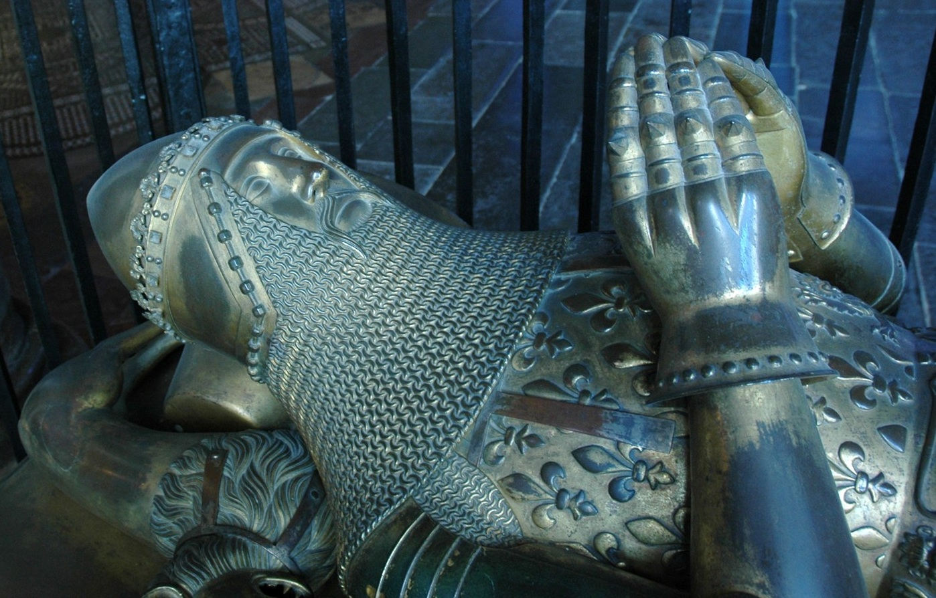
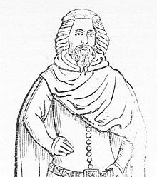
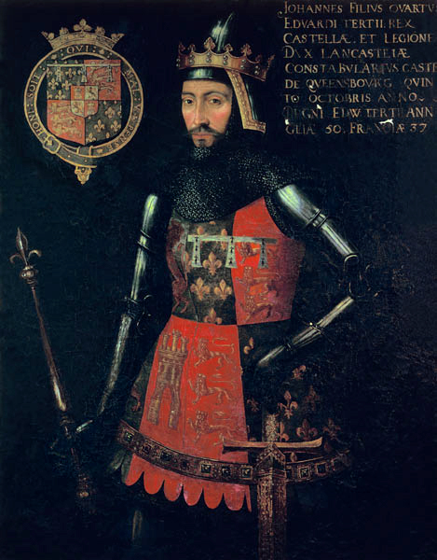
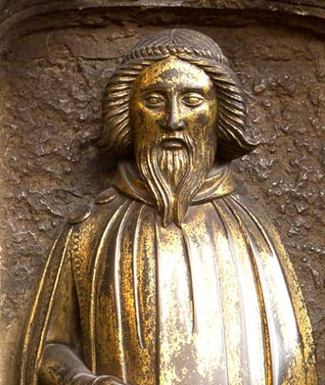
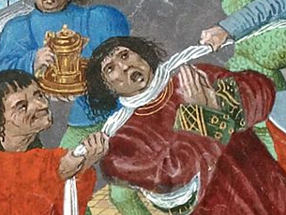
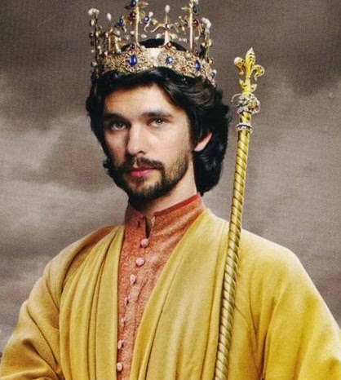
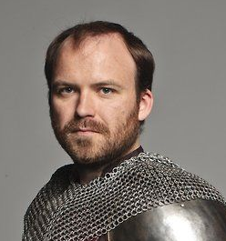
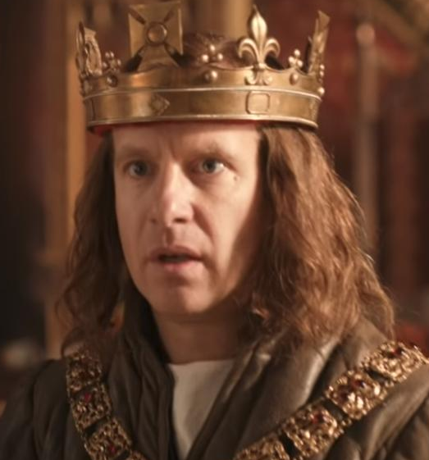
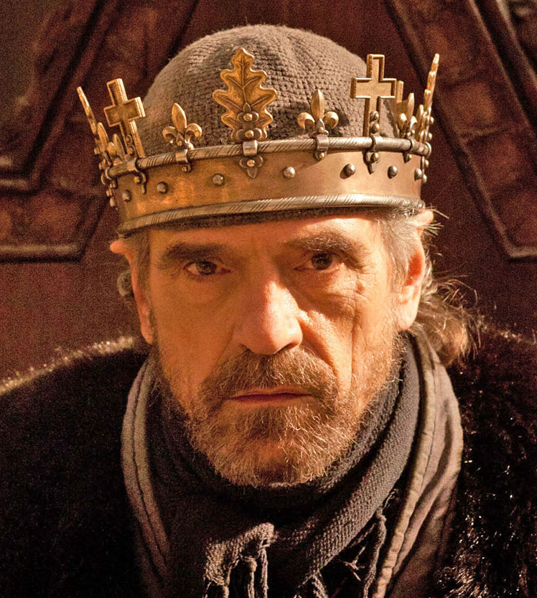
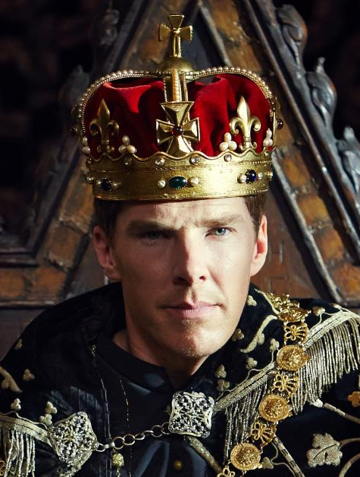
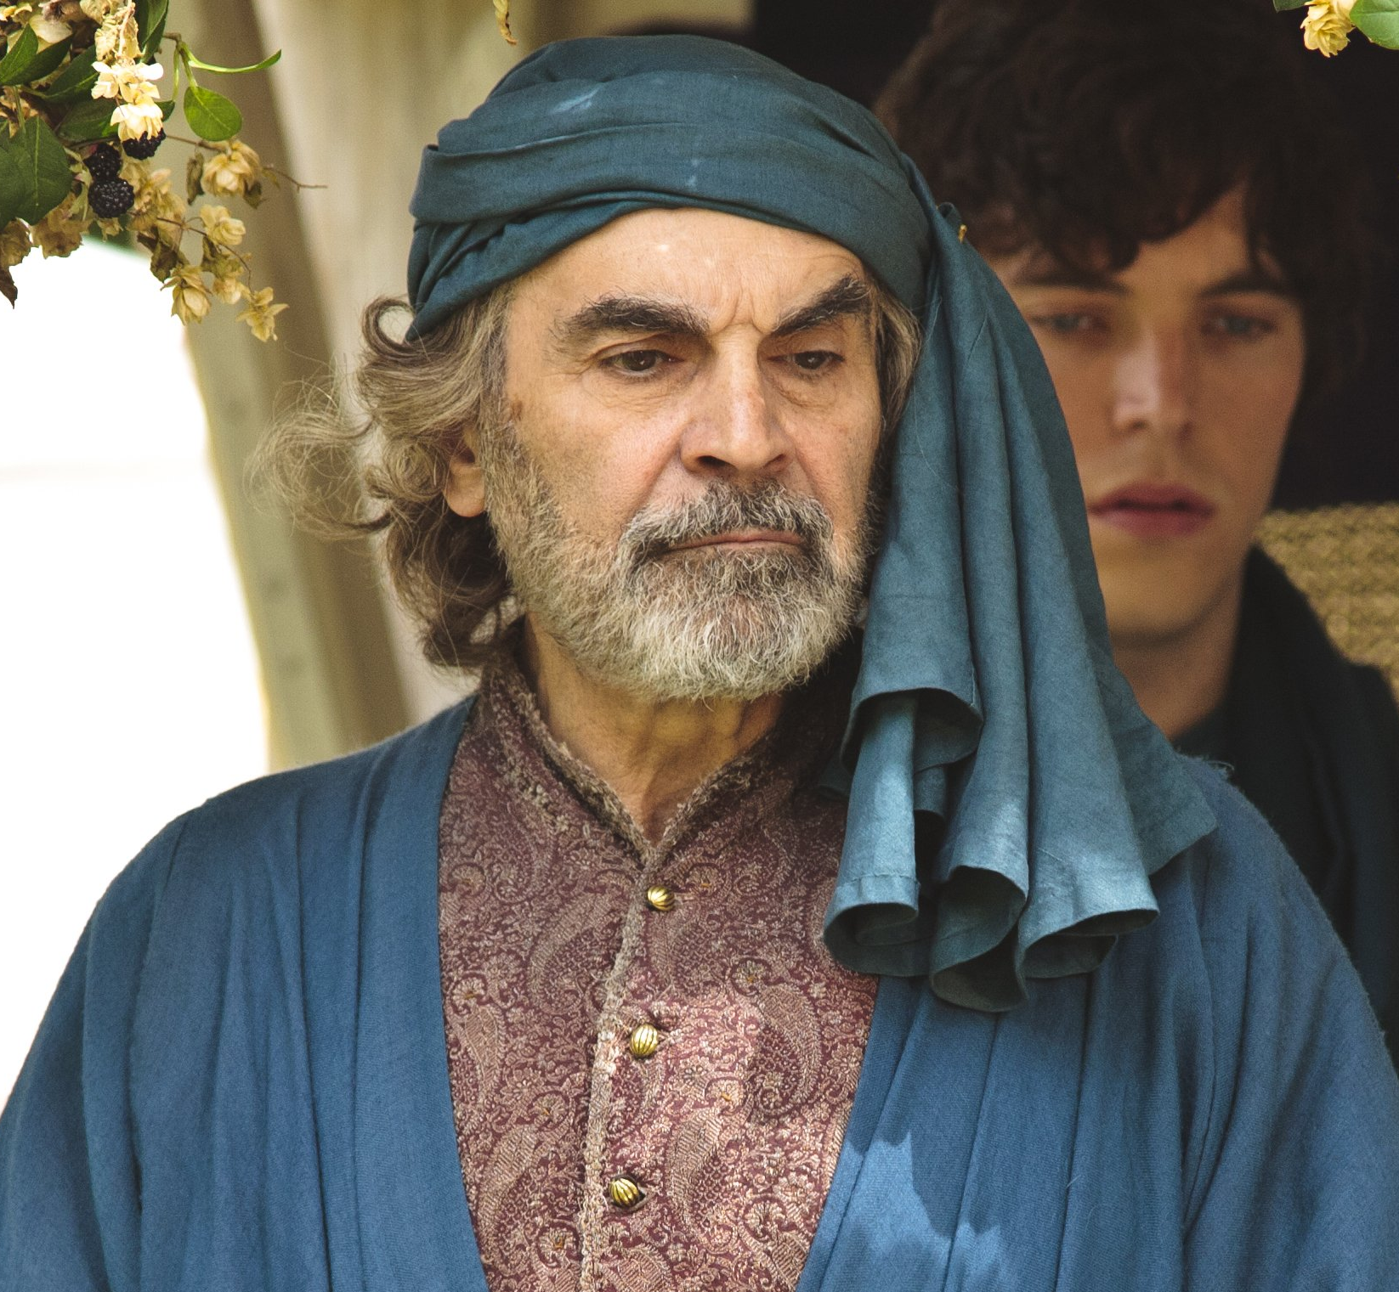
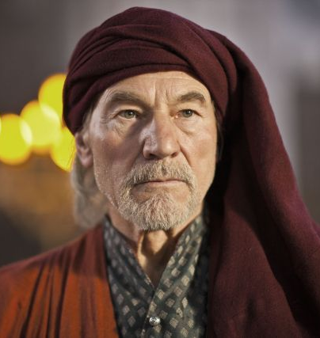
Edward the Black Prince
Lionel of Antwerp
Duke of Clarence
John of Gaunt
Duke of Lancaster
Edmund Langley
Duke of York
Thomas of Woodstock
Duke of Gloucester
- Dies before his father
- Son becomes king Richard II
- Rebelled against Richard II
- Was murdered, probably by Thomas Mowbray on Richard’s orders
- No sons
- Daughter’s line marries into the York family
- York family uses daughter’s line to strengthen claim over Lancaster
- Son is Henry Bolingbroke, who usurps throne from Richard II and becomes Henry IV
- Head of Lancaster line
- Grandson is Richard Plantagenet, who leads the Yorkists
- Two great-grandsons become kings, Edward IV and Richard III
In the Hollow Crown Richard II →

Slide 5
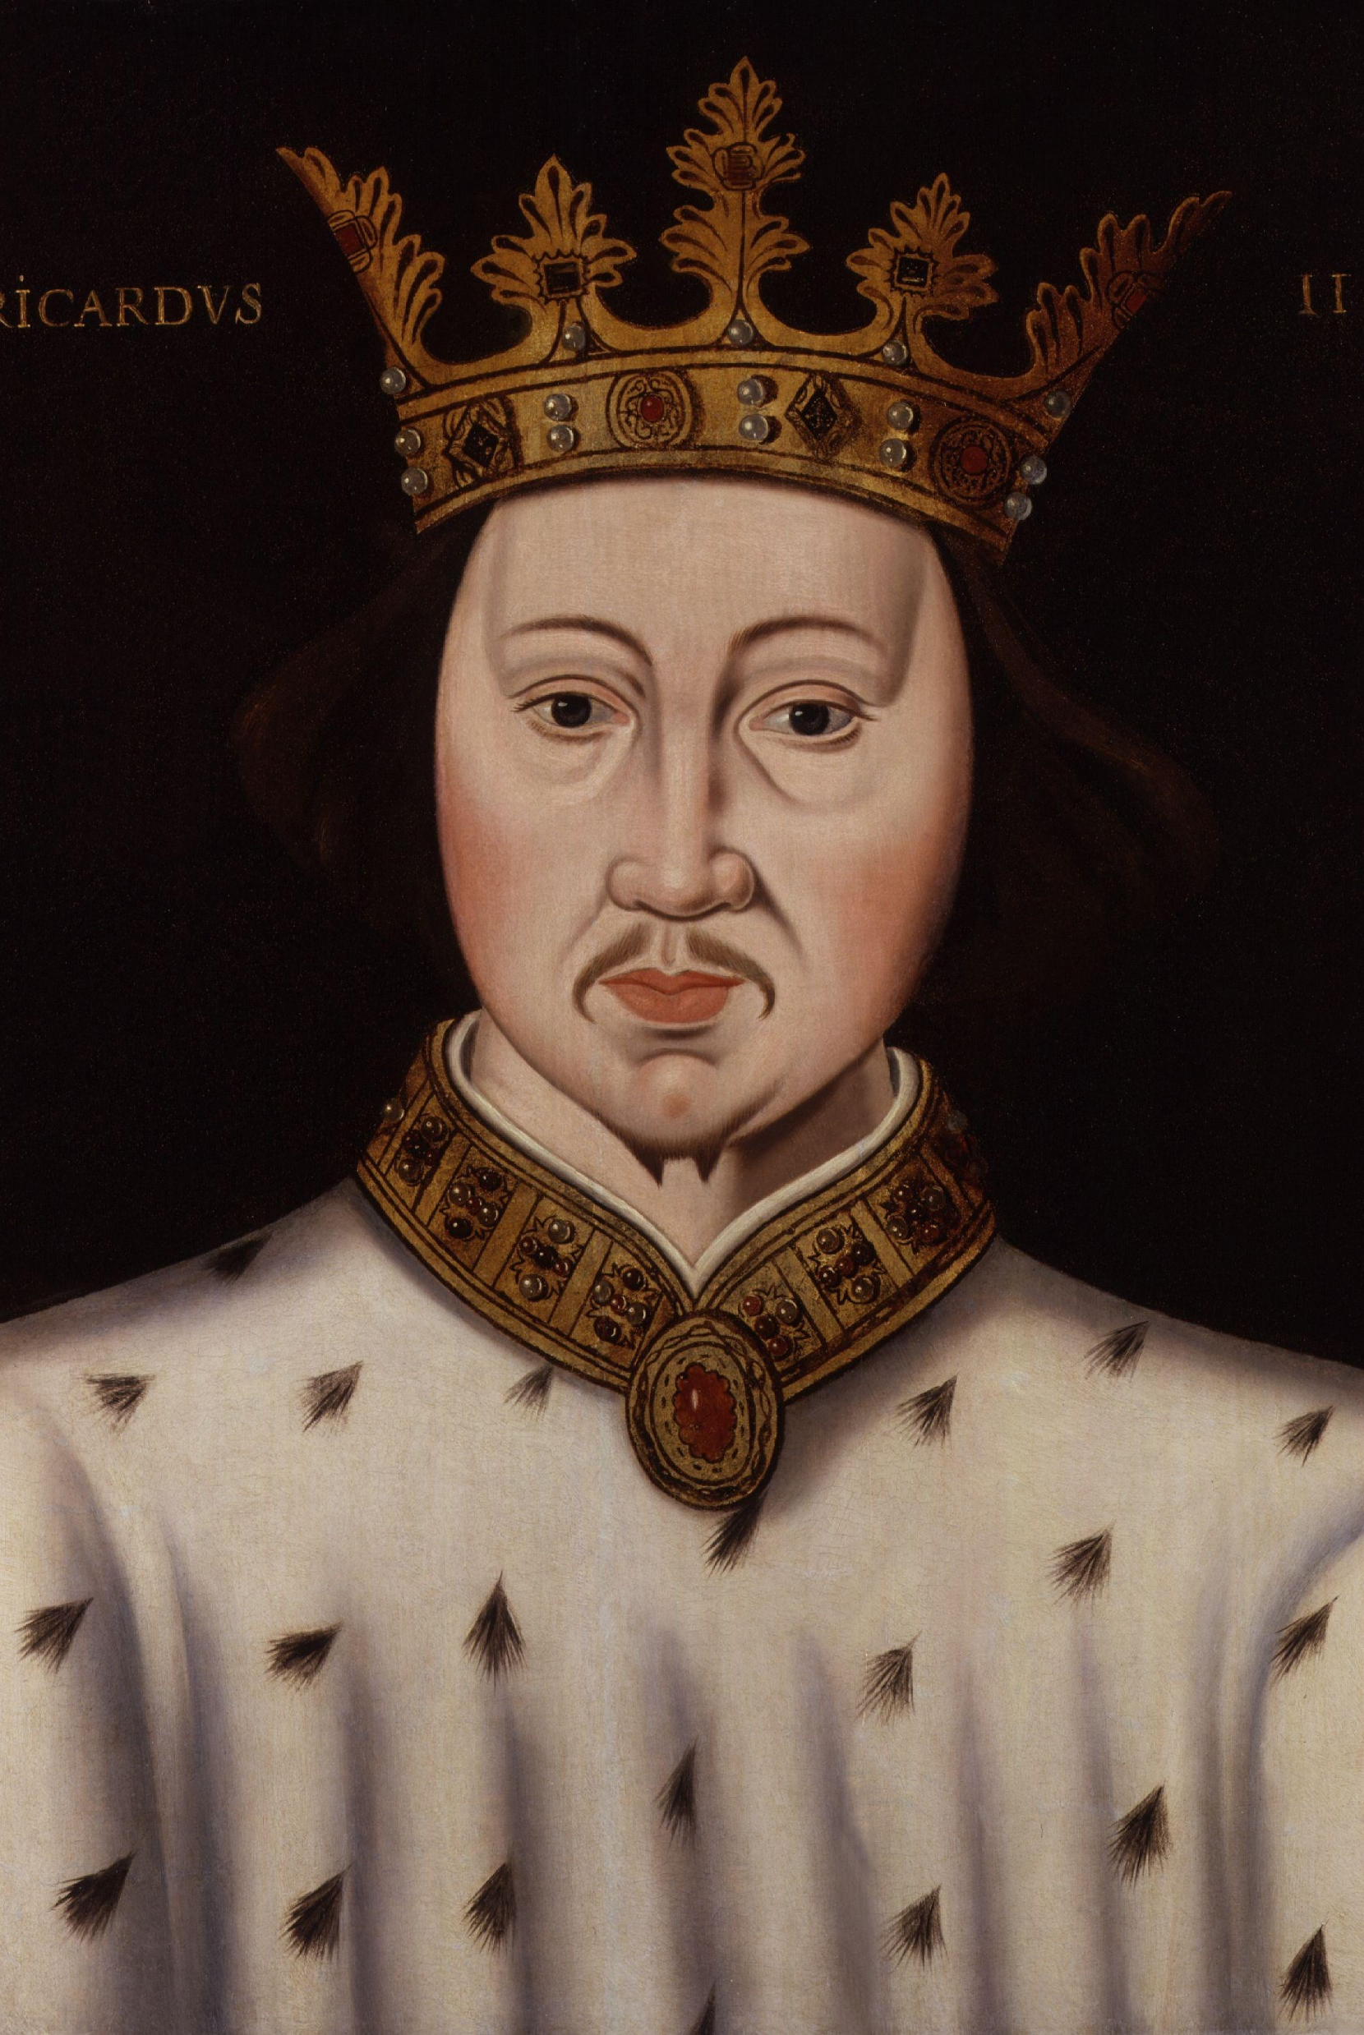
Sources of Conflict
“Over-mighty subjects” → People who are not the king having more money, land, and soldiers than the king
Richard II is viewed as a weak king by his uncles and most of the public
Richard may have had one of his uncles murdered
Richard is bad at managing money
When he needs money to fund his war, he confiscates his cousin’s inheritance

