Slide 1
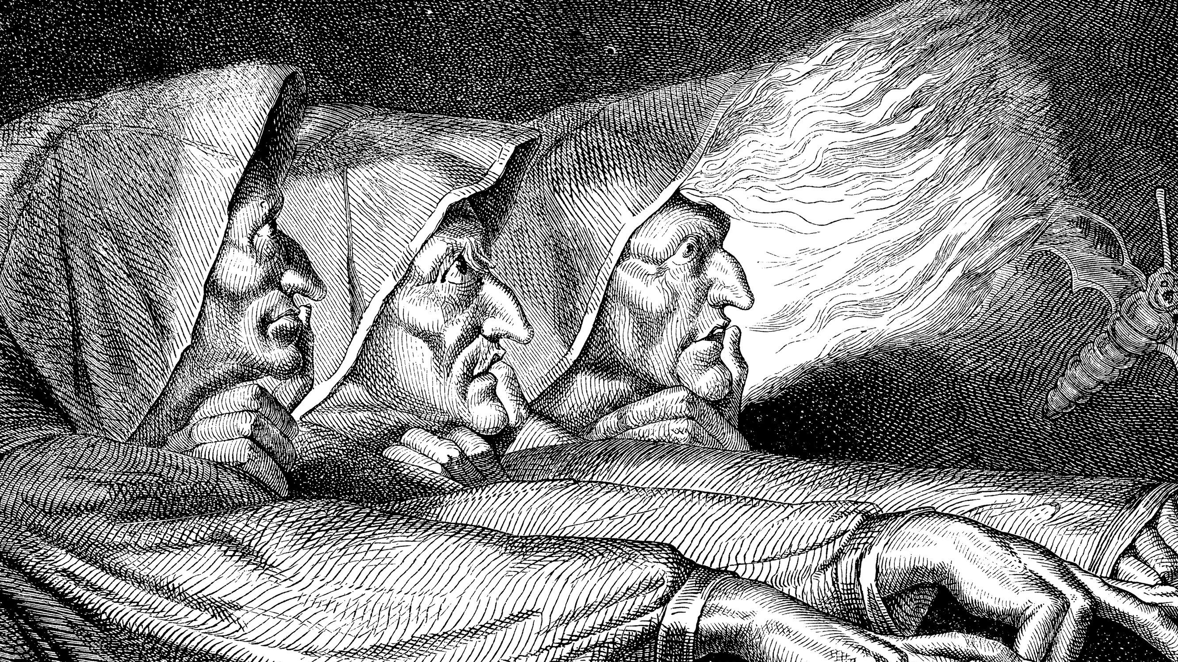
Macbeth
ENGL 212

Slide 2
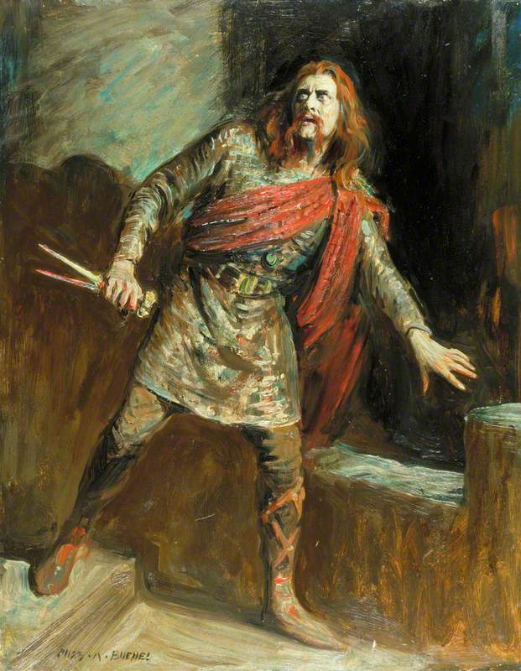
Overview
Written 1606-7
King James on the throne (Liz died in 1603)
Last in a series of “great tragedies” on the nature of spiritual evil? (Hamlet, Othello, King Lear)
Historical Macbeth (1005-57) lived pre-Norman Conquest of England. “King of Alba” aka Scotland
Shx’s Macbeth comes from Holinshed’s Chronicles
Real Macbeth not a murdering usurper
King James thought he was descended from the real Banquo (there wasn’t one)

Slide 3
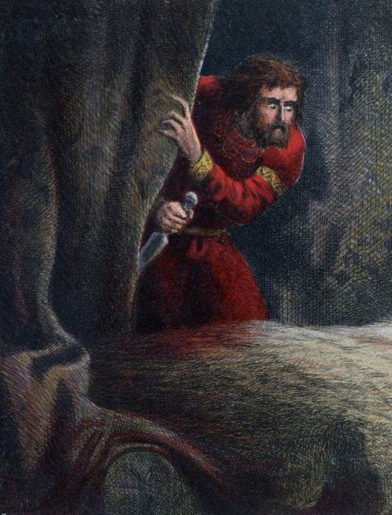
Early Modern Tragedy
Tragedy is didactic, cathartic
Tragedy tells the story of a person who falls from grace by their own doing
Hubris, the fatal flaw of pride
Anagnorisis, the moment of recognition
Senecan Tragedy
Revenge plays
Extremely violent, bloody
Presence of ghosts
Themes of madness vs. sanity

Slide 4
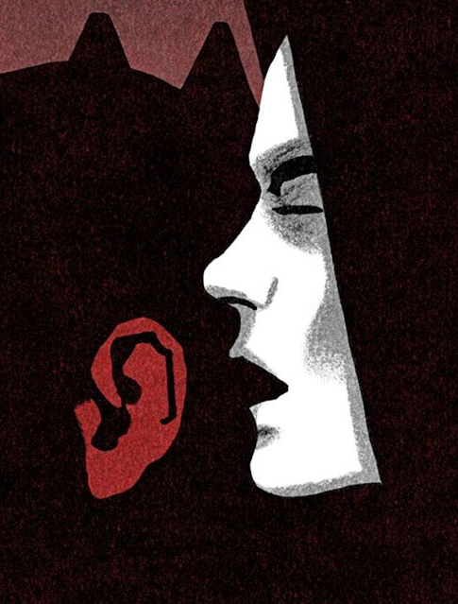
Becoming Evil
How do regular people commit evil acts?
Self and not-self: how to un-make who you are?
“The Alien Word” – something else plants the idea in your head
But why would a good person listen? Are they already bad somehow?
Overhearing yourself
Hamlet and Macbeth’s non-action

Slide 5
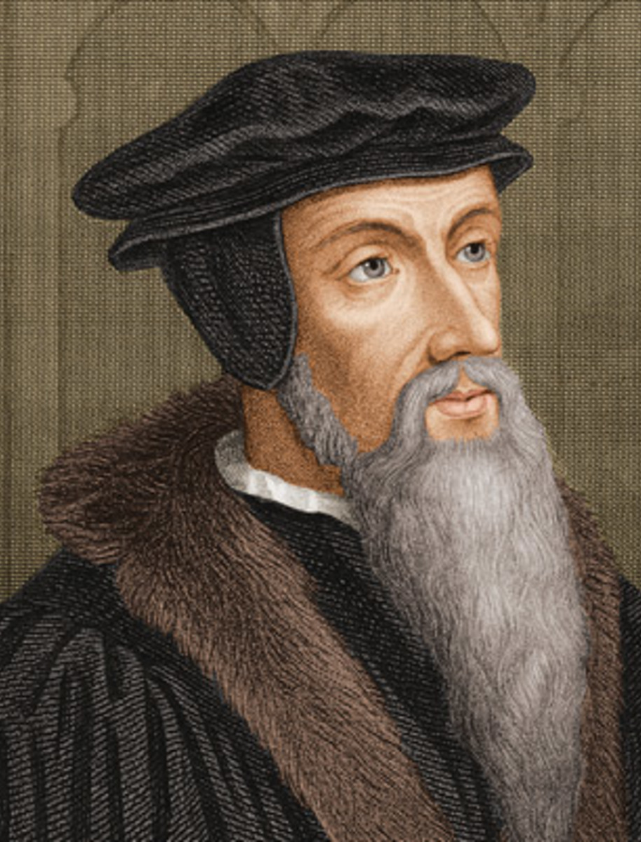
Calvinism & Sin
Calvinism – named for John Calvin (1509-64), a French Reformer and theologian
Limited Atonement aka “Predestination”
Actually, double predestination
God’s omniscience and omnipotence
Why is God not evil?
Damned people damn themselves
God is not the cause of their evil, only judge
Determining election – reading the self

Slide 6
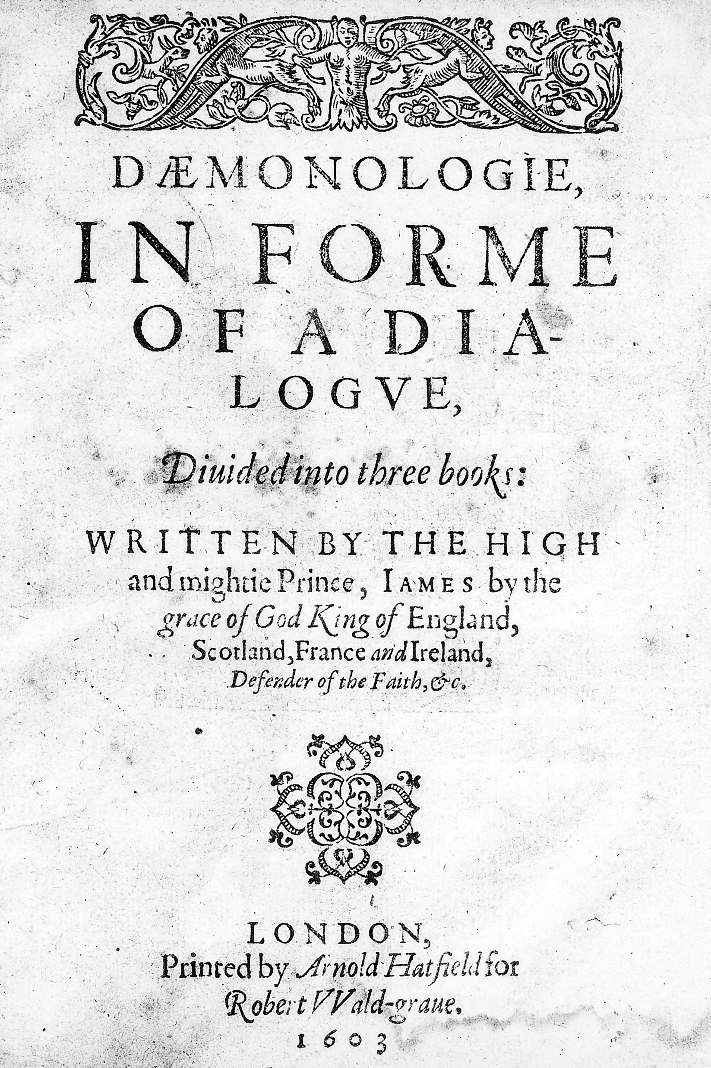
Early Modern Witches
Witches believed to be brides of the devil
Reverse of the nun-Christ relationship
Explicitly physical, not only spiritual
Witches are seen as political traitors, punishable by death
King James, demonologist and author
Gunpowder Plot, 1605
Scottish Witchcraft Act of 1563
North Berwick witch trials (ran for 2 years, implicated over 70 people)
Caused by incident involving James’ marriage to Anne of Denmark

