Slide 1
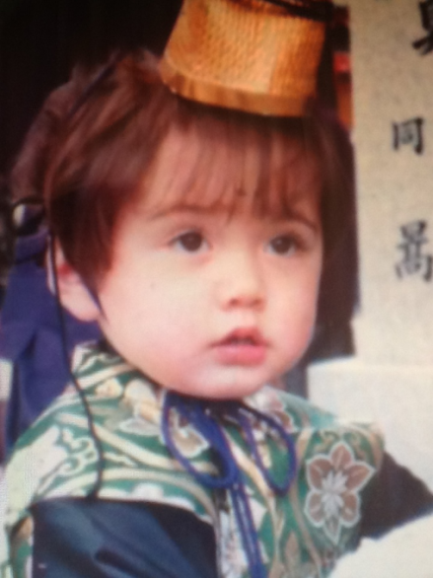

International Marriage
and Bilingualism in Japan
by Steve McCarty (Osaka Jogakuin University) Fun Quiz with Answers: Download this worksheet >
https://hcommons.org/app/uploads/sites/1001531/2022/02/Fun_quiz_worksheet-1.docx
Print it out for students > Project this presentation!

Slide 2
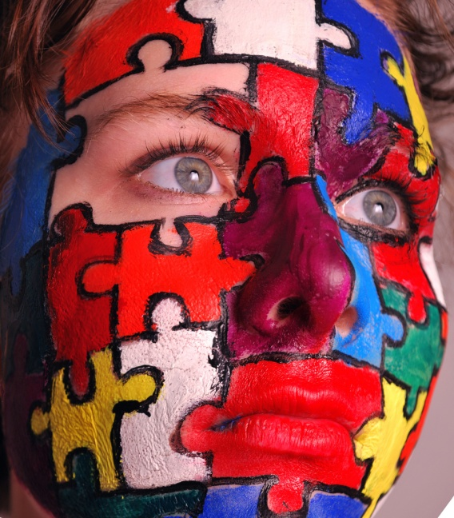
Fun Quiz
Just guess or listen carefully
to be a winner!
First, do you know what Western
people (Europe, U.S.A., etc.) look like?
Circle the right answer on the handout.
Watch out: This
is a trick!
What is the most common hair color of Westerners?
a) blond or light brown b) dark brown or black c) red
2. Most common eye color? a) blue b) brown c) black
Is it possible to have green eyes if one parent has
blue eyes and the other parent has brown eyes?
Yes No

Slide 3
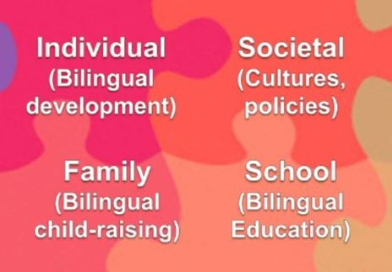
Levels of Bilingualism
There is some overlap in the levels. For example,
language shift can happen at any of the levels.
Remember these levels for the next fun quiz questions.

Slide 4



Fun Quiz questions about the Levels of Bilingualism
4. Raising a child to be bilingual is what level? a) Individual bilingualism b) Family bilingualism c) Societal bilingualism d) Bilingual Education
5. A type of bilingual, for example, dominant in one language and weaker in the other language, is what level? a) Individual bilingualism b) Family bilingualism c) Societal bilingualism d) Bilingual Education
6. Attitudes of powerful groups that affect schools are what level?
a) Individual bilingualism b) Family bilingualism c) Societal bilingualism d) Bilingual Education

Slide 5
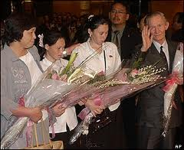
Family Bilingualism and Language Shift:
Example of the Jenkins-Soga family
BBC News photo
Use the details below
to answer the next
fun quiz questions
Jenkins is from “a poor community in North Carolina, where he dropped out of school, aged 15, to join the US Army.” After he, Belinda and Mika went to Japan,
“Soga's dream had finally come true, but the transition to life in Japan has been a struggle. Jenkins speaks no Japanese, and relies on Korean to communicate with his family, a situation he describes as ‘difficult’. ‘I've spoken more Korean than I have English; I've spoken it for 40 years. Sometimes I even think in Korean. I’ve got to learn Japanese," he says. His daughters have quickly become fluent [in Japanese] and are settling down in Sado“ - The Independent, 7 March 2006
In North Korea, Hitomi Soga never told her daughters that she was Japanese.

Slide 6
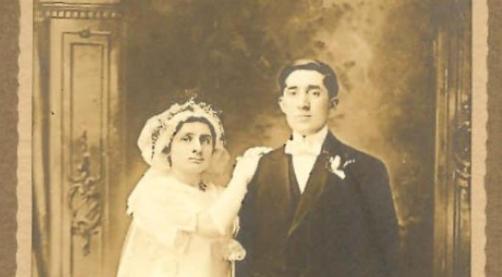
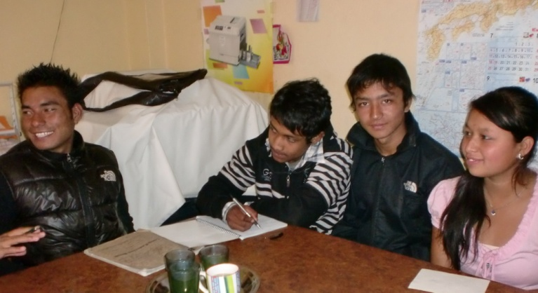
Questions about the Jenkins-Soga family
7. Are all of the Jenkins-Soga family members bilingual (or multilingual)? Yes No
8. In North Korea, did Hitomi Soga speak to her daughters in Japanese? Yes No
9. According to the 2006 article, could all of the Jenkins-Soga family members speak Japanese? Yes No
10. Compared to their father, the daughters could quickly learn to speak Japanese mainly because they were a) already educated in Japanese
b) in top schools in Japan c) much more intelligent than their father
d) much younger than their father

Slide 7
International Marriages in Japan
Warm-up questions
11. Which have more international marriages? a) Japanese men
b) Japanese women
12. The partners of Japanese people in international marriages are mostly a) Asians b) Westerners
13. The number of ‘haafu’ children of international marriages born in Japan every year is now about a) 200 b) 2,000 c) 20,000 d) 200,000
Study the next article to see some of the reasons for this trend

Slide 8
“Country kids need language support: Growing educational diversity not limited to urban areas” - The Japan Times, 14 March 2006
“Ji Young was 13 when she moved from Seoul to a small village in Yamagata in 1999. Her mother had arrived from Korea a few months earlier to marry a Japanese man. Entering the local high school, she struggled at first with the language, cultural differences, and relations with friends, though quickly picked up spoken Japanese. … Today, one in 17 (6.1 percent) of all marriages in [Yamagata] prefecture are international marriages, compared with around one in 20 nationally.“
14. According to this 2006 article, what percent of marriages in Japan are international? a) 1% b) 5% c) 6.1% d) 20%
15. According to the title of the article, do Ji Young and foreign kids all over Japan get enough support in Japanese as a Second Language to keep up in Japanese schools? Yes No
16. What is the main reason for many international marriages in Yamagata? a) Globalism b) Internationalization c) Farmers are popular with foreigners d) Farmers are not popular with young Japanese women

Slide 9
“Kids learn and forget quickly” – Daily Yomiuri, 20 July 2004
“The rapid language learning for which children are famous is associated with a rapid forgetting of unused forms. Both learning and forgetting happen quickly in the beginning and decrease with age.“
“There appear to be no negative consequences of students’ exposure to English in Japanese primary schools. Instead there are advantages that have to do with eventual mastery, including pronunciation, automatic production of correct forms, and a feeling of ease with the language.”
Last Fun Quiz Questions
17. If a small child sees a zebra and says “horse,” should parents worry? Yes No
18. Can a second language harm the development of a first language? Yes No
19. When is the best age to start two languages? a) 0 b) 3 c) 6 d) 9 e) 12
20. In 2013 international marriages in Japan have increased to 1 in 18 couples.
‘Haafu’ Christel Takigawa represented Japan in its successful 2020 Olympics bid.
In conclusion, how is Japan changing? a) more crime & higher taxes b) loss of
Japanese culture c) more open-minded & diverse d) English instead of Japanese

Slide 10
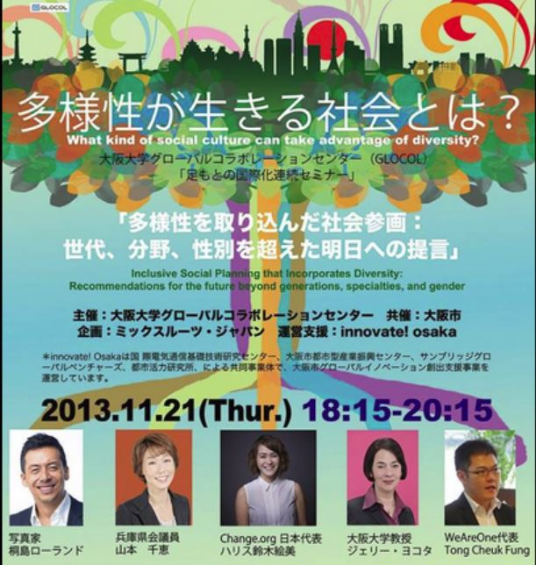
Now let’s correct the Fun Quiz and find out who has the most international knowledge!
Exchange your handout with a partner and correct it in red or another color.
Each question is 5 points for a possible total score of 100. Write the score and give the handout back to the owner.
Then let’s see which students got the
highest scores!

Slide 11
Fun Quiz
Just guess or listen carefully
to be a winner!
First, do you know what Western
people (Europe, U.S.A., etc.) look like?
Circle the right answer on the handout.
Watch out: This
is a trick!
What is the most common hair color of Westerners?
a) blond or light brown b) dark brown or black c) red
2. Most common eye color? a) blue b) brown c) black
Is it possible to have green eyes if one parent has
blue eyes and the other parent has brown eyes?
Yes No

Slide 12
Fun Quiz questions about the Levels of Bilingualism
4. Raising a child to be bilingual is what level? a) Individual bilingualism b) Family bilingualism c) Societal bilingualism d) Bilingual Education
5. A type of bilingual, for example, dominant in one language and weaker in the other language, is what level? a) Individual bilingualism b) Family bilingualism c) Societal bilingualism d) Bilingual Education
6. Attitudes of powerful groups that affect schools are what level?
a) Individual bilingualism b) Family bilingualism c) Societal bilingualism d) Bilingual Education

Slide 13
Family Bilingualism and Language Shift:
Example of the Jenkins-Soga family
BBC News photo
Use the details below
to answer the next
fun quiz questions
Jenkins is from “a poor community in North Carolina, where he dropped out of school, aged 15, to join the US Army.” After he, Belinda and Mika went to Japan,
“Soga's dream had finally come true, but the transition to life in Japan has been a struggle. Jenkins speaks no Japanese, and relies on Korean to communicate with his family, a situation he describes as ‘difficult’. ‘I've spoken more Korean than I have English; I've spoken it for 40 years. Sometimes I even think in Korean. I’ve got to learn Japanese," he says. His daughters have quickly become fluent [in Japanese] and are settling down in Sado“ - The Independent, 7 March 2006
In North Korea, Hitomi Soga never told her daughters that she was Japanese.

Slide 14
Questions about the Jenkins-Soga family
7. Are all of the Jenkins-Soga family members bilingual (or multilingual)? Yes No
8. In North Korea, did Hitomi Soga speak to her daughters in Japanese? Yes No
9. According to the 2006 article, could all of the Jenkins-Soga family members speak Japanese? Yes No
10. Compared to their father, the daughters could quickly learn to speak Japanese mainly because they were a) already educated in Japanese
b) in top schools in Japan c) much more intelligent than their father
d) much younger than their father

Slide 15
International Marriages in Japan
Warm-up questions
11. Which have more international marriages? a) Japanese men
b) Japanese women
12. The partners of Japanese people in international marriages are mostly a) Asians b) Westerners
13. The number of ‘haafu’ children of international marriages born in Japan every year is now about a) 200 b) 2,000 c) 20,000 d) 200,000
Study the next article to see some of the reasons for this trend

Slide 16
“Country kids need language support: Growing educational diversity not limited to urban areas” - The Japan Times, 14 March 2006
“Ji Young was 13 when she moved from Seoul to a small village in Yamagata in 1999. Her mother had arrived from Korea a few months earlier to marry a Japanese man. Entering the local high school, she struggled at first with the language, cultural differences, and relations with friends, though quickly picked up spoken Japanese. … Today, one in 17 (6.1 percent) of all marriages in [Yamagata] prefecture are international marriages, compared with around one in 20 nationally.“
14. According to this 2006 article, what percent of marriages in Japan are international? a) 1% b) 5% c) 6.1% d) 20%
15. According to the title of the article, do Ji Young and foreign kids all over Japan get enough support in Japanese as a Second Language to keep up in Japanese schools? Yes No
16. What is the main reason for many international marriages in Yamagata? a) Globalism b) Internationalization c) Farmers are popular with foreigners d) Farmers are not popular with young Japanese women

Slide 17
“Kids learn and forget quickly” – Daily Yomiuri, 20 July 2004
“The rapid language learning for which children are famous is associated with a rapid forgetting of unused forms. Both learning and forgetting happen quickly in the beginning and decrease with age.“
“There appear to be no negative consequences of students’ exposure to English in Japanese primary schools. Instead there are advantages that have to do with eventual mastery, including pronunciation, automatic production of correct forms, and a feeling of ease with the language.”
Last Fun Quiz Questions
17. If a small child sees a zebra and says “horse,” should parents worry? Yes No
18. Can a second language harm the development of a first language? Yes No
19. When is the best age to start two languages? a) 0 b) 3 c) 6 d) 9 e) 12
20. In 2013 international marriages in Japan have increased to 1 in 18 couples.
‘Haafu’ Christel Takigawa represented Japan in its successful 2020 Olympics bid.
In conclusion, how is Japan changing? a) more crime & higher taxes b) loss of
Japanese culture c) more open-minded & diverse d) English instead of Japanese

Slide 18

Now let’s find out who has the most international knowledge!
Each question is 5 points for a possible total score of 100. Write the score and give the handout back to the owner.
Let’s see which students got the highest scores!
Did you get
more than half?
;-)
Movie Website

Slide 19

Questions or Comments?
Author’s Website of publications:
https://japanned.hcommons.org
or in Japanese:
https://japanned.hcommons.org/chosaku
Thank you!

