Slide 1
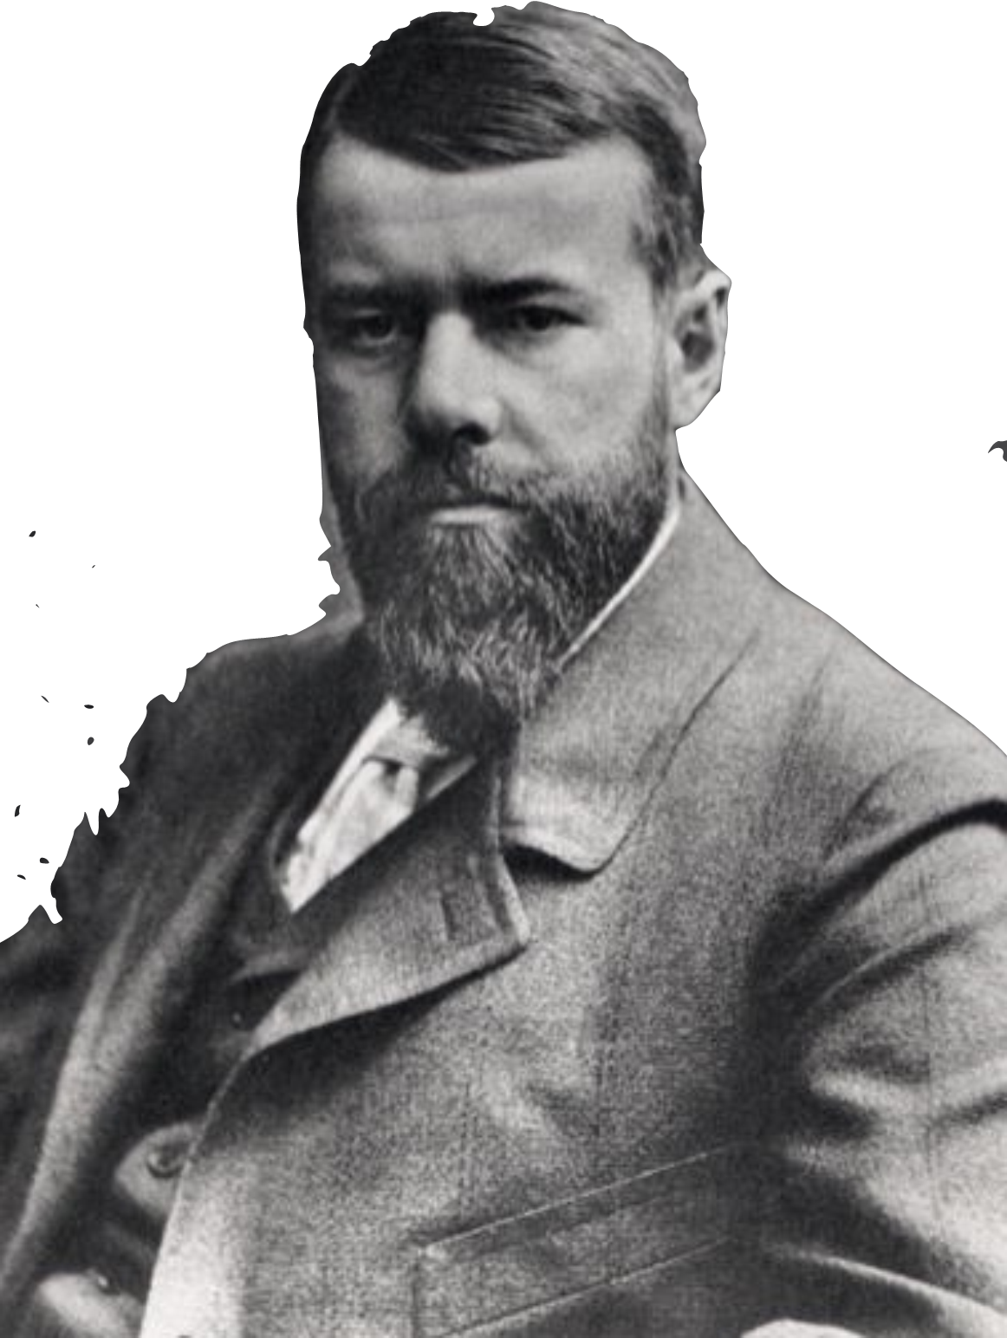
Write like Max Weber!
Academic Writing Workshop
GERM281 The German Idea of War
April 30, 2021

Slide 2
Learning Objectives
After todays‘s session, we will be able to …
… understand function and basic architecture of paragraphs in academic writing.
... provide constructive feedback on their peers’ drafts.
... integrate constructive feedback into their writing.

Slide 3

Writing Workshop: Paragraphs
Choose one paragraph from your final paper draft that might need some work.
In Groups of 2-3 students, screen-share your paragraph. Read it out loud. Then your peers will give feedback.
Give feedback according to the four leading question on the slide shared via google docs.

Slide 4
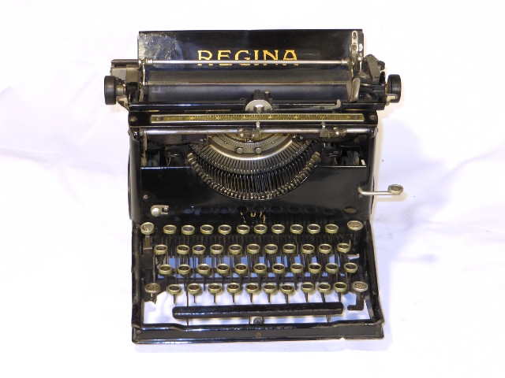
Writing Workshop: Paragraphs
Some considerations regarding effective feedback:
Writing is much more collaborative than we often assume. Giving and receiving feedback can help us understand our own writing better and look at our texts both as writers and readers.
Respond with care. You’re reviewing a paragraph your peer spent a lot of time on. Thoughtful feedback is constructive, descriptive, positive, and supportive.

Slide 5
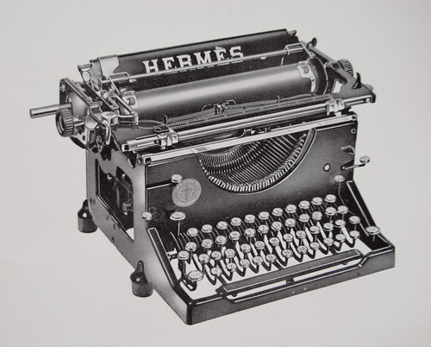
Writing Workshop: Paragraphs
Does the paragraph start with a topic sentence?
Does the paragraph stay on track to discuss the topic sentence? Are there sentences that move away from this focus?
Does the paragraph provide evidence for its claims? Are quotations used effectively, i.e. do they contribute to the paragraph’s topic?
Does the paragraph end convincingly? Does it build a bridge to the next one?

Slide 6
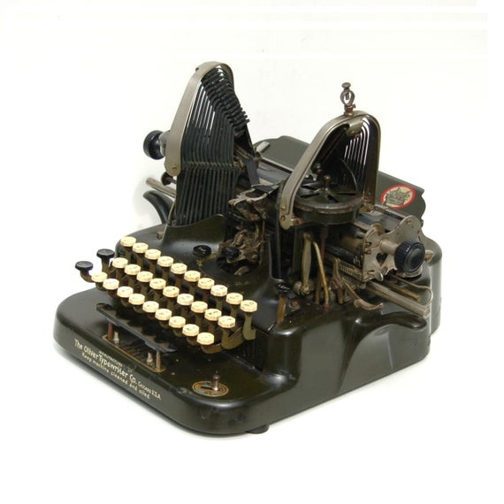
Writing Workshop: Paragraphs
What to do after you received feedback?
Consider which comments were most helpful and edit your paragraph accordingly.
Go through your essay and repeat this workflow for each paragraph. Be your own reader, or share your work with a friend.
When revising your essay, always consider whether every paragraph adds to the understanding of your main thesis statement.

